Slide 1
Personal, social and learning to learn competence
Key competences for people 50+

Slide 2
Tell me and I will forget;
Show me and I may remember;
Involve me and I will understand.
Chinese proverb

Slide 3
Ice breaking : Le nom indien

Slide 4
Module 1
Introduction to communication
Definition
Left brainand right brain
Difference between verbal and non verbal communication
The verbal communication
The barriers to communication
Tools for a good communication
Assertivity
Empathy
Clarity
Active listening
Reformulation and Feedback
Non verbal communication
NLP
Transactional Analysis
The 5 drivers

Slide 5
Introduction: The Post-it round.
What do you think communication is?

Slide 6
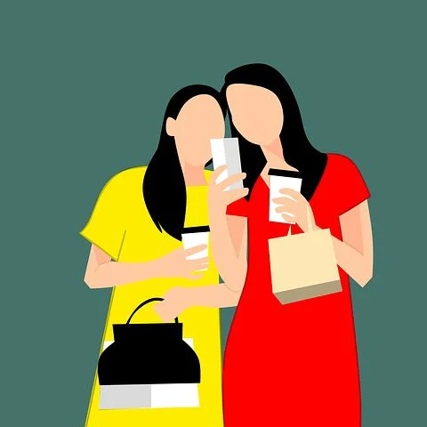
Did you know?
In an exchange 75% of communication is non-verbal, 25% verbal of which 19% oral and 6% written .
We remember :
10 % of what we read,
20 % of what we hear,
30 % of what we see,
50 % of what we hera and see,
80 % of what we say,
90 % of what we say when we do it.

Slide 7
Some definitions
In sociology and linguistics, communication is the set of phenomena that can occur when an individual transmits information to one or more other individuals using articulated language or other codes (tone of voice, gestures, gaze, breathing...)

Slide 8
The three types of communication
Three forms of communication can be distinguished:
Interpersonal communication that connects two individuals. ...
Group group communication which brings together several individuals. ...
Mass communication, which is a set of techniques that allow an actor to address a large audience.

Slide 9
The components of communication
The components of communication
Meaning: meaning of the message
Message: all the signals emitted consciously or unconsciously by the sender.
Strategy: implementation of actions, acts of communication
Actors: interlocutors who participate in the messages
Context: General framework in which the communication takes place
Channel: the medium through which the message is transmitted

Slide 10
Did you say: communicate?
« You can't not communicate … »
Palo Alto
But……

Slide 11
Did you say: communicate?
Between what I think,
What I want to say,
What I think I say,
What I say,

Slide 12
Did you say: communicate?
What you want to hear,
What you hear,
What you think you understand,
What you want to understand,
What you understand...

Slide 13
Did you say: communicate?
… There are at least ten ways to disagree.....
But let's try anyway!
Bernard Werber

Slide 14
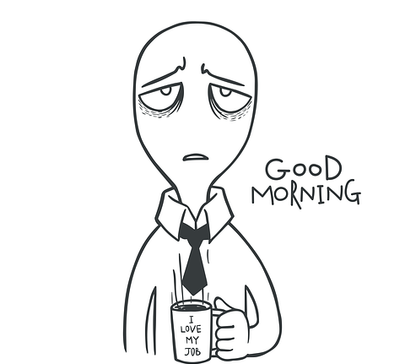
It's your turn: draw me a ……..

Slide 15
Difference between verbal and non verbal communication?
Verbal communication is based on language (in all its forms).
On the contrary, non-verbal communication is
all the visible signals that a person emits,
consciously or not.

Slide 16
What is going on in our brain?
The human brain is made up of two hemispheres (left and right).
The reason for this dichotomy is that the two hemispheres play particular, though not always completely separate, roles (Sperry).

Slide 17
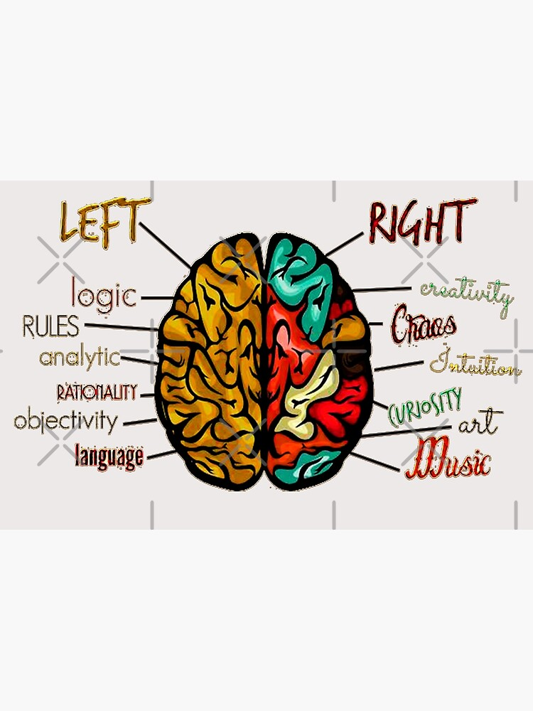
Left brain
The left hemisphere is very good at anything that requires rapid and sequential perception, manipulation of abstract concepts such as mathematics, precision or structuring operations. It retains verbal and sound information. It is described as audio-temporal.

Slide 18
Left brain
The left brain is marked by knowledge and control of the environment, which it seeks to evaluate and control.
logic
linear thinking
mathematics
facts
thinking through words
Notes:
Test

Slide 19
Right brain
The right hemisphere is very good at concrete things, visualising a picture or object, parallel operations, self-perception or an overview. It is called visuo-spatial.

Slide 20
Right brain
Right brain: is influenced by the innate, and reacts flexibly to its environment to which it seeks to adapt. It is the creative brain.
imagination
holistic thinking
intuition
the arts
rhythm
non-verbal cues
visualization of feelings
daydreaming

Slide 21
How does it work?
Aoccdrnig to a rscheearch at Cmabrigde Uinervtisy, it deosn’t mttaer in waht oredr the ltteers in a wrod are, the olny iprmoetnt tihng is taht the frist and lsat ltteer be at the rghit pclae. The rset can be a toatl mses and you can sitll raed it wouthit porbelm. Tihs is bcuseae the huamn mnid deos not raed ervey lteter by istlef, but the wrod as a wlohe..

Slide 22
Test yourself
Read this sentence
FINISHED FILES ARE THE RESULT OF YEARS OF SCIENTIFIC STUDY COMBINED WITH THE EXPERIENCE OF YEARS.
How many F can you count ?

Slide 23
Test yourself !
Grey black yellow green blue red
Orange brown green red black
Red violet blue black green yellow
Notes:
test

Slide 24
For proper functioning, we need our intuition, and the overall perception of our right brain, which will then be analysed and verified by our left brain.

Slide 25
VERBAL communication

Slide 26
THE BARRIERS TO communication

Slide 27
The barriers to communication
1) Giving orders, commanding
"You must...", "Do this...", "Stop doing that...".
This usually puts the other person in an attitude of either submission or rebellion. It is a test of strength that can create more resistance or even hostility, which will be expressed at the time or later.
2) Threatening
"If you continue...", "You'd better... or else...", "If you persist in... this is what will happen...".
It is also a power struggle that is set up this way. The aim is to instil fear and submission.

Slide 28
The barriers to communication
3) Lecturing, guilt-tripping
You should...", "You shouldn't...", "You should have...", "It's your fault if...".
This communication seeks to activate awareness through a sense of guilt. This can lead to a loss of confidence and withdrawal, or a desire to justify oneself, to defend oneself or to blame others.
4) Giving solutions, advice
"What I would do in your place is...", "I advise you to...", "Do this instead...".
Sends the message that the other person may not be able to solve their own problems. May prevent them from thinking for themselves and becoming autonomous.

Slide 29
The barriers to communication
5) Try to convince, persuade
"Yes, but...", "The facts prove that...", "That's why you're wrong..."
Not suitable if emotions are high. Usually leads to a battle of arguments about who is right or wrong, who is more intelligent.
6) Judgmental, critical
"You are this... or that...", "You lack maturity", "You should have more common sense".
The other person may identify with the judgement, feel foolish or incompetent and close down. This may also lead to counter-attack ("What about you? Aren't you this... or that...?").

Slide 30
The barriers to communication
7) Praise, flattery
"You are absolutely right", "You are doing a very good job", "I agree".
Can be perceived as paternalism or manipulation if there is doubt about sincerity. Can create an anxiety-provoking expectation if the other person does not feel they are living up to the compliments.
8) Humiliating, ridiculing
"Yes, my boy, that's it, keep talking", "Never heard a stupider excuse", "And to think that some people are paid to do this kind of nonsense..."
Attacks self-esteem and creates feelings of rejection and misunderstanding. May cause aggressive reaction.

Slide 31
The barriers to communication
9) Ask questions, investigate
Why do you want to do this? With whom? Since when? How did it happen? How long? Where exactly?
In a helping or listening relationship, we often ask too many questions because it reassures us and gives us the impression of having control over the situation. Sometimes it is also to speed up the process.
But questions can be intrusive or only serve the curiosity of the questioner. They can also significantly influence the interlocutor's expression and make him or her say what we want to hear... leading to a possible search for solutions along false lines.

Slide 32
The barriers to communication
10) Deflecting, evading or using inappropriate humour
"Let's talk about something else...", "Of course, if you were the big boss this wouldn't have happened...", "By the way, you know about..."
Often, out of embarrassment or awkwardness, we try to avoid certain discussions or problems that we don't want to deal with. So we change the conversation, try a little joke to lighten the mood or adopt a sarcastic tone.
This can be experienced as an invitation not to address problems, not to confide in each other, and can lead to a loss of trust in the relationship. The other message is that the other person's problems are not important, not important at all, because they are brushed aside.

Slide 33
What are the five qualities of good verbal communication?
These are the 6 qualities of powerful communication:
Assertiveness.
Open-mindedness.
Empathy.
Clarity.
Listening.
Reformulation and feedback.

Slide 34
assertivitY

Slide 35
Express
Inform
Communicate
Convince
Getting your point of view accepted
Arguing

Slide 36
The assertivity
Déefinition : the term "assertiveness" appeared in the first half of the 20th century.
The American psychologist, Andrew Salter, introduced it and gave the following definition: "the ability to express oneself and defend one's rights without infringing on those of others".
This notion then spread until it became the subject of books dedicated to its promotion during the second half of the 20th century.
Assertiveness is seen as the art of getting a difficult message across without passivity but also without aggression.

Slide 37
Don't let them walk all over you.
Be true to yourself, don't hide your feelings;
Seek realistic compromises in case of disagreement, negotiate on the basis of mutual interest rather than threat.
Develop relationships with others based on trust rather than dominance and calculation.
Be assertive
Controlling the environment.
Be comfortable in face-to-face situations.

Slide 38
AssertivityTest

Slide 39
Open-mindedness
What is open-mindedness?
Open-mindedness, according to dictionary definitions, is the attitude of a person who "shows great tolerance, interest, curiosity and understanding for ideas that differ in part or in whole from his or her own.
It means being willing to :
Listen to different people,
accept and respect their ideas and views, even if they are different from our own.
respect the freedom of others, their different attitudes by showing kindness.
not to be "locked in" to certainties: to question oneself in the face of new encounters and ideas.
examine these new ideas with curiosity and interest, and if we find them relevant, make them part of our lives.

Slide 40
What does open-mindedness bring to life?
he negative effects of a lack of openness can be seen first of all:
little conciliation ;
fear of change ;
fear of the unknown ;
Fear of the other and his ideas;
entrenched certainties about everything;
intolerance of new attitudes and ideas, etc.
The list goes on and on, and it shows how open-mindedness is an essential quality to develop!
Indeed, it promotes creativity and allows us to interact with others in a more beneficial way.

Slide 41
What does open-mindedness bring to life?
By being more receptive to others and new environments, one can more easily step out of one's daily routine, and accept change.
Open-minded people are more humble, able to acknowledge that they do not know. In addition, they are intellectually enriched by exploring the world and others. This allows them to be imaginative and creative.
Benevolence is also one of the qualities that arise from this: being open-minded makes one capable of compassion, listening to others, generosity and solidarity.
All this leads naturally to great opportunities, whether human, professional or personal! Open-minded people find solutions to their problems more easily, through their openness to the world and their positivity.
Albert Einstein said: "The measure of intelligence is the ability to change.

Slide 42
Keeping a free... and critical conscience
Be careful, however: being open-minded does not mean taking in everything in any way and by anyone.
Keep a critical mind and step back from ideas, people and things, but do so with goodwill.
Always have doubts, so that you don't rush into any new idea that seems very exciting at first.

Slide 43
empathY

Slide 44
Empathy.
https://www.youtube.com/watch?v=1Evwgu369Jw
Empathy is the recognition and understanding of another person's feelings and emotions.
In a more general sense, it is the recognition of one's non-emotional states, such as one's own beliefs.
In common parlance, the phenomenon of empathy is often illustrated by the expression "putting oneself in the place of the other".
This understanding occurs through a decentration of the person and can lead to actions related to the survival of the empathised subject, independently and sometimes even to the detriment of the interests of the empathising subject.
.

Slide 45
Empathy
Empathy is the recognition and understanding
feelings and emotions of another individual.
In a more general sense, it is the recognition of one's non-emotional states, such as one's own beliefs.
In everyday language, the phenomenon of empathy is often illustrated by the expression "putting oneself in the place of the other".

Slide 46
EMPATHY consists of :
To succeed in immersing oneself in the subjective universe of the interlocutor.
Understand the meaning of the speaker's words in the context of his or her own sensitivity and reactions.
Remaining emotionally independent while focusing on the meaning of what the speaker expects and wants to say.

Slide 47
Clarity
Synonym: transparency, clarity.
Definition :
That which makes things visible, perceptible to the eye; electromagnetic radiation capable of impressing the eye.
character of what is intelligible.
What is well understood is clearly stated and the words to say it come easily (Jean Boileau 17th century)

Slide 48
Active LISTEING
A knowledge of how to be and how to do.

Slide 49
What "active listening" is not
A conversation
A discussion
An interview
An interrogation
A speech
A confession
A diagnosis
49
Notes:
49

Slide 50
The speaker's attitude
The attitude of the listener
Openness and availability without prejudice
"Non-judgmental »
« Non-directiveness »
Genuine intention to understand the other in his or her way of thinking, expressing himself or herself, discovering his or her subjective world.
Effort to analyse what is said and what happens during the exchange.
50

Slide 51
Barriers to listening
Giving orders, directing, commanding,
Warn, warn, threaten,
Moralising, preaching, lecturing,
Advise, give suggestions or solutions
Explain, argue, persuade through logic,
Judging, criticizing, disagreeing, blaming
Compliment, agree, evaluate positively, approve
Calling names, ridiculing, shaming
Sympathise, console, support
Dodge, distract, humor
51
Notes:
51

Slide 52
More barriers...
Cutting off speech
Dedramatise, trivialise: "don't say that, but no..."
The expressions:
"yes, but..." = opposition
"he or she looks... = prejudice
"you shouldn't have... = judgment
"let's start by talking about... = directionality
"I think you ... = subjectivity
Preparing a response while the other is talking
Signs of impatience

Slide 53
reformulation

Slide 54
A definition ?
« It is an intervention by the negotiator that consists of repeating in other words and in a more concise or explicit manner, what a person has just expressed...»
54
Notes:
54

Slide 55
The aims of reformulation
Communicates to the subject what the receiver has understood or is trying to understand
It clarifies the meaning of the subject's words by reflecting back to him/her what he/she is saying in a different way and offers the possibility to continue or deepen the discussion
It allows the sender and receiver to avoid misunderstandings by allowing them to confront their perceptions
55
Notes:
55

Slide 56
Silence
Silence allows the subject to feel that he has time to express himself...
By respecting this silence, the negotiator indicates that he is not in a hurry to conclude, that his rhythm is that of the subject...
56

Slide 57
non verbal communication

Slide 58
What is the role of non-verbal communication?
Non-verbal behaviours serve as regulators of the interaction between sender and receiver; they are often essential elements of the feedback needed for effective communication.

Slide 59
Types of non-verbal communication
Facial expressions. The human face is particularly expressive. ...
Movements and posture. ...
Gestures. ...
Physical contact. ...
Proxemia. ...
Voice. ...
Appearance.

Slide 60
Some tools to better understand non-verbal communication
NLP
Transactionnal Analysis

Slide 61
Neuro-linguistique
Programmation

Slide 62
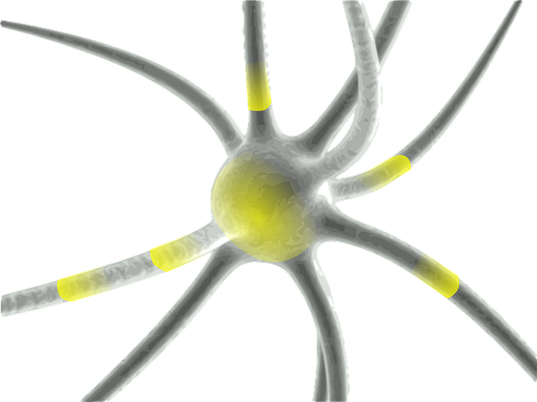
Neuro
Because this capacity to learn, to set up ways of thinking, feeling and acting is based on the functioning of our nervous system. It is indeed the nervous system that, thanks to our five senses, perceives the environment, the world in which we live, and interprets, codes and transmits messages of all kinds. NLP techniques act directly on this neurological organisation.

Slide 63
Linguistique
M1
Because it is language that structures and reflects the way we think.
It is the vehicle for our experiences, our perceptions and our representations of the world.

Slide 64
Programmation
Because since our earliest childhood, we program ourselves, we learn things, ways of thinking, feeling, sensing and behaving. So, since the material is the same (brain and nervous system), what one person is able to do, another is potentially able to do.

Slide 65
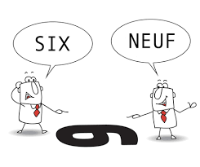
" The map is not the territory it represents ". This is probably the best way to express the fact that each of us constructs a subjective representation of reality and that we live and 'function' in response to this representation.

Slide 66
The perception of reality

Slide 67
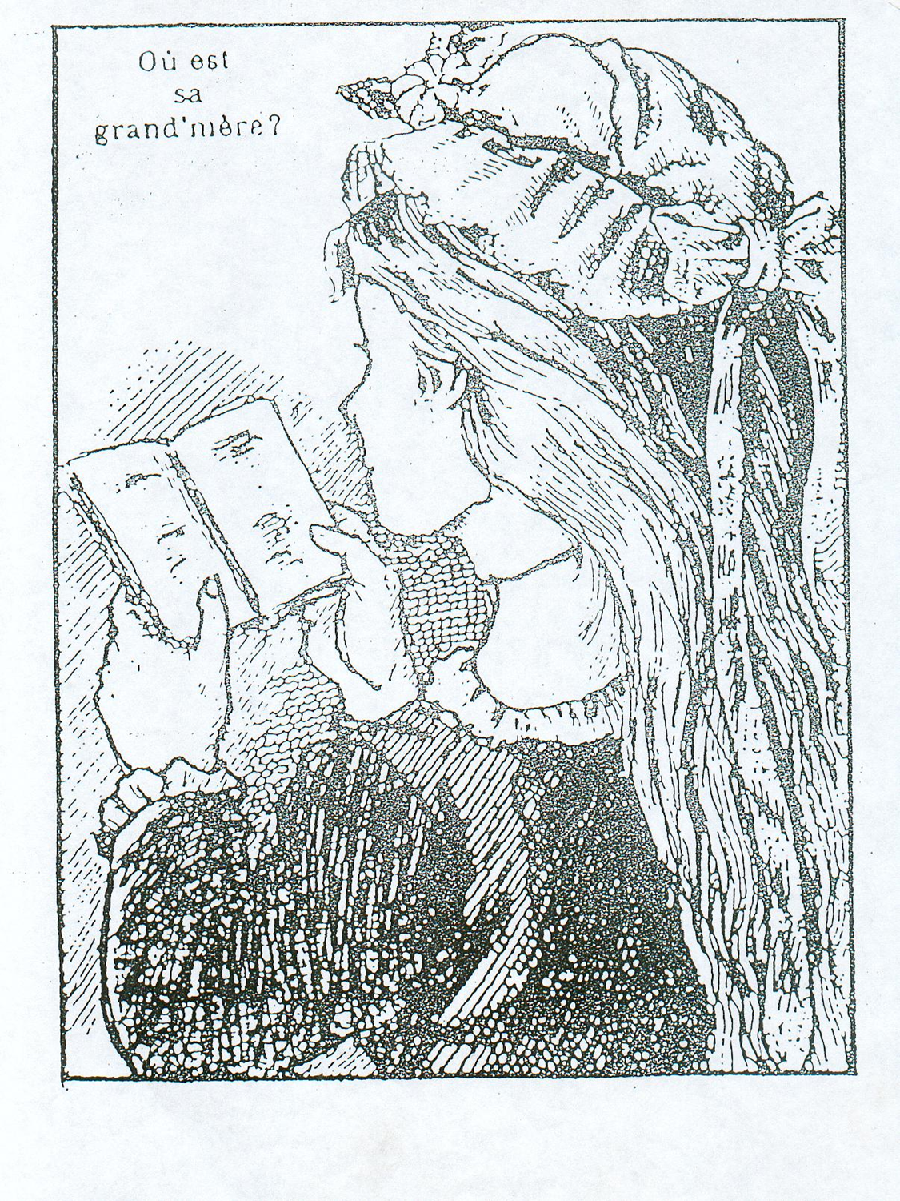
The perception of reality
How is this image represented?
Look for the old woman
Look for the young woman

Slide 68
The perception of reality
This exercise shows that we do not all see the same thing objectively.
We can therefore deduce that it can be difficult to communicate with a person who does not, in good faith, see the same thing as we do.
We can then try to explain the reason(s) for this discrepancy: culture, education, personality, age, work group, leisure group, experience, social class...
In fact, everything that constitutes our reference system.

Slide 69
What to choose first?
The form or the
the substance?

Slide 70
And here, what do you see?

Slide 71
It's all about perspective

Slide 73
The perception of reality
Reality passes through many filters and we are never objective because we only have representations of reality.
What is it that makes us not see objects in an objective way? Not in the same way as others?
Already at all levels, both auditory and visual, we have only a partial knowledge of reality (we only see certain wavelengths, we only hear certain sounds...).

Slide 74
M1
Conclusion: Communication is improved by learning to
Observe,
Taking into account others (acceptance of others),
And by adopting an attitude of control towards one's own perceptions and interpretations.

Slide 75
Beliefs
There are two types of beliefs:
A = B, equality beliefs
and
A => B, limiting beliefs

Slide 76
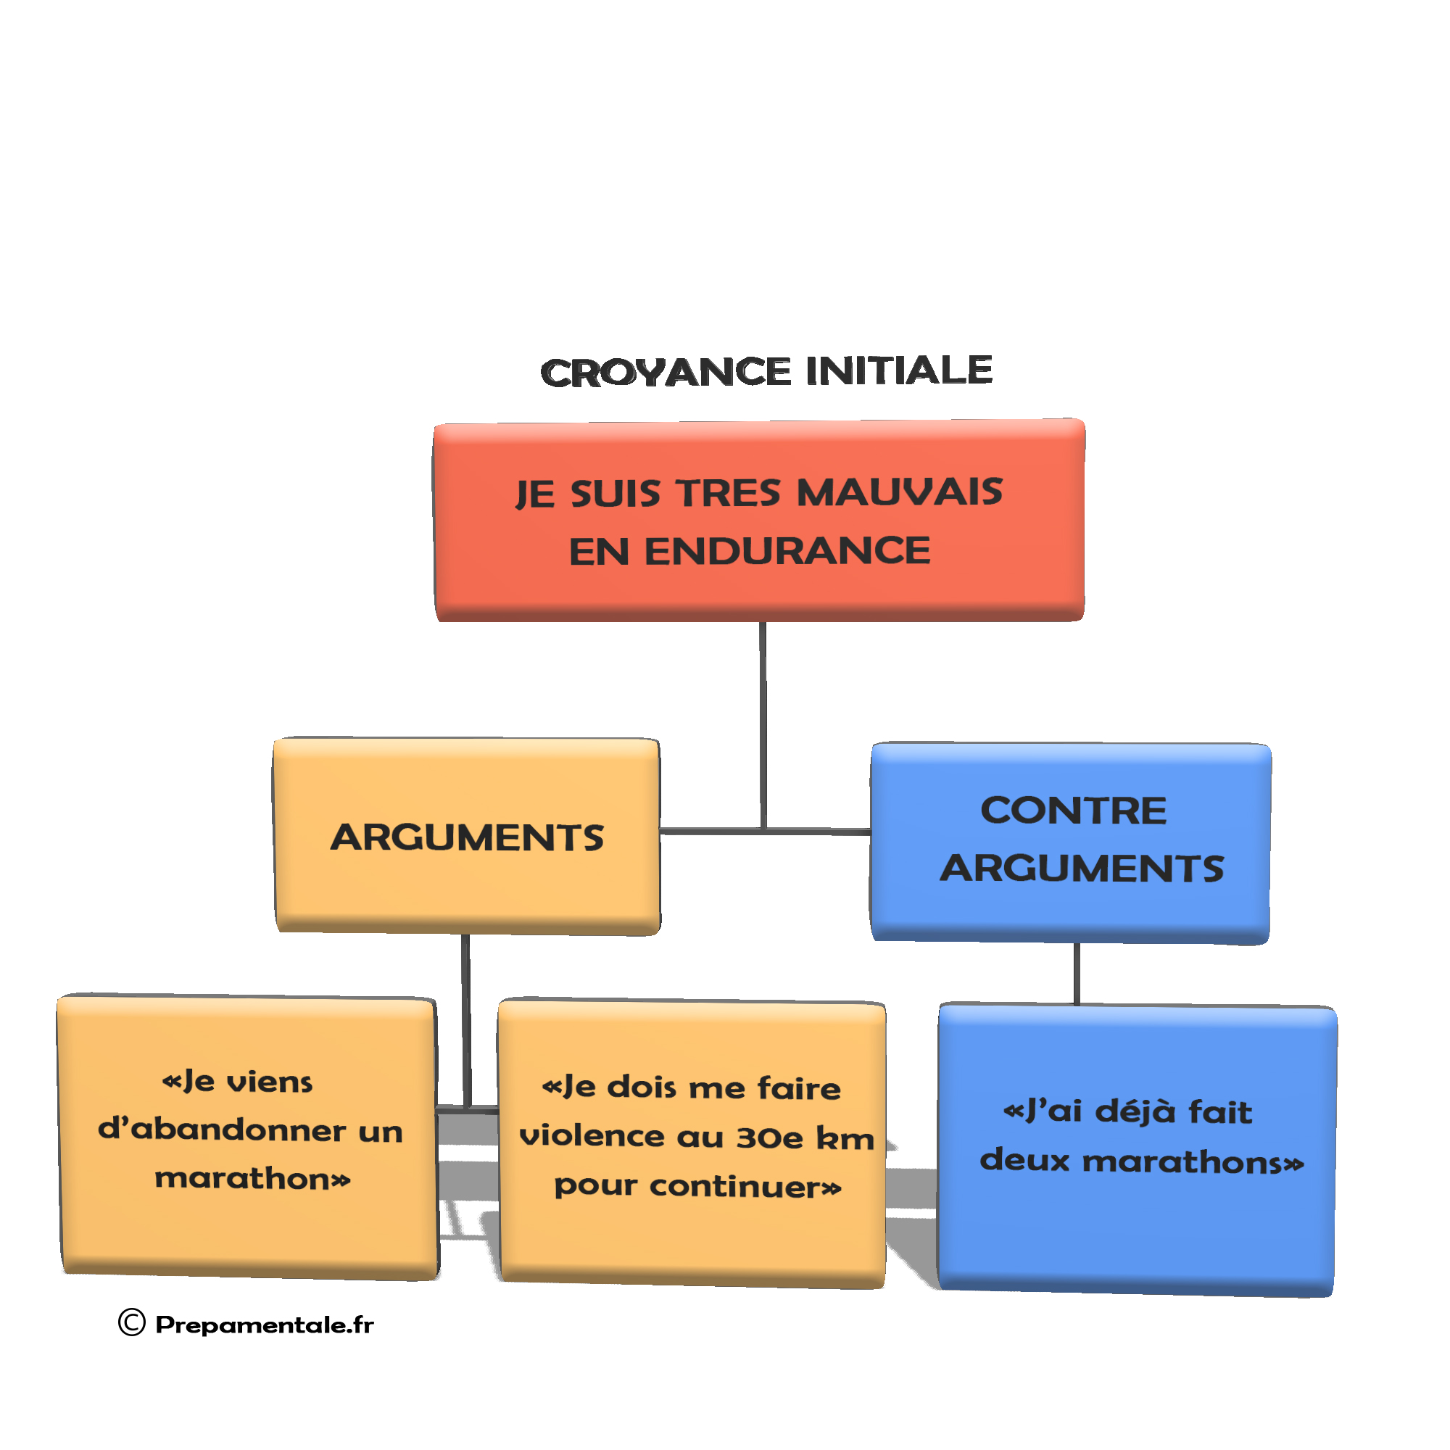
Limiting beliefs
What is a limiting belief?
Most of the difficulties we encounter in communication, or in situations, and which create stress for us, come from negative beliefs, of which we are aware or mostly unaware, about ourselves, about others, about life in general.
We tend to take for granted what we believe to be true, to the point that we don't think about it anymore. We identify with our beliefs and decode the world around us through those long-forgotten glasses on our nose.

Slide 77
Limiting beliefs
They seem natural, universal, or shared by 'common sense' people - in short, they are 'true'.
However, in order to better manage our stress, we need to consider our beliefs as hypotheses that we can change when the results they produce do not suit us.
By acting on our belief system, we can change our perception of stressful situations.

Slide 78
Limiting beliefs
Some limiting beliefs:
I'm no good, I'm worthless!
I'm not good at languages, maths!
I'm not going to make it, I'm not up to it!
I am not worthy of love!
Others are so much better than me!
If I say "no" I will hurt his feelings!
You have to work hard and relentlessly!
Pleasing yourself is selfishness
!

Slide 79
What are your conscious limiting beliefs that fuel your stress?………………………………………………………………………………………………………………………………………………………………………………………………………………………………………………………………………………………………………………………………………………………………………………………………………………………………………………………………………………………………………………………………………………………………………………………………………………………………………………………………………………………........

Slide 80
Transactionnal Analysis
Created at the initiative of Eric Berne (1910-1970), an American psychiatrist.
In the 1950s, Berne, inspired by Freud, distanced himself from psychoanalysis.
It seeks to create a therapeutic tool that is effective and rapid, therefore less expensive and accessible to all.

Slide 81
Transactionnal Analysis
T.A. offers a framework for understanding relational problems and intervention methods for resolving them.
It is based on an inescapable premise: "each person is "fundamentally correct", has value, importance and dignity, and has the capacity to think and choose.

Slide 82
The ego states
The ego states provide information about the type of relationship we have with others ...or with ourselves (inner dialogue).
Cela signifie que, tout au long de sa vie, une personne :
Observe how his parents (or grandparents, guardians, then a spiritual figure or a great professional) behave, what they say, what they transmit of their emotions when faced with different situations in life. These observations will serve as models later on. Imagine that it is a "look" at the Other,
Experiences, grasps everyday reality and records its conclusions. Here, the "gaze" is aimed at the front and around oneself.
To one's own feelings, emotions and needs, which are evolving by nature and which it will try to satisfy with more or less success: "the gaze" is then turned towards oneself.

Slide 83
The ego states
Parent (P): which retains all thoughts + feelings + behaviours of parental models and integrated as they are,
Adult (A): which retains all thoughts + feelings + behaviours related to the "touch" of reality, to the here and now,
Child (C): which retains the set of thoughts + feelings + behaviours as the person experienced them in childhood.

Slide 84
The ego states
Thus, at each moment we approach reality with three possibilities:
Placing models on it ("being in the Parent"),
Replicating personal experiences from the past ("being in the Child"),
Or taking reality as it is - not as we would like it to be - with what we are and not what we were or what we would like to be ("being in the Adult").

Slide 85
The ego states
Strict adherence to the official organisation chart,
Management principles,
Work organisation
Strong values (e.g. family values)
Career opportunities
Fulfilment
Standards
Recognition on merit …
« Parent »

Slide 86
The ego states
Objective and rational approaches
Pragmatic cooperation focused on efficiency
Authenticity of communication
Effective confrontation
Projects
Dialogue
Analysis
Delegation...
« Adult »

Slide 87
The ego states
Informal organisation
Human relations focus
Motivation
Obedience, adaptation
Creativity, cunning, resourcefulness
Manipulation
Joys, sorrows, enthusiasms, disappointments, resentments...
« Child »

Slide 88
The ego states
There are no "good" or "bad" ego states, they all have a different essential and complementary function. These are the functions of each:
Normative Parent: function of protection and transmission of values
Nurturing Parent: function of permission and encouragement
Adult: function of exploring the environment
Rebellious Adapted Child: legitimate opposition function
Adapted Submissive Child: function of adaptation to the environment
Free Child: function of expressing basic needs and emotions

Slide 89
The ego states
On the other hand, the excessive use of an ego-state, without necessity in relation to the situation, leads to making the use of its function inoperative:
if a person regularly speaks sharply to a child, the child will no longer be able to distinguish between a warning in the face of proven danger and a trivial situation
if someone systematically does what he is told, he will no longer be able to distinguish between adequate adaptation and what is called over-adaptation, i.e. adaptation to the detriment of his own needs,
or if a colleague interrupts a meeting every two minutes because he is thirsty, it is likely that after a while he will no longer have a say.

Slide 90
Examples
Normative Parent: a child wants to cross the road when a car is coming, a passer-by says sharply: "Back off!
Nurturing Parent: to a colleague who has just been given a new and difficult assignment: "You'll do fine, the boss is right, you're our best resource for this project!
Adult: at a car dealership: "How much is that car?" in a neutral tone,
Rebellious Adapted Child: someone speaks to me in a tone of voice that I don't accept, I tell them forcefully: "Please speak to me in a different tone of voice",
Adapted Child Submissive: for no apparent reason, a policeman stops me and asks me for my papers; without asking questions I give them to him,
Free Child: in the middle of a work meeting, a colleague suggests a break because he is thirsty: "Come on, let's have a coffee break!" in a cordial and dynamic tone.

Slide 91
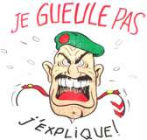
Ego states
EGO STATE: The indication of the invested Ego State is usually indicated by the non-verbal...
PARENT CRITIQUE
OU NORMATIF

Slide 92
Exercise
Here are some sentences, can you guess what functional ego state the person was in when they said them?
"You can always run! I'll never do it!", said defiantly and energetically, in a tone of rebellion
"Can you help me write this part?", in an informal tone
"Oh, that's so pretty! I want the same one!" said in a happy and enthusiastic voice, with a smile on her face
"This is unacceptable! Don't you dare do that!", her face red with anger, her tone high and her volume high
"What I'm telling you now is for your own good", in a friendly and comforting tone with a soft voice
"Classes start at 3pm. They end at 6pm", in a neutral tone
"Respect is the rule here, you're out", in a firm tone, pointing to the exit
"Are you sure I can? I'm not sure, I'd rather not", in a fearful tone, with a worried face

Slide 93
The Parent state
The parent ego state has four subdivisions:
The foster or giving parent
The normative parent
The persecuting parent
The saviour parent
Persecutor
-
Saviour
-
Normative
+
Donation
+

Slide 94
The Parent state
 | Attitudes, faces, gestures tone of voice | Formulations, typical expressions
Normative parent + | Firm, gestures supporting speech, determined face, negotiated authority, gives rules, serious face, arms crossed, reward... | "You must, you must, because .... "That's good, go on, right,...", "No, that's not possible, that's a mistake,...", "Is that clear, don't forget the instructions, keep to the time limit...".
Persecuting parent - | Critical, threatening voice, angry, frowning, punishing, can go as far as physical abuse, scathing voice, harsh, severe, intolerant, very directive, breaking, ironic, dismissive... | You should be ashamed", "That's enough", "I'm not surprised at you", insults, mimics, gestures, devaluing sighs, "I forbid you, get lost"...
Foster parent + | Affectionate, tender gestures, protective shoulder, warm, reassuring, welcoming, understanding face, soft and harmonious voice, conciliatory, tolerant, relaxed face... | "Can I help you?", "How are you? don't worry", "very strong, you are in good shape"...
Rescue parent - | Hyperemotional, concerned, sentimental, charming voice, stifling gestures and attitudes,... | "Don't worry, I'll take care of it", "It's not your fault",...

Slide 95
The Adult state
The adult ego state has no subdivisions.
He is interested in facts, news, objective analysis and expresses himself in a calm manner: "he says things".
In verbal communication, his voice is calm, steady, and his gaze is frank.
In non-verbal communication, he stands up straight, at a suitable distance, (so-called social), he is relaxed.
The ego states

Slide 96
The Child state
This ego state is creative, it is in the emotion. The child has 4 subdivisions:
the submissive child.
The rebellious child
The adapted child
The free child
Adapted
+
Free
+
Submitted
-
Rebel
-
The ego states

Slide 97
The Child state
 | Attitudes, faces, gestures tone of voice | Formulations, typical expressions
Adapted child + | Kind to others, calm, avoids conflict, even tone of voice, polite, discreet, listens, orderly, obedient, very social, smiling, respectful, does not take initiative, waits to be asked questions,. | "yes, no thank you ...." "hello, good evening,...", "please,...", "may I.....?", "if you like, when you like",...
Submissive child - | Insignificant, low voice, shy eyes, avoids contact, shy, reserved, blushes easily, silent, does not answer questions, does not take initiative | "yes", silence
Free child + | Natural attitudes, frank, direct, spontaneous, enthusiastic, curious, intuitive, expressive face, creativity, desire, imagination,... | Explosion of joy, fear, sadness, anger, "I want, I don't want, I want,...", chic, shit, again, "I love, I hate,...".
Rebellious child - | Gesticulating, shouting, defending, provoking, any form of opposition, sulking, fooling around, forgetting, ironic, conflict-seeking, identity-seeking,... | "I'm fed up, I'm fed up,...", "no", "cause toujours", "tous pourris",...

Slide 98
Online Enneagram Tests
https://www.eclecticenergies.com/francais/enneagramme/dotest

Slide 99
Transactional analysis: Transactions
A back and forth (stimulus and response) between two ego states.
A transaction in TA is the unit of exchange (verbal or non-verbal) of communication, between two or more natural or legal persons

Slide 100
Transactional analysis: Transactions
A transaction is a unit of exchange between two or more natural or legal persons

Slide 101
Parallel transactions
Parallel transactions are potentially the most effective communication in most cases in business,
Other types of transactions can be more or less trapped...and a source of communication difficulties

Slide 102
Transactional analysis: Examples of parallel (complementary) transactions
P
P
Communication,
the relationship
proposed
is accepted
A
A
E
E
During a parallel transaction, the outward and return journey is done by the same channel, the same way. There is no intervention of other ego states in the return (the response).

Slide 103
Transactional analysis: Examples of parallel (complementary) transactions
P
P
8000 euros
A
A
What is the budget?
E
E

Slide 104
Transactional analysis: Examples of parallel (complementary) transactions
Nowadays, children are poorly educated
It wasn't like that in our time
P
P
A
A
E
E

Slide 105
Cross-transaction
Cross-transaction: another ego state (MS) than the one targeted by the first interlocutor intervenes.
This interfering MS affects a MS other than the one from which the transaction originated.

Slide 106
Transactional analysis: Example of a cross transaction
P
P
You are still waiting
the last moment!
I will work on the file
this weekend
A
A
E
E
Voltage

Slide 107
Transactional analysis: Example of a cross transaction
P
P
Unexpected response!
Where were you this morning?
I've been looking for you...
A
A
E
E
Are you from the police?
I do what I want!
Voltage

Slide 108
Transactional analysis: Examples of hidden (trapped) double transactions
One transaction can hide another....
P
P
You come to see my
Japanese prints?
Apparent message
A
A
E
E
Actual message
I want to have a good time
moment with you...
Implied

Slide 109
Transactional analysis: Examples of common transactions
Domination
Current representation:
...of the managerial model
...of the authority
...of the helping relationship
...of the negotiator
...of the seller
P
P
A
A
E
E
Submission
Dependency/Counter dependency relationship

Slide 110
Module 2: learn to learn
The different learning styles
The four learning styles (Kolb's typology)
What is your learning style test
How to memorise?
The VAKOG
Critical thinking :
Definition
The 5 critical thinking skills
How to improve critical thinking?
How to use the information?
Where to find the information?
How to summarise information
How to report information
Developing motivation
The theory of expectations (Victor Wroom)
The needs pyramid
How to find your deepest motivation

Slide 111
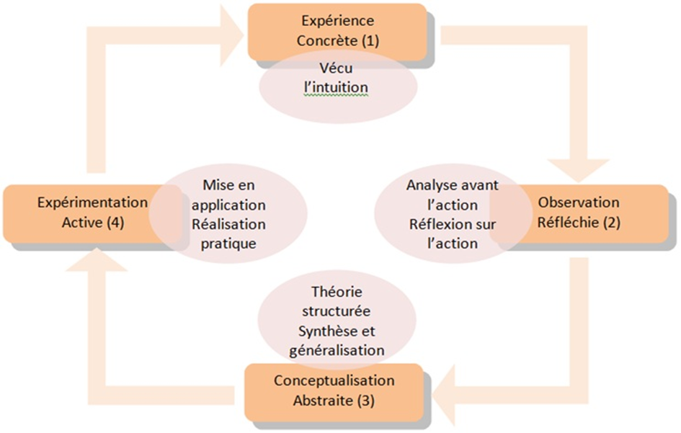
The 4 learning styles
Learning style identified from four styles resulting from the combination of two bipolar dimensions: concrete-abstract, action-reflection:
Convergent style (abstract-action)
Divergent style (concrete-reflective)
Assimilative style (abstract-reflective)
Accommodating style (concrete-action)

Slide 112
David Kolb studied learning and noted that everyone who is in a learning situation goes through a cycle of four phases.
And, he also observed that each person generally prefers two phases of this cycle.
The cycle of learning phases.
1. Concrete experience of an action/idea (I am painting a kitchen wall).
2. Thoughtful and careful observation. (How does it look? Do I like it?)
3. Abstract and theoretical conceptualisation (Could I have used a better #method - a brush instead of a roller?)
4. Implementation of the idea/action based on the initial experience. (I try a different method).

Slide 113
Kolb has named the different types of learners according to their preferred phase of the learning cycle.
The divergent Prefers the phases (1) concrete experience and (2) reflection on that experience. Divergers are imaginative and interested in people and emotions.
The assimilator Prefers phases (2) reflection on an experience and (3) abstract and theoretical conceptualisation of an experience. Assimilators like to create theoretical models and are less interested in people and practical applications of knowledge than others.
The converger Prefers the (3) abstract, theoretical conceptualisation of experience and (4) application of the idea/action phases. Convergers like to be practical and tend to be unemotional. In addition, they prefer to deal with things rather than people.
The accommodator He prefers the phases (1) concrete experience and (4) implementation of the idea/action based on this experience. Accommodators adapt easily to new experiences and tend to find solutions to problems based on their intuition.

Slide 114
A tool for better memorization: the VAKOG

Slide 115
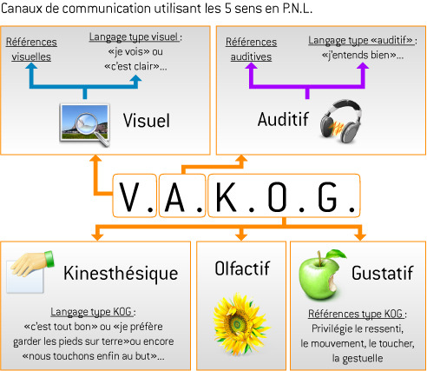

Slide 116
Information input
Filter 1
Filter 2
Visual
Auditory
Kinesthetic
Olfactory
Taste
Filter 3
Input
for more information:
words or
behaviours
People
Activity
Location
Object
Accuracy
Small
Accuracy
Lateral
Size of
cutting
Sorting
information.
The 5 senses
Information input: the three filters

Slide 117
Filter 1 The five senses/VAKOG
A Visual will use expressions like: It's clear, panoramic effect, dark day, it's dark to me, it's bright, I see what you mean, etc.
An auditor will use the following expressions: I am not deaf to your call, it sounds hollow, you seem silent, but shut him up, you reason badly, etc.

Slide 118
Filter 1 The five senses/VAKOG
A Kinesthetic will use expressions related to verbs of movement: move, jump, etc. And will also refer to expressions: goosebumps, calm, affectionate, etc. And will also refer to expressions: I have goose bumps, calm, affectionate, etc.
An Olfactory will use words: It stinks, it smells good, etc.
A Gustative will say: I savour my victory, good taste, delicious, etc.

Slide 119
Eye movement
I remember an image
I imagine an image
I remember a sound
I imagine a sound
I think of a smell, a feeling, an emotion
I talk to myself

Slide 120
TEST
WHAT IS YOUR MEMORY PROFILE?

Slide 121
Critical thinking
Definition
The 5 critical thinking skills
How to improve critical thinking?

Slide 122
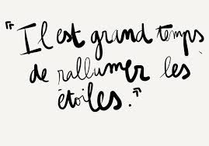
Critical thinking: definition
Critical thinking is a primarily rational activity, based on questioning and challenging prejudices and 'ready-made' opinions.
In sum, critical thinking is characterised by doubt, intellectual rigour, in-depth examination, reflection, etc., and it is also conceived as a process.

Slide 123
The 5 critical thinking skills
The key skills of critical thinking are: analysis, interpretation, inference, explanation, self-regulation, open-mindedness and problem solving.
Examples of critical thinking skills
Analytical thinking.
Good communication.
Creative thinking.
Open-mindedness.
Problem-solving skills.
Ask thoughtful questions.
Promote a teamwork approach to problem solving.
Self-assess your contributions to the company's objectives.

Slide 124
How to improve critical thinking?
How can you improve your critical thinking skills?
Knowing exactly what you want is the first step in critical thinking.
Manage your prejudices. ...
Consider the consequences of your options. ...
Do your research. ...
Accept that you are not always right. ...
Break it down. ...
Don't make things too complicated.

Slide 125
How to improve critical thinking?
How to develop critical thinking skills
Don't believe everything you are told. The first step in critical thinking is to consider more than one point of view. ...
Don't believe everything you think. ...
Ask questions. ...
Further research. ...
Evaluate your work.

Slide 126
Developing motivation
The theory of expectations (Victor Wroom)
The pyramid of needs (Maslow)
Recognition
How to find your deepest motivation

Slide 127
MASLOW's pyramid of needs
Membership
Security
Physiological
Self-realization
Esteem

Slide 128
MASLOW's pyramid of needs
Physiological needs: sleeping, feeding, drinking, dressing... In short: primary biological and physical needs
Security needs: elements of stability, protection
Needs to belong: integration into a group, social status
Esteem needs: to be recognised, to be loved, to be accepted by others
Self-fulfilment needs: self-realisation, self-fulfilment, personal development (e.g. through meditation)

Slide 129
TEST
What are your current needs?

Slide 130
Victor Vroom's V.I.E model

Slide 131
Explanations of the Vroom V.I.E model
a - The valence
Valence, in Vroom's theory, is the value we place on what we are going to achieve. If I embark on this project, is what I am going to get really valuable to me?
For example, we are managers and we give a new assignment to one of our employees. Motivation will be proportional to the value the employee places on the reward. We may note that this is very subjective. If we promise a bonus of 100 euros, an employee who finds it useful will be more motivated than an employee who does not need it. If the reward is career development, an employee who does not want to develop will not be motivated.

Slide 132
Explanations of the Vroom V.I.E model
b - Instrumentality
In Vroom's theory, the instrumentality is the probability that we can meet our expectations. If our employee has to achieve outstanding results to earn the 100 euro bonus, he or she may not believe it. If some people have already done this job and have not developed, what guarantee is there that they will really develop? So the employee will try to understand the probability that by doing this action he will get the desired reward.

Slide 133
Explanations of the Vroom V.I.E model
c - Expectation
Finally, in this theory of motivation, expectation corresponds to the ability to succeed based on one's own skills. Here, the employee will seek to understand whether he or she is really capable of carrying out the mission. If he does not feel capable, he will feel that he has little chance of succeeding. The game will not be worth the candle. On the other hand, the more capable they feel, the more likely they are to succeed in the mission.

Slide 134
Confidence and resilience

Slide 135
What is self-confidence?
Self-confidence allows us to have a realistic view of our abilities. Believing in our abilities allows us to better manage our emotions and achieve our goals. Self-confidence is beneficial for mental health, success, decision making and resilience.
The four main pillars...
Consistency. ...
Intention. ...
Relevance. ...
Results.

Slide 136
The main types of trust
Most typologies on trust are based on the framework defined by Zucker (1986). He distinguishes three forms of trust:
interpersonal trust,
inter-organisational trust
institutional trust.

Slide 137
Causes of a loss of self-confidence
Self-deprecation is the main cause of low self-confidence. ...
Having a negative mindset. ...
Being surrounded by negative people. ...
Position yourself as a victim. ...
Being a perfectionist about yourself. ...
Ignore and suppress negative emotions.

Slide 138
7 tips to help you trust yourself
1 - Do not feel guilty. ...
2 - Helping does not mean saving. Beware of the opposite effect. ...
3 - Helping to raise awareness of the problem. ...
4 - Reverse the roles. ...
5 - Seeing yourself with an outside eye. ...
6 - Dismantle the speeches. ...
7 - Offer support.

Slide 139
Resilience: definition
The ability of an individual to build and live satisfactorily despite traumatic circumstances. 3. The ability of an ecosystem, a biotope or a group of individuals (population, species) to recover after an external disturbance (fire, storm, clearing, etc.).

Slide 140
The origins of resilience
The word resilience comes from the Latin resilientia and has its origins in the metallurgy sector to mean the ability of a material to return to its original state after an impact or under continuous pressure.
In ecology, this is the ability of an ecosystem to return to normal functioning after a disturbance.
This concept was evoked in the 1940s by American psychologists and taken up in the 1990s by Boris Cyrulnik (French psychoanalyst and neuropsychiatrist). It is now part of everyday language thanks to his publication "Un merveilleux malheur" (Editions Odile Jacob).
Adapted to the social sciences, resilience is a psychological phenomenon which consists of an individual affected by a trauma, a difficult situation or an exacerbated emotion identifying this event in such a way as to not, or no longer, experience it in a negative way. Furthermore, it can be a question of so-called 'at-risk' individuals who manage to develop without psychological damage despite an unfavourable family and social context.
Boris Cyrulnik defines resilience as "a strategy of struggle against misfortune that allows one to derive pleasure from living, despite the whisper of ghosts in the depths of one's memory".

Slide 141
What are the benefits of resilience?
Stress reduction
Building self-confidence
Reduced risk of depression
Increased optimism
Development of serenity

Slide 142
Some things to cultivate: 10 keys to contribute to resilience
collect your emotions and explore the message they send
encourage mindfulness meditation to come back to the present moment and avoid anticipatory fear
try to let go
explore its resources
focus on your positive actions
overcome frustrations
demonstrate mental flexibility
use the narrative approach
believe in oneself
engage in therapeutic support

Slide 143
Life positions
The +/+ position: I respect myself and I respect you, I accept you as you are, I am aware of my value and yours: we are equal. This implies that I consider what you say to me, that I speak to you in an adult way, that I see our relationship in terms of cooperation and sharing.
The -/+ position: this is a position that results in a devaluation of oneself, the other(s) are much better than me, they do it better, they are happy, and I will never be happy...: it is a depressive position that can be summarised as follows: It is a depressive position that can be summarised as follows: "I am not worth much, anyone is worth more than me".

Slide 144
Life positions
The +/- position: here I think I am better than you/the others, this manifests itself in two different ways: either I look at the other person in a condescending way "You poor thing, you are not capable of doing it, let me do it", or I look at him/her in a haughty or even aggressive way "You're too bad, you're an incompetent, get out of the way so that I can do it", or "You're too bad, do as I tell you and no other way.
It is a position of devaluation or domination, of arrogance towards the other.
The -/- position: "I am worthless and so are you", may be the position adopted by a child whose parents have made it clear that he or she is not welcome, who has grown up in a difficult environment and who does not expect anything from anyone. They have a negative image of themselves and the world.

Slide 145
Life position
OK - +
OK + +
Self-deprecation ;
Over-valuing the other.
"Go on your own".
Victim" attitude.
I lose - you win
Fair valuation of self
and the other.
"Let's go together".
I win - you win
OK -
OK +
OK - -
OK + -
Over-valuing oneself ;
Devaluation of the other.
"Let it go".
Persecutor" or "Rescuer" attitude.
I win - you lose
Self-deprecation ;
Devaluation of the other.
"Let it go".
I lose - you lose

Slide 146
Transactional analysis Signs of recognition (stroke)
Exchanges, contacts that tell me that I exist in the eyes of someone else
Basic / survival need
Unit of measurement of human relations
Defines the relationship in intensity and tone

Slide 147
Transactional analysis Signs of recognition (stroke)
One of the keys to behaviour:
If I don't get (enough) positive strokes
I will look for negative strokes
Which are better than...nothing

Slide 148
Transactional analysis Managing signs of recognition
EASY DIFFICULT FOCUS
ASK
GIVE
RECEIVE
REFUSE

Slide 149
Knowing how to say "NO
This prevents us from saying no!
Let's look at children... they all go through the period of asserting their ego and the famous "no" period. Saying 'no' is a way of protecting themselves and asserting their mini-authority and personality.
It is then easy for them to say 'no'. And they don't justify themselves because they don't feel the need to. It is "no" and that is "all"!

Slide 150
Knowing how to say "NO
We are all afraid to be :
Being humiliated.
Being rejected.
Being ignored.
In addition, these three major fears can be associated with motors called "drivers" by psychologists. Five drivers have been defined: Be perfect, Be strong, Make an effort, Hurry up, Be happy.
Notes:
Testing the binding messages

Slide 151
TEST
What driver makes you say 'YES' too often when you want to say 'NO'?

Slide 152
Be perfect.
The Be perfect register invites the individual to always do better and to strive for perfection in order not to disappoint and to attract the benevolent attention of others to him.
Of course in this case the Perfect Beings always have time to do more as they are well organised!
How can I say no, then?

Slide 153
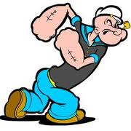
Be strong.
Be strong prevents the individual from having moods... a boy doesn't cry, for example. As we then forbid ourselves to have moods we also forbid ourselves to feel compulsion or displeasure in doing something... so we always say 'yes'.

Slide 154
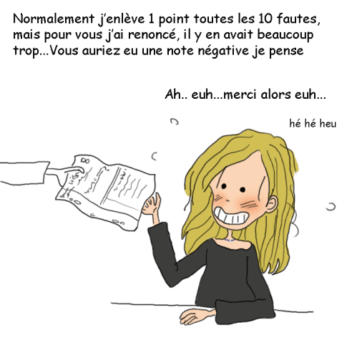
Make an effort.
The third register of Make an effort... speaks for itself.
Life is not allowed to be easy or simple! We don't give ourselves the right to succeed without a lot of work...
So making an effort by helping others and always saying YES fits well into this model.

Slide 155
Please do a favour.
The same goes for the Pleasure... naturally! In the register of please, one must first satisfy others before thinking of oneself. How can we say "no" when we are doing this?
The Pleaser is afraid of disappointing and then not existing as a person.

Slide 156
Hurry up.
The last driver is the hurry-up driver, which prevents people from taking their time and invites them to do everything or the maximum all the time.

Slide 157
Module 3: Time management
Definition and time blockers
Time is a source of stress
What would you do if you had more time?
The Eisenhower matrix
Some tips:
Define and prioritise your activities
Develop a list of activities
Organise your activities in sequence
Planning your activities
Creating a Gantt
Planning your future without stress: what will your life be like in 5 years?

Slide 159
Accepting to lose time to gain time

Slide 160
Why manage your time?
Time is our most precious asset, it is a capital, it is inexorably running out.
If this source is wasted, it leads to :
of stress,
nervous tension,
unnecessary costs,
Does stress affect you?
Notes:
When the level of stress becomes too high, persists and you feel you have no resources to cope with it, then it can cause an imbalance in your life and become harmful. Symptoms can then manifest themselves at the physiological, psychological (emotions and cognitions) and behavioural levels. A first step, and a central part of good stress management, is to recognise your body's warning signals when they occur.
The assessment of your stress level depends on the number and permanence of the manifestations you feel, as their occasional presence is quite normal. The table below can give you some indication.

Slide 161
Why manage your time?
Manifestations on the physical plane
Sleep disorders
Increased or decreased appetite
General fatigue
Difficulty in relaxing, nervous tics
Muscle tension, tremors
Sweating, hot flashes
Headaches
Dizziness
Difficulty breathing, feeling of suffocation
Accelerated heartbeat
Digestive disorders (heartburn, abdominal cramps, diarrhoea)

Slide 162
Why manage your time?
Psychological (emotional and cognitive) manifestations
Concerns
Unstable mood, irritability
Fear of the worst happening
Fear of losing control
Difficulty in making decisions
Decreased motivation
Changes in sexual interest
Difficulty concentrating
Memory lapses, forgetfulness
Depression
Sense of vulnerability
Lack of self-confidence

Slide 163
Why manage your time?
Behavioural manifestations
Late or no-shows for appointments
Nail biting, tics, quirks
Look at the time often
Skipping meals or eating fast food
Smoking more
Drinking more alcohol
Using drugs or medication
Avoiding situations (people, places)
Postpone
Checking things several times

Slide 164
The elementary properties of time are:
Time cannot be stored
Time cannot be increased
Time cannot be divided
Time cannot be given up
Time cannot be recovered
Time cannot be spared
Time cannot be bought
Time cannot be sold
Time cannot be accelerated
Time cannot be slowed down
The use of time is individual and can be influenced
The perception of time is subjective and can be influenced

Slide 165
Subjective and objective duration
Time is objectively measurable but subjectively experienced. The subjective perception and evaluation of events influence our notion of time.
Subjective duration and objective duration of time:
Waiting for the bus alone or with a friend

Slide 166
Definition of time management
The concept of time management is actually misleading and contradictory, as time flows regardless of how we plan it.
Time itself cannot be managed.
What you can manage is yourself and your relationship with time.
Time management is therefore, in fact, a specific part of self-management.

Slide 167
What is your conception of time?
Be aware of your behaviour when there is too much to do and not enough time
Are you reactive or proactive?
TEST .
Notes:
tests

Slide 168
What are your time crunches?
Because of the others
The meeting
file searches
employees looking for information,
the telephone,
changing objectives,
emergencies,
customers who ask for it,
travel,
interviews that go on and on,

Slide 169
What are your time crunches?
Because of you
your personal concerns,
storage defects,
external disturbances,
the time of day.
Notes:
test

Slide 170
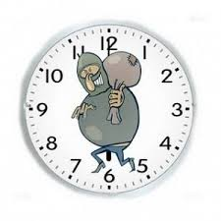
The Time Thieves
Notes:
test

Slide 171
What guides our conception of time?
A personal choice, depending on one's objectives: a manager who works 10 hours a day may be just as satisfied with his organisation as one who decides to leave at 6 p.m.
Cultural conditioning: the Anglo-Saxons have invented a managerial time that corresponds to the monochronic culture, whereas the Latins are polychronic
Our temperament. The routine person is quick to confront his incompetence, some need the unexpected, the pleasure of a relationship. Losing time is an attitude that allows some people to better resist anguish and pressure.
Others are naturally messy and constantly scattering, or have a slow and cautious temperament (see test of the main trends in your time management behaviour),
Finally, more often than not, our working methods are to blame!

Slide 172
Preparing to invest in change?
To change the way you act and work, you have to want to, you have to find your energy and accept to lose time to gain time by reorganising.
Desire + a few techniques allow you to better control your time.

Slide 173
Some concepts
The Eisenhower matrix
The priority pyramid
Parkinson's Law
Pareto's law
The theory adapted to the times

Slide 174
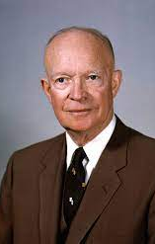
The Eisenhower principle
This method of prioritising tasks was originally suggested by Dwight D. Eisenhower, 34th President of the United States of America. Eisenhower is said to have once said: "What is important is rarely urgent and what is urgent is rarely important". Based on this quote the Eisenhower Box was developed as a way to help people prioritise their tasks.

Slide 175
The Eisenhower principle
What is the Eisenhower Matrix?
The Eisenhower Matrix, also referred to as Urgent-Important Matrix, helps you decide on and prioritize
tasks by urgency and importance, sorting out less urgent and important tasks which you should either delegate or not do at all.
https://youtu.be/tT89OZ7TNwc

Slide 176
Where does the name come from ?
Dwight D. Eisenhower was the 34th President of the United States from 1953 until 1961. Before becoming President, he served as a general in the United States Army and as the Allied Forces Supreme Commander during World War II. He also later became NATO's first supreme commander. Dwight had to make tough decisions continuously about which of the many tasks he should focus on each day. This finally led him to invent the world-famous Eisenhower principle, which today helps us prioritize by urgency and importance.

Slide 177
How to use the Eisenhower Matrix?
Prioritizing tasks by urgency and importance results in 4 quadrants with different work strategies:
We call the first quadrant Do first as its tasks are important for your life and career and need to be done today or tomorrow at the latest. You could use a timer to help you concentrate while trying to get as much of them done as possible. An example of this type of task could be to review an important document for your manager.
The second quadrant we call Schedule. Its tasks are important but less urgent. You should list tasks you need to put in your calendar here.
➀ Do First First focus on important tasks to be done the same day. | ➁ Schedule Important, but not-so-urgent stuff should be scheduled.
➂ Delegate What's urgent, but less important, delegate to others. | ➃ Don't Do What's neither urgent nor important, don't do at all.

Slide 178
5 time management tips when working with the Eisenhower Matrix
Putting things to-do on a list frees your mind. But always question what is worth doing first.
Try limiting yourself to no more than eight tasks per quadrant. Before adding another one, complete the most important one first. Remember: It is not about collecting but finishing tasks.
You should always maintain only one list for both business and private tasks. That way you will never be able to complain about not having done anything for your family or yourself at the end of the day.
Do not let you or others distract you. Do not let others define your priority. Plan in the morning, then work on your stuff. And in the end, enjoy the feeling of completion.
Finally, try not to procrastinate that much. Not even by over-managing your to-dos.
Finally, try not to procrastinate that much. Not even by over-managing your to-dos.

Slide 179
The priority pyramid
Taking a holiday
Give the report back to my boss
Make an appointment with your hairdresser

Slide 180
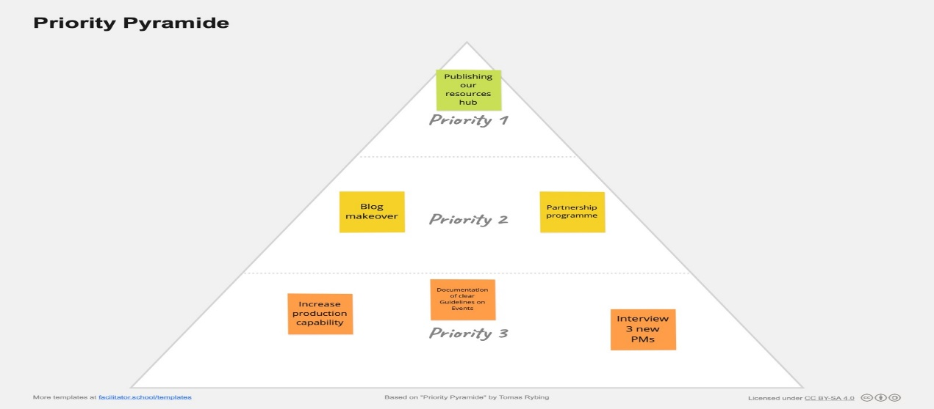
The priority pyramid
What is a Priority Pyramid?
The priority pyramid is a visual prioritization method that helps to make decisions on the most important things to work on. Through limited space the group is guided to filter tasks and agree on priorities.

Slide 181
The priority pyramid
How does a Priority Pyramid work?
Step 1: Sorting Out
Sort out all voted post-its and place them on the pyramid canvas.
Tip: Make sure that you didn't vote on duplicates or that some voted items aren't much the same
Step 2: Visualisation
Place the top voted post-it on the top of the pyramid. Add different layers below according to their number of votes. If post-its have the same number of votes they stay on the same level next to each other.

Slide 182
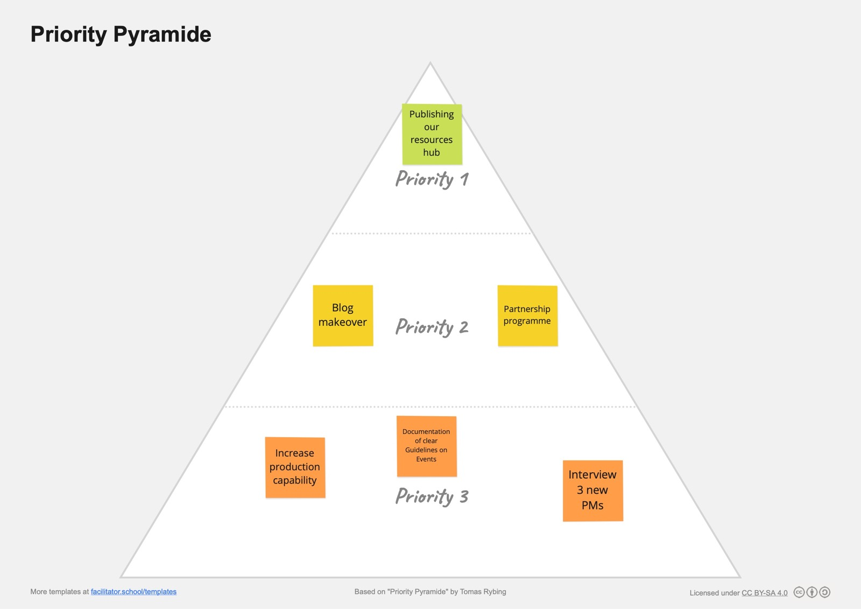
Example
What is a good example for a Priority Pyramid?
A good example of the Priority Pyramid is to use it as part of a planning meeting. The group can use the three areas of the pyramid to organise all project options and come to a consensus on the priority.
Below, you see an example of what such a priority pyramid could look like at the end. As you can see, this provides a clear visualisation of all options that the group could focus on in different levels of importance.

Slide 183
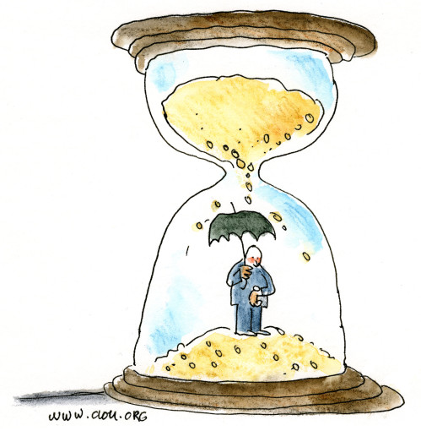
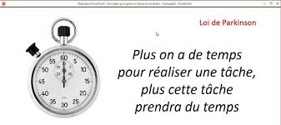
The Parkinson law

Slide 184
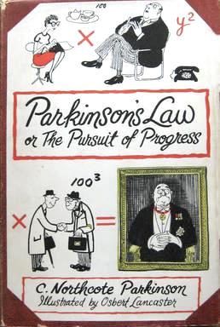
The Parkinson law
Parkinson's law is the adage that "work expands so as to fill the time available for its completion."^{[1]} It is sometimes applied to the growth of bureaucracy in an organization, but can be applicable to all forms of work.

Slide 185
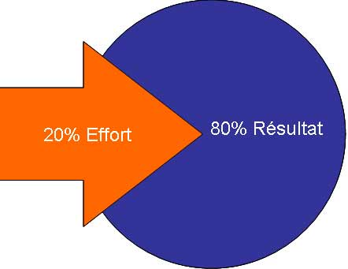
Pareto’s law or the 80/20 law
Significance
20% of the causes lead to 80% of the effects.
20% of factors influence 80% of objectives.
Examples:
Sport: 20% of the effort in training leads to 80% of the performance
After-sales service: 80% of complaints come from 20% of customers
Population: 20% of the French surface area contains 80% of the population (calculation based on the 9,000 densest municipalities)
Management control: 20% of indicators provide 80% of the information.
Notes:
La gestion du temps », c’est un ensemble d’outils efficaces pour exécuter vos tâches dans un délai imparti. Dans ce contexte, Vilfredo Pareto (1848 – 1923) a énoncé un principe universel qui porte son nom, la loi 80-20 ou loi de Pareto.
Origine La loi trouve ses racines au début du 20° siècle: Pareto en tant qu’économiste travaille sur la recherche de l’explication des disparités économiques dans le monde. Sa théorie est soutenue par divers spécialistes de cette époque. L’un d’eux était le Dr Joseph Juran qui a observé qu’elle peut être appliquée non seulement à un domaine particulier, mais aussi que ce principe a valeur « universelle ».

Slide 186
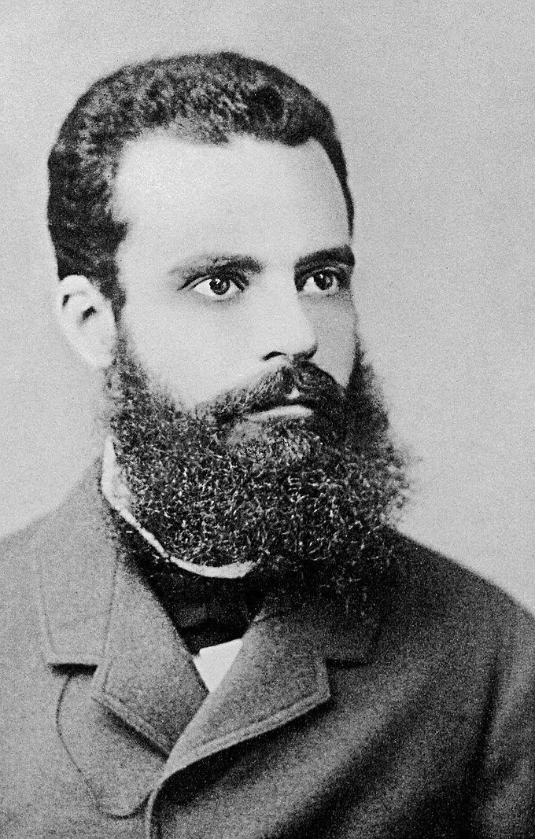
Pareto theory can be adapted to time management. Never load your agenda at 100%, always keep 20% for unknown events.

Slide 187
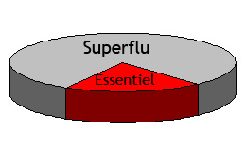
Pareto theory adapted to time
1) Avoiding unnecessary tasks: The most important part of management is to avoid time-consuming tasks that do not produce effective results
2) Foresight: When planning, tasks must be chosen carefully to ensure future returns. Today's solutions have a clear impact on tomorrow's results.
3) Keeping an eye on high value tasks: Efforts should be streamlined to focus on the important 20%. If you work in this way over a period of time, the results will be beneficial.
In the long run, your Pareto managed efforts will pay off.
Notes:
La loi de Pareto s’applique également au temps : vous pouvez observer sur votre vie cet effet en mesurant le temps consommé à réaliser vos travaux les plus utiles et productifs, et le comparer au temps globalement passé dans une journée ou une semaine.

Slide 188
Some techniques
Use some colour codes.
For example: using colour codes on your diary.
Green code : According to the 80/20 rule, only really important things can be placed in these areas.
Blue code : When I am less efficient (tiredness, hunger...), only things that are easy to do or not very tiring are placed here.
Red code : Contingency areas, these spaces can only be used 4 days in advance, so I always have room for a contingency.
It is now up to you to invent your own codes.

Slide 189
Some techniques
Use technology appropriately. :
Whatever the "machine" is, it is at your service, not the other way around.
Don't switch off your mobile phone but put it on vibrate mode and look at who is calling you, is it urgent or important, otherwise let the person leave you a message.
Use two phones: one private and one professional
Use e-mail, the internet in general, and organisers. Dictaphone and other digital recorders.
Do you have a computer or technical problem that is beyond your competence?
Give yourself a time limit to solve it, beyond that call an expert. We all have a champion friend ready to help us.

Slide 190
Some techniques
Reading technique.
4 reading stages, the passage to the next stage is not automatic, far from it!
1st stage, search mode: very fast reading, 10 seconds maximum per page, I don't really read, I look for what interests me. I'm not interested, I don't go further, I'm interested phase 2.
2nd stage: fast reading. I read what interests me, a few minutes are enough. If it is really interesting or useful: stage 3.
Stage 3: in-depth reading. The article is identified, I take the time to read it quietly. In some cases I move on to stage 4.
Stage 4: archiving. The article is worth keeping. The important points are highlighted, annotated and then archived.

Slide 191
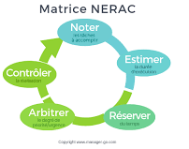
The NERAC method
As a reminder, here is what NERAC means:
Note down the activities to be carried out
Estimate the duration for each activity
Reserve time for the unexpected - add 1/3 of the time
Arbitrate by priority - Eisenhower matrix
Monitor activities

Slide 192
Evaluate time
Knowing how to evaluate time: durations, deadlines, start date, workload

Slide 193
Plan
Love your to-do list (especially if they are things you least like to do)
Make a daily to-do list
Set aside an hour of quiet time each day
Organise your work according to your natural energy cycle
Define and manage your "response policy
Start with the most important tasks
To achieve your goals, keep interruptions to a minimum
Establish a strategy for managing instant messaging

Slide 194
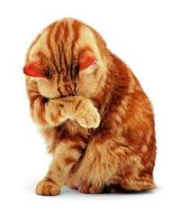
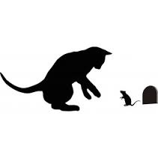
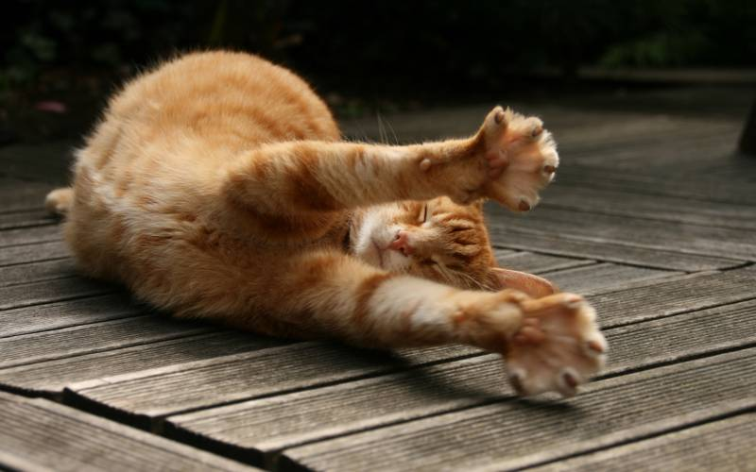
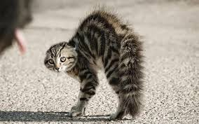
Choose the time of day when you are most efficient to do the activities you like less or not at all.

Slide 195
Setting priorities
Learning to recognise your shortcomings
Learn to say no with courtesy
Ranking priorities in order of importance
Avoiding procrastination

Slide 196
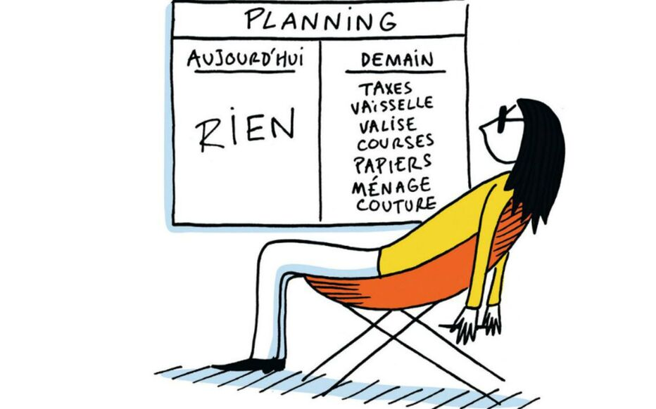
Procrastination
What are the reasons why we put off doing what we should be doing today?
Fear of failure
The fear of success, the fear of succeeding
Fear of losing autonomy and independence
Fear of being alone, of loneliness and isolation
Perfectionism

Slide 197
If you recognise yourself in the following list of statements, you are affected by procrastination.
If you find a task difficult, you put off getting started.
You abandon the task you are doing if you encounter a difficulty along the way.
You often ask yourself why you have to do this or that.
You often find it difficult to start working.
You tend to start several things at the same time so that you don't get anywhere with any of them.
You don't start working if you don't get any interest or pleasure from it.
You find reasons to do something other than what you have to do.
You have no problem starting something but you never manage to finish or go through with it.
You reassure yourself that there will be no consequences for not doing your job.
You find it difficult to concentrate on what you are doing and your mind wanders to other things

Slide 198
THE TIME
"Never give time to time; it takes advantage of it. (Jean Amadou)
"You have to be willing to lose time to gain time
"In Europe we have the time, in Africa they have the time
Notes:
Time is a concept in relation to the country.

Slide 199
What are your priorities today?
Work?
Family ?
Leisure activities ?
Health?

Slide 200
Module 4: Conflict Management
The different types of conflict :
open, latent, latent
Conflicts of opinion, needs or interests
Reactions to conflict: the different reactions to conflict (quilt, broken record...)
What is self-confidence?
What do we mean by resilience?
Relationship between self-confidence and resilience
How to improve self-confidence?

Slide 201
Is conflict a necessity?
M4
This is a sign to consider:
The expression of a need
The expression of a conviction
The expression of a problem to be solved

Slide 202
Conflicts and disagreements
Conflict and disagreement: what are the differences?
When we talk about conflict, we are not talking about simple disagreements. Conflict is at the heart of effective teamwork and healthy collaboration. Encouraging your team members to be open and honest with each other is an integral part of team collaboration. When your colleagues disagree, it means that they do not hesitate to share their opinions and confront them in order to find the best solution together. So in small doses, disagreements can be positive.
When does it become a problem? A disagreement becomes a conflict when one or more team members feel anxious and unable to be fully themselves at work. This may mean that the disagreement has become personal or that it has revealed a larger problem within the team. In these situations, you can adopt various conflict resolution strategies to better understand the causes of the conflict and find a solution together with your team.

Slide 203
The different levels of conflict
M4
Latent or latent conflict
Choked
Fear
Repressed conflict
Former conflict
Not accepted
Declared conflict
Clair
Aggression
Conflict

Slide 204
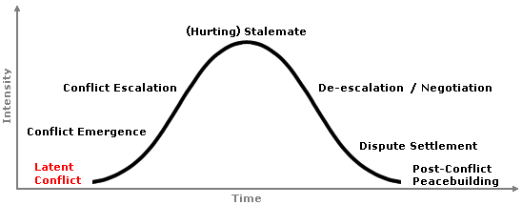
Latent conflict
When the "stages of conflict" are listed by conflict scholars, the first phase is often listed as "latent conflict" or "unstable peace," It exists whenever individuals, groups, organizations, or nations have differences that bother one or the other, but those differences are not great enough to cause one side to act to alter the situation. Differential power, resources, differing interests or values all have the potential to spark conflict if a triggering event occurs. Citing Collins, Paul Wehr observed that, "social life is above all a struggle for power and status regardless of the type of structure. An inevitable power differential between groups, and between individuals, produces latent conflict in all social relations."

Slide 205
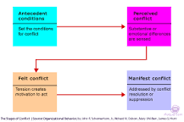
What is suppressed conflict?
Conflict suppression is a superficial and often temporary state that leaves the situation open to future conflicts over similar issues.

Slide 206
open conflict
An open conflict is one where the protagonists show great hostility towards each other.
This may lead to verbal or physical fighting.

Slide 207
The different types of conflict
M4
Conflict of needs
Conflict of opinion
Conflict of interest
Conflict

Slide 208
Conflict of needs
They arise when some members of a team, a family or a group have contradictory or irreconcilable needs. The definition of objectives, the organisation of work and the sharing of responsibilities often become sources of conflicting needs. Needs for belonging, recognition, security or physiological needs

Slide 209
Conflict of opinion
Conflicts of ideas: the disagreement between the parties concerns different opinions, points of view, perceived as opposed - Conflicts of values: the dispute concerns a choice of life, an ideology.
- Conflicts of interest: there is a divergence of interests between the two groups or individuals.
- Conflicts between people: these arise from reactions of antipathy and competition. The factors evoked are related to others, to oneself or to the environment.
- Positional conflicts: this type of conflict arises when people take up positions on different ideological grounds in the exchange. Each person has a position that may be based on a model that has been unconsciously integrated and never questioned or reflected upon.
.

Slide 210
Conflict of interest
What is a conflict of interest?
A conflict of interest can be defined as a situation where one or more persons or institutions are at the centre of a decision making process where their objectivity and neutrality may be questioned.

Slide 211
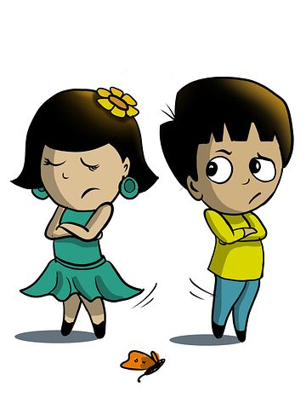
The misunderstanding
Misunderstanding
Interpretation
Vulnerability
Different views
Lack of information
Imagination

Slide 212
Psychological
The different causes of conflict
Differences
History
Ethnicity
Causes
insecurity
Danger
Results
Tensions
Stress
Personality
Nationality
Sabotage
Upheaval
Tests of strength

Slide 213
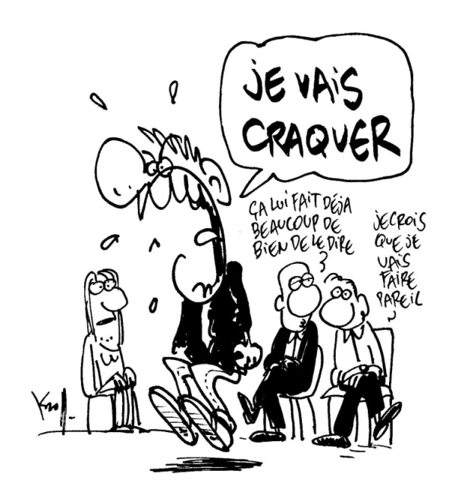
Linked to the operation of the company
The different causes of conflict
M4
Poor task definition
Incorrect division of labour
Interdependence of tasks
Cumbersome and routine work methods
Lack of communication

Slide 214
Generational
The different causes of conflict
M4
"A generation is a particular group whose members share a proximity in age and have gone through similar life events at key stages of their development. But whose reactions and opinions differ".
The traditionalists
Baby boomers
Generation Y
Generation X
1930
1950
1970
1990

Slide 215
M4
Some techniques to avoid conflict
Team spirit
Group cohesion
Solidarity
Defined/recognised competences
Respect for individual roles and hierarchies
Listening and caring
Notes:
Testing the role of each

Slide 216
Steps to avoid conflict
M4
Anticipate
Define a goal
Think
Open mind
Self-confidence
Self-affirmation
Clarify the situation
Do not provoke conflict
Promoting reflection
Putting yourself in the other person's shoes
Self-acceptance
Non-judgmental
Competence
Feedback
How to say
not
Hearing the criticism
Reformulate

Slide 217
Organiser le changement
The 5 stages of unwanted change :
Denial
Anger
Guilt, blackmail, negotiation
Sadness, depression
Acceptance

Slide 218
The five steps of change in images

Slide 219
Reactions to change
M4
The active participant :
volunteer for change
The active resister:
fight against change
The passive resister :
does not commit but does not oppose either
The passive contractor :
Quiet, unobtrusive and reluctant to commit publicly to change

Slide 220
The four type of resistance to change
Inertia: this is characterised by a form of acceptance of change but without visible reaction and above all without action. The individual is cautious, waiting to see what happens to justify this passive behaviour.
Argumentation: resistance through argumentation is productive, the exchange makes it possible to integrate the change and also to negotiate its development.

Slide 221
The four type of resistance to change
Rebellion is an active and explicit form of resistance. It can take the form of refusal to change but also of strike or resignation.
Sabotage: it aims to discredit the change project or its bearer, to scupper it by pernicious means.

Slide 222
What is the best way to react to change?
Be non-active.
Be reactive.
Be proactive and positive.
Acknowledge that change is part of life. Nothing would exist without change. ...
Accept your emotions. ...
Reframe the situation to see the positive. ...
Action is required because decisions, not conditions, determine your path.

Slide 223
Managing conflict: the different stages
M4
Identifying the beginnings of conflict
Diagnose and analyse the different types and levels of conflict
Objectives
Recognising your sphere of influence to deal with conflict
Mobilising internal resources in conflict situations
Regulating and exiting conflicts

Slide 224
The five conflict resolution strategies:
Forcing/dominance (I win - you lose)
by hierarchical authority
by physical force
by the support of the majority
by application of the law
Appeasement (win-lose)
Instead of trying to win at the expense of the other, the other is allowed to win in the hope of avoiding the consequences of a long and expensive conflict.
Disengagement / flight (failure -failure)
A partner postpones negotiations again and again or makes excuses at the last minute in a repeated manner.

Slide 225
The five conflict resolution strategies:
Integration/collaboration (win-win)
The parties seek a consensus, i.e. a solution that is acceptable to everyone, not because there is no better solution, but because the pie has been enlarged. If the parties have had to make concessions, they feel that these have been balanced by attractive gains.
A particular mode of this approach is where the parties seek a common overarching goal that neither can achieve alone and which replaces the individual goals that separate them.
The compromise
The parties haggle until they find a balance which, if not considered optimal, is nevertheless accepted given the circumstances and the fear that otherwise the conflict will drag on and escalate.
It is a hybrid solution, where everyone gains a little (but not as much as they would have liked) and everyone loses a little (but less than they feared).

Slide 226
The five conflict resolution strategies:
If you have to make a rational choice between the five possibilities, it is advisable to take into account four dimensions of the situation:
the relative power of the two parties,
the importance of the issue,
interdependence between the parties
the climate of trust or mistrust between them.

Slide 227
Analysis model for determining a conflict strategy :
Domination Cooperation
(I win / you lose) (both win)
Compromise
(both lose)
Escape Appeasement (nobody wins) (you win / I lose)
+
Power Issue (propensity to assert oneself) -
- Interdependence + Trust (propensity to cooperate)

Slide 228
The advantages and disadvantages of the five conflict resolution strategies:
Attitudes | Benefits | disadvantages
Withdrawal | Allow time for reflection Requires some energy and time Defuses conflicts of people and values Enables the people concerned to manage the difficulty themselves | Fosters, in some cases, the escalation of the conflict Can be seen as an exploitable weakness A resignation from his leadership role
Compromise | Can crystallize the situation Creates a spirit of conciliation Allows everyone to save their position | Often a routine solution Encourages bargaining Leaves the protagonists with a feeling of "not finished".

Slide 229
The five conflict resolution strategies:
Attitudes | Benefits | disadvantages
Domination | Quick solution Can secure Satisfaction with the decision | Develops passivity and strategic submission Risk of interrupting the employee's commitment Gives the loser a sense of revenge
Confrontation Negotiation | Builds confidence Long-term solution Promotes self-expression Develops motivation | Requires time and energy Can be experienced as insecure Not everything is negotiable Can be perceived as a weakness
Soothing | Suitable if the issue is minimal Calms the spirits Long-term security Improves the relationship | Can be seen as a refusal to take responsibility Can obliterate a simmering conflict

Slide 230
Choice of strategy
Adopt forcing, when you are in a strong position and the game is worth the candle, when the interdependence between the parties is weak and you do not believe you can trust the other.
Indeed, it would not be advisable to fight when there is no real chance of winning, when the stakes are not worth the sacrifices that any battle inevitably entails, and when you have to live with the other party after you have won, who may resent you.

Slide 231
Choice of strategy
We will choose appeasement when we are dependent on the other person, when we are in a weak position, when the stakes are low and when we fear an escalation of the conflict, but only when we can trust them (that they will not abuse their victory and still make life difficult for you)
Disengagement is chosen when you have no power or trust in the other person, when you are not obliged to deal with them and when the issue is not important.
One distances oneself and avoids contact.

Slide 232
Choice of strategy
Consensus is chosen when the stakes are too high not to seek a favourable solution, when one is strong enough to deal with the other as an equal and the relationship with him is good enough to be able to trust him, and when, in addition, one is indeed obliged to cohabit with him in the future.
Two further conditions must be added: on the one hand, the problem that separates the parties must be sufficiently complex to be dealt with at different levels and in different ways; on the other hand, there must be sufficient time to engage in the analyses and to allow the ideas necessary to find a valid solution to mature.

Slide 233
Choice of strategy
Compromise will be chosen when the assessment of the situation leads to less clear results, provided that the parties have roughly equal power.

Slide 234
Personality of the protagonists
People who seek to dominate do so because they have a domineering character characterised by a lack of concern for the needs of others and a need to win at all costs;
People who tend towards appeasement, on the other hand, are primarily concerned with the interests of others; they are generous and willingly obey the orders of others;
People who try to avoid conflict are fearful and cautious, without great ambitions and rather lonely;
People who propose collaboration, are as interested in each other as in themselves, are self-confident and optimistic, naturally cooperative and innovative;
People who are more inclined to compromise are pragmatic and conciliatory.

Slide 235
Some rules to follow
Accept conflict in its functional aspects instead of seeing it only as a source of trouble.
Do not immediately view the conflict as a zero-sum game where any gain for some inevitably means an equivalent loss for others.
Break down the problem and look for a solution that can achieve the objectives of all parties instead of tearing each other apart.
Do not be solely self-oriented, but take into consideration the needs, aspirations and positions of others (as they are, not as they are assumed!).
Search together for the facts needed to solve the problem

Slide 236
Some rules to follow
To feel mutually responsible for maintaining a positive climate of openness and honesty where it is unthinkable that anyone would seek to impose anything.
And avoid bargaining, voting or 'averaging'.
More specifically, it is suggested to start with a differentiation phase, during which the different points of view are presented, specific differences are analysed and mutual feelings are broken down; then, to move on to the integration phase, during which the parties rectify their perceptions and attitudes and appreciate their similarities, identify common objectives and engage in positive actions to solve their problems.

Slide 237
Resolving the conflict step by step
What is the real problem?
What do the people involved want?
Is the conflict of a manageable size?
Which process to choose?
How to find a solution?
How to ensure compliance with the agreement?
1
2
3
4
5
6

Slide 238
Being a mediator
Encourage...
Avoid...
The parties to be communicated
To solve the problem for the parties
A positive attitude
The accusations
Impose solutions
Listening to each other

Slide 239
Knowing how to react to hostile reactions

Slide 240
Knowing how to react to hostile reactions
The DESC method
Practical for formulating a criticism or disagreement without offending your interlocutor, the DESC method is a mediation tool widely used in non-violent communication (NVC). It is a 4-step process:
Describe the situation factually
Expressing an emotion, a personal feeling ("I" rather than "you")
Suggest a solution
Conclude by highlighting the positive consequences for both parties
The broken record (or wear and tear technique)
When faced with a request that is considered illegitimate, the broken record consists of maintaining your position by repeating your arguments for as long as the request is made. After some time, your interlocutor should give up.

Slide 241
Knowing how to react to hostile reactions
The counterpoint
To make your point, use first-person phrases such as "I can't let you say that" and add your reasoned response rather than "You're wrong" which would directly incriminate the other person.
Globalisation
Place your idea/product in a broader context. E.g.: "This question can be asked today for all trustees".

Slide 242
Knowing how to react to hostile reactions
The sphynx
The sphinx is the last resort when faced with a blatant case of aggressive behaviour by the person you are talking to, and is similar to a "passive-aggressive" posture. It consists of remaining silent while the other person speaks to you. This time of silence will allow you to step back from what was said and speak calmly.
The quilt technique
The idea here is to cover yourself while gently welcoming what the other person is saying. Let the other person make his or her point and punctuate it with phrases such as :
"That's your opinion..."
"I leave you free to say what you want..."
"What you say is your own business...
"You are free to think so..."

Slide 243
Thank you for your attention
For any questions
F.salesse@isc-saumur.fr

Slide 244
Disclaimer:
Funded by the European Union. Views and opinions expressed are however those of the author(s) only and do not necessarily reflect those of the European Union or the European Education and Culture Executive Agency (EACEA). Neither the European Union nor EACEA can be held responsible for them.

