Slide 1
Key competences for people 50+
Course: Digital Competences

Slide 2
What is Internet Safety?
1. To protect devices, content, personal data and privacy in digital environments
Internet safety is all those measures that are taken to protect all the elements that are part of the network, such as infrastructure and information, which is usually the most affected by cybercriminals.
2. To protect physical and
psychological health, and to be aware of digital technologies for social well-being and social inclusion
3. To be aware of the environmental impact of digital technologies and their use

Slide 3
Current situation
We rely on more and more third-party cloud-based services for our daily tasks.
In the process, we part with more of our personal data (sometimes without even knowing).
We take more of our work-based devices home to work (and visa versa).
In general, we are connecting more devices to the internet, creating more profiles with various software and apps.
More hackers, threats and scams lurk than ever before.
As artificial intelligence develops, the capability of cyber-hackers develops alongside.

Slide 4
What can we do?
Use a reliable antivirus software
Back up your work multiple times if possible
Encrypt external hard drives and password-protect key files
Do not duplicate passwords
Use social media consciously
Do not share personal data about you or others
Delete suspicious emails
Avoid dangerous websites

Slide 5
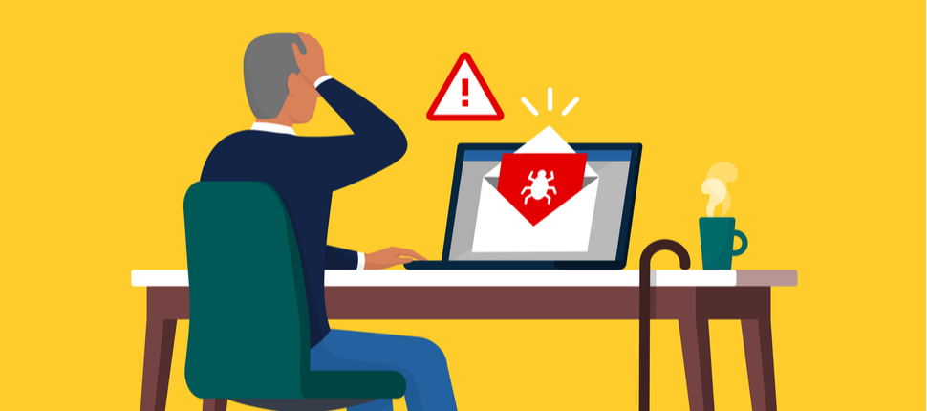
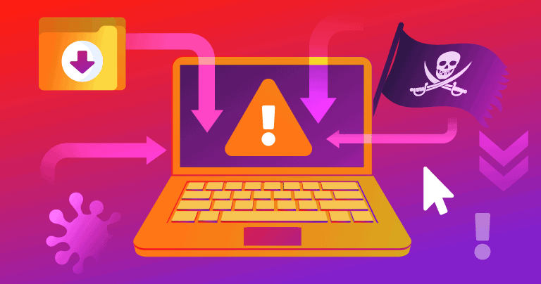
Protecting Devices
To protect devices and digital content, and to understand risks and threats in digital environments.
2. To know about safety and security measures and to have a due regard to reliability and privacy.

Slide 6
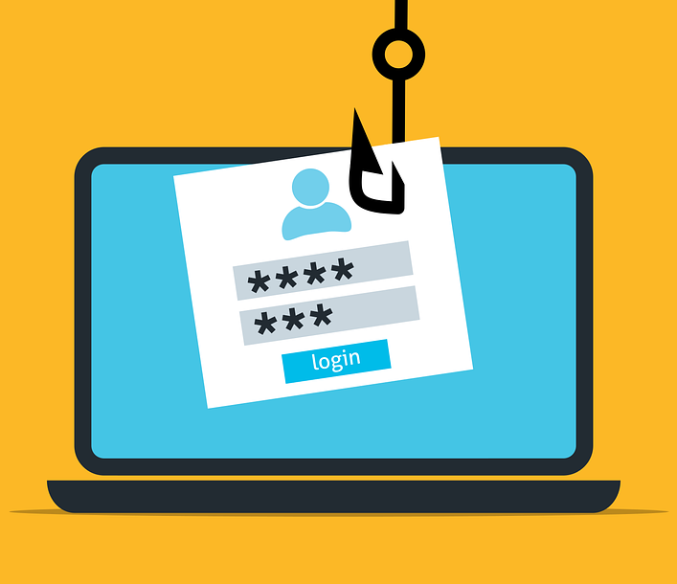
Phishing
Phishing occurs when someone tries to steal information like your login or account details by pretending to be someone you trust in an email, text, or other online communication
They try to send you to or the attachments they try to get you to open or viruses on your computer.
Other types of scams might try to trick you into downloading malware or unwanted software by telling you that thereʼs something wrong with your device.

Slide 7
Ask yourself…
Does it look professional like other websites you know and trust, with the product’s or company’s usual logo and with text that is free of spelling errors?
Does the siteʼs URL match the product’s or company’s name and information youʼre looking for?
Are there misspellings?
Is the email or site offering something that sounds too good to be true, like a chance to make a lot of money?
Does the message sound just a little bit weird?
Did you receive a link from your bank account that is suspicious?

Slide 8
Strong passwords: Things to take into account
Use a different password for each of your important accounts.
Use at least eight characters. The longer the better (as long as you can remember it!).
Use combinations of letters (uppercase and lowercase), numbers, and symbols.
Make your passwords memorable so you don’t need to write them down which would be risky.
Always use strong screen locks on your devices. Set your devices to automatically lock in case they end up in the wrong hands.

Slide 9
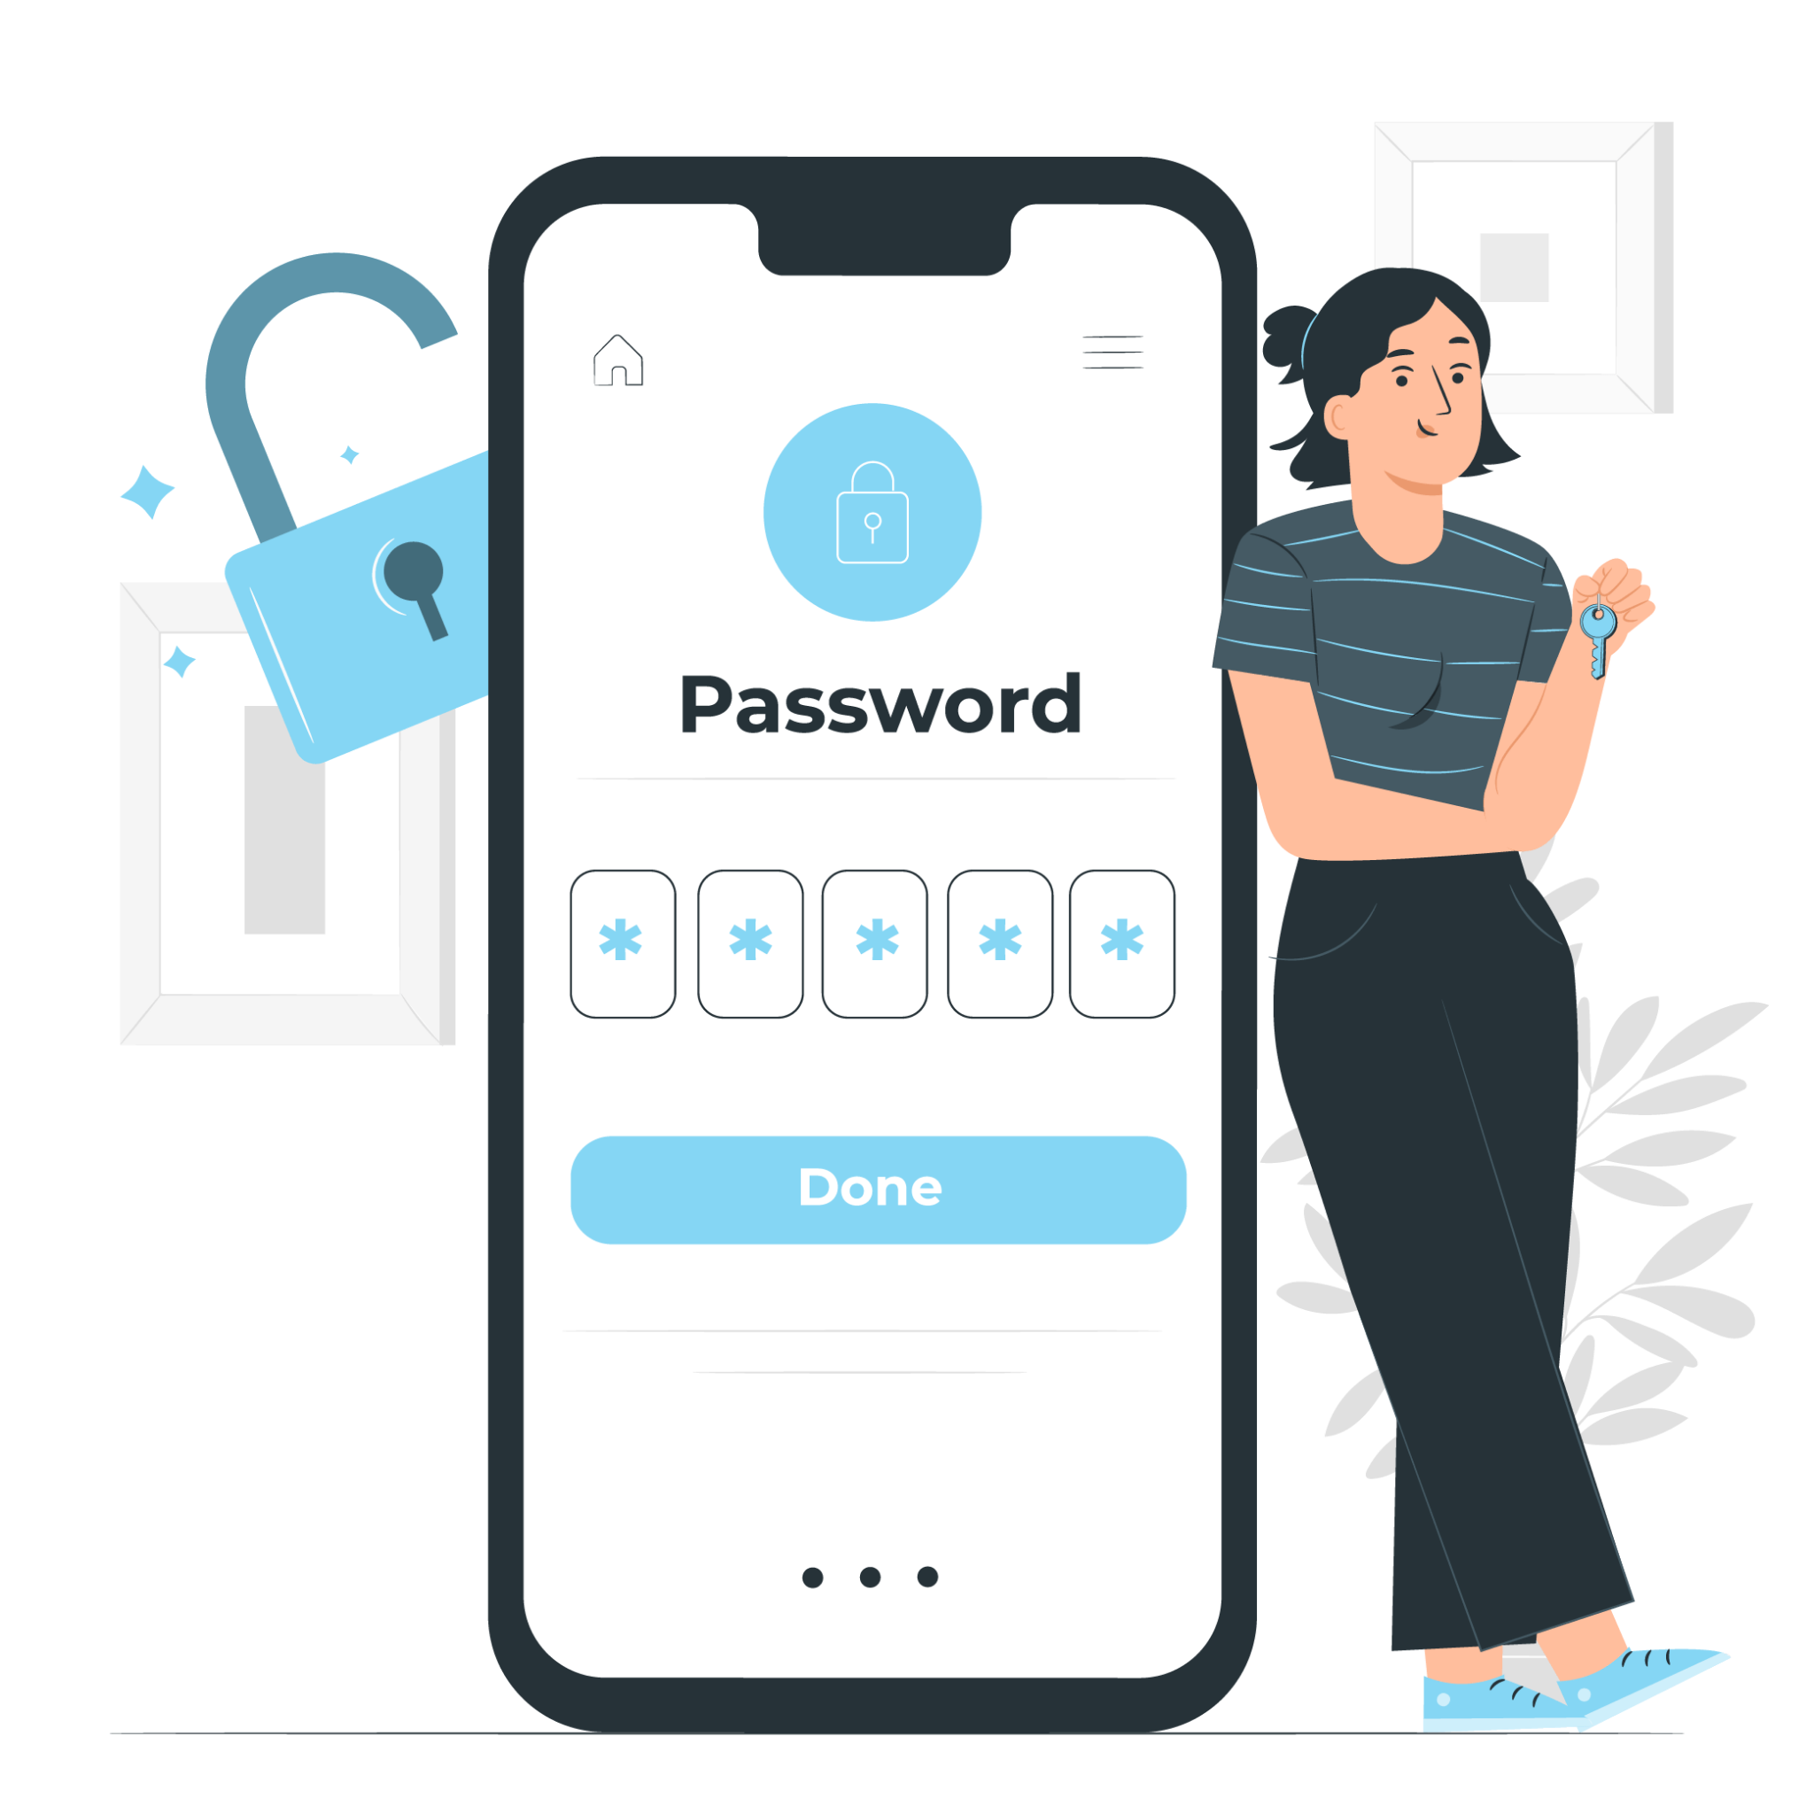
Strong passwords: Things to avoid
Donʼt use personal information (name, address, email, phone number,birth dates, etc.), or common words in yourpassword.
Donʼt use a password thatʼs easy to guess, like your nickname, just the name of your school, favorite baseball team, a string of numbers like “123456” or the word “password”
Donʼt share your password with anyone other than your parents or guardian.
Never write passwords down where someone can find them.

Slide 10
Activity: Strong Passwords
Digital technologies make it easy for us to communicate with friends, classmates and relatives. We can connect with them in so many ways: via email, text, and instant messages; in words, pics, and videos; using phones, tablets, and laptops. But it is also easier for us to share information that hackers or scammers could steal and use it to damage our devices, our relationships, and our reputations.
Protecting ourselves, our info, and our devices means doing simple, smart things like using screen locks on phones. In this activity we are going to create a strong password that will help us to be more protected on the internet.

Slide 11
Activity: Strong Passwords
For creating an extra-secure password:
Think of a fun phrase that you can remember. It could be your favorite song lyric, book title, movie catchphrase, etc.
Choose the first letter or first couple letters from each word in the phrase.
Change some letters to symbols or numbers.
Make some letters uppercase and some lowercase.
Compare passwords
Vote!
For each pair of passwords, weʼll all vote and discuss whose is stronger.
Supporting tool: https://padlet.com/

Slide 12
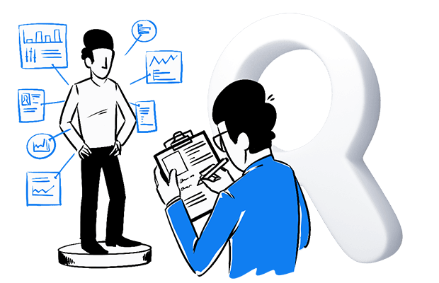
Protecting Personal Data and Privacy
To protect personal data and privacy in digital environments.
To understand how to use and share personally identifiable information while being able to protect oneself and others from damages.
To understand that digital services use a “Privacy policy” to inform how personal data is used.

Slide 13
Public and Private Data
Public | Private
Public data is any data/information/text available on a website that does not require you to login and is not prohibited from being accessed in the sites robots.txt file. | Any kind of LinkedIn.com personal data (except public LinkedIn Jobs data)
 | Facebook private profiles, user data and private groups
 | Follower details for many social networks
 | Emails on social media profiles
 | Private data on social media profiles
 | Emails from websites that do not show an email but provide a means to contact the business through a website form

Slide 14
TRUE OR FALSE?
Using WhatsApp, your data is protected.
Apple is more transparent than Android when it comes to collection and sharing personal data.
Snapchat can retrieve your temporary messages/images.
I am obliged to give my full name when I create a profile.
I can be fired for something I posted on my instagram account.
Google gets information about us when we search something.
Everyone have access to your information.
It is very easy to be hacked.
Computers could spy on us.

Slide 15
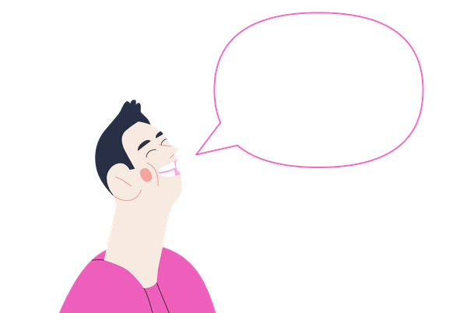
What is a Digital Footprint?
Every search or action you do on the internet leaves some trace. This is called Digital Footprint.
Everything on the internet about you, including videos, photos, mentions, and much more.

Slide 16
What is a Digital Footprint?
Example: Imagine you are walking on the beach and while you walk, you are leaving footprints on the sand. That is what happens with your digital footprint. Every time you use the internet, you leave a trace. The only difference is that these traces cannot be dissolved by the sea.

Slide 17
Ways to leave a Digital Footprint
You can leave a digital footprint actively or passively:
Actively
Posts on Social Media
Participating in online forums or blogs
Accepting cookies
Passively
Use of websites
Shopping online
Things your search on Google
Your likes on social media (Instagram, Facebook)

Slide 18
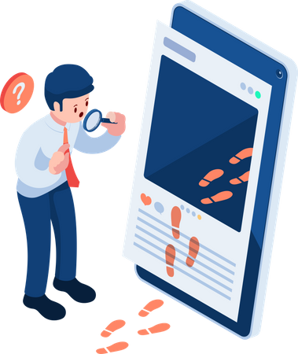
Why Are Digital Footprints Important?
They are permanent.
They can determine the reputation of a person.
Employers can check the fingerprints of their potential employees, especially their social networks, before making hiring decisions.
The words and photos you post online can be misunderstood.
Content intended for a private group can spread to a wider circle, damaging relationships and friendships.
Cybercriminals can take advantage of your digital footprint.

Slide 19
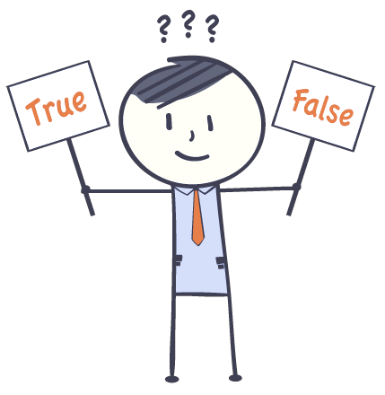
Quiz: True or False?
Your digital footprint is not permanent
You can’t control everything that is shared about you
Searching on the internet does not leave a footprint
You decide who see your posts
You can damage the reputation of others
A bad reputation can make it hard to find a job

Slide 20
Disclaimer:
Funded by the European Union. Views and opinions expressed are however those of the author(s) only and do not necessarily reflect those of the European Union or the European Education and Culture Executive Agency (EACEA). Neither the European Union nor EACEA can be held responsible for them.

Slide 21
Key competences for people 50+
Course: Digital Competences

Slide 22
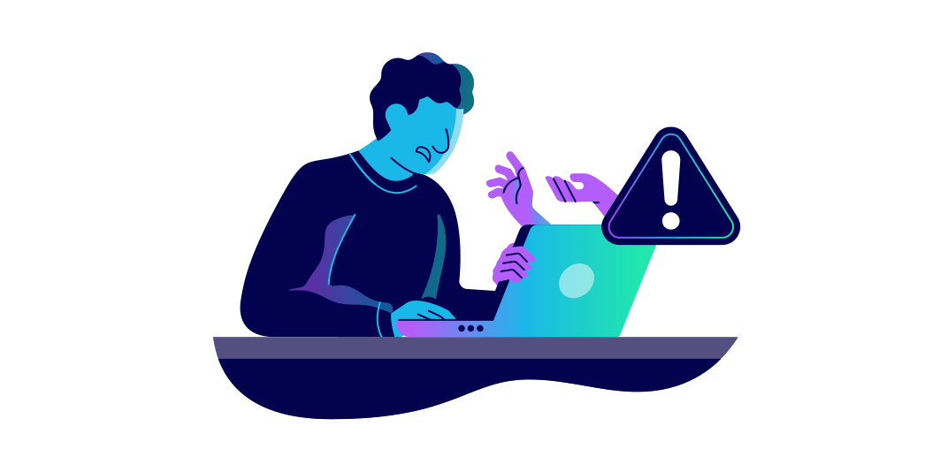
Protecting health and well-being
It is important to:
To be able to avoid health-risks and threats to physical and psychological well-being while using digital technologies.
To be able to protect oneself and others from possible dangers in digital environments (e.g. cyber bullying).
To be aware of digital technologies for social well-being and social inclusion.

Slide 23
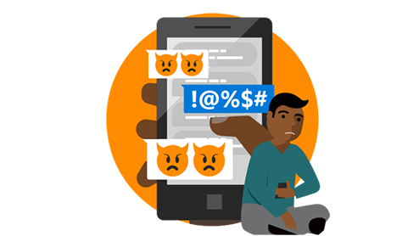
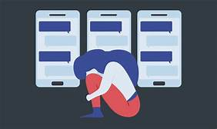
Cyberbullying (Definition)
It occurs when someone is harassed or bullied through social networks and other electronic media.

Slide 24
Where does it happen…
Virtual social networks: Facebook, Instagram, Twitter, Snapchat.
Text messages (SMS).
Instant messaging: WhatsApp, Facebook Messenger, email.
Ways to respond…
Ignore the messages.
Block the bully.
Use reporting tools.
Take a screenshot of messages.
Talk to a friend.
Trust an adult.
Reasons why this happens…
Someone acts or looks differently than others.
Someone is angry or resentful toward another person.
Someone is jealous of another person.
Someone feels bad because he or she has been bullied.

Slide 25
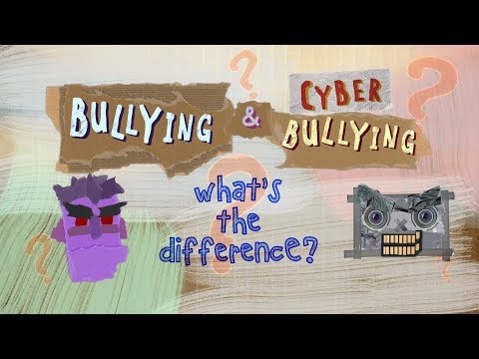
Watch this video

Slide 26
How to protect yourself?
Experiencing harassing calls and messages can be very difficult emotionally. It is important for you to know that you can protect yourself against such threats. Here are some tips you should take into account:
Limit information you post on your account, especially personal details such as your address, telephone number, the name of your IDP camp/city/location, names of your relatives.
Don’t post photographs of your home that might indicate its location.
Learn about the privacy settings of your social media apps, including who can see your info and blocking/hiding contents options.
Systematically check the background of your videos/photos before publishing them.
Report suspicious or threatening accounts.
(United nations: Cyber-harassment: self-protection tips, 2022)

Slide 27
Activity: Report online
When meanness and other inappropriate content turn up online, people have options for taking action.
It’s important to get used to using online reporting tools. Students should get in the habit of taking a screenshot of conversations or activity that’s harmful or suspicious before using blocking and reporting tools.
This ensures that trusted adults can see what happened and help resolve this situation.
In this activity we are going to see different situation and students must decide whether they would report it or not. This would help them to see that some situations should not be put up with.

Slide 28
Activity: Report online
SITUATIONS
A student posts a group photo in a public account, and you hate the way you look in it.Would you report that photo or not? How can you respond?
Someone creates an account of a student you know using their name and photo.They turned the photo into a meme and drew a moustache and other weird facial features on it, turning the photo into a joke. Would you report the account or not?
Someone posts lots of mean comments about a student in your school without using their name,but you have a feeling you know who it is. Would you report those comments or not?

Slide 29
Activity: Report online
4. A student creates an account with your school’s name in the screen name and posts students’ photos with comments that everybody hears about.Some of the comments are mean to students;some are compliments. Do you report the mean comments, the whole account, or both?
5. You’re watching a cartoon video and all of a sudden there’s some weird content in it that’s definitely not appropriate for kids and makes you feel uncomfortable. Do you report it or not?
6. You’re playing an online game with friends and someone (none of the players) starts chatting with you. They’re not being mean or anything,but you don’t know him. Do you ignore him or report him?

Slide 30
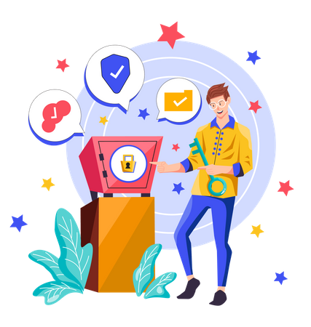
What is Cybersecurity?
Cybersecurity is the practice of protecting systems, networks and programs from digital attacks. Generally, these cyber-attacks aim to access, modify or destroy confidential information; extort users or users or disrupt business continuity.
When we surf the Internet or use our devices to access our social networks or other services, we enjoy all the advantages offered by technology. However, without being aware of it, we can also expose ourselves to numerous threats or risk situations, such as infection by viruses or the theft of our accounts and information.

Slide 31
How can we identify cyber threats?
Most common types of cybersecurity threats:
Phishing: It is the practice of sending fraudulent emails that look like emails from reputable sources. The goal is to steal sensitive data, such as credit card numbers and login information. It is the most common type of cyberattacks.
Malware: It is a term used to describe malicious software, including spyware, ransomware, viruses and worms. Malware breaches networks through a vulnerability, usually when a user clicks on a dangerous link or email attachment that then installs risky software.
Spam: It is any kind of unwanted, unsolicited digital communication that gets sent out in bulk. Often spam is sent via email, but it can also be distributed via text messages, phone calls, or social media.

Slide 32
What can we do?
If you receive a suspicious email, phone call or text message ( even if it seems like from a familiar company or a friend) here’s what to do:
Breathe. Phishing messages often pressure or threaten you to respond quickly. If an email needs you to act “now”, it’s probably a danger.
Don’t open any link or attachments you are unsure of. Reach out to the sender in a different way, like by phone, to confirm.
Consider your internet history. Unless you requested it, any message asking you to reset your password or update your account info is likely false.
Delete any messages that seem to good to be true like winning a contest you did not enter.

Slide 33
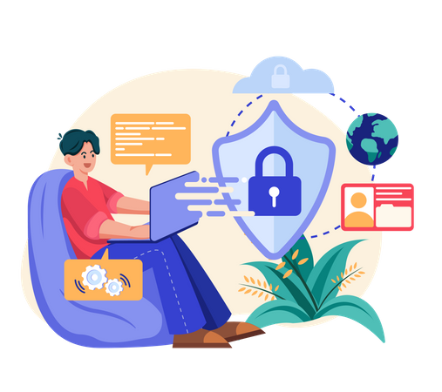
Tips to put in practice
Tip 1: Update your device
Updating your software is like getting your car serviced. It improves your device’s performance and makes it more secure.
Tip 2: Turn on multi-factor authentication
Multi-factor authentication on your account is what a security screen is to your home. It protects you from criminals who are trying to break in.
Tip 3: Practice safe passwords
Create long or complex passwords to make them safe. Use a different password for every account. Never ever share your passwords with anyone!

Slide 34
Activity: How Safe?
As you may know it is important to ensure internet safety by protecting our personal information online. Identify which of the following aspects should or should not be included in a safe profile:
First name, nickname or pseudonym
Hobbies, interests with no specific details such as club name
Only photos where specific details can’t be identified such as location, time
Likes and dislikes such as movies or food
Full name
Full name of friends or family
Birth date
Photos that can easily identify you e.g. car license plate
Home address, phone number
UNSAFE PROFILE ?
SAFE PROFILE ?

Slide 35
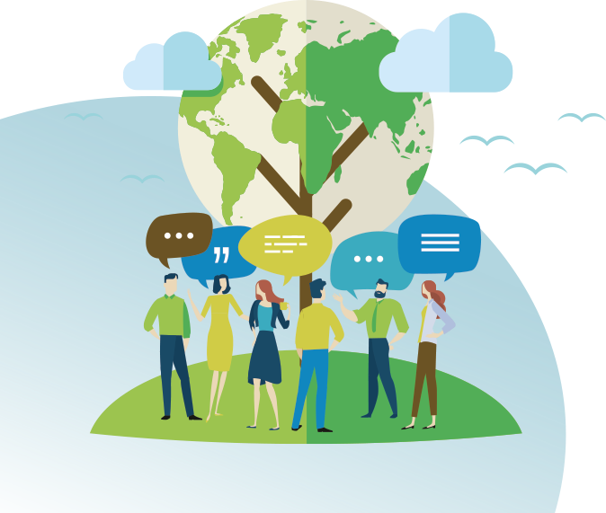
Protecting the environment
To be aware of the environmental impact of digital technologies and their use.

Slide 36
Green Computing
Those who lobby for green computing would also aim to convince political decision-makers to favour policy encouraging the transition towards more environmentally friendly technology.
This could be done by reducing the use of dangerous materials, optimising energy efficiency during product lifecycles and demanding that obsolete products by biodegradable.
Comprises various ideas regarding the limiting of impact of ICT technology on the environment.
Promotes the idea of sustainable development and also addresses questions regarding the social and economic influence of ICT.
Advocates for the idea of reducing greenhouse gases emitted by the ICT industry and more generally.
Aims to minimise the negative impact of the ICT impact on the environment through the designated production of environmentally sustainable ICT.

Slide 37
Impact of ICT
Our ICT impacts the environment in:
The production and transport processes as well as in our homes, as it consumes large amounts of energy.
We tend to replace our technology frequently and there is no way to recycle effectively. This is made worse by the fact that the manufacturers incorporate planned obsolescence strategies in their design processes which deliberately reduces a product’s lifespan, pushing us to buy new devices more than we would otherwise need to, which contributes to climate change.
Each step of an object’s lifecycle generates carbon emissions, from primary element extraction primary elements until its disposal.
It has been estimated that up to 270 kilograms of carbon emissions are produced in the production of a laptop computer.

Slide 38
What can we do?
Strictly limit the purchasing of new devices
Repair broken material
Buy second hand or reconditioned tech
Minimise your use of cloud storage
Clear out your inbox regularly
Don’t use email when not connected to wifi

Slide 39
Activity: Good or bad habits?
Which of the following habits do you think contribute to the protection of the environment?
Use more energy-efficient appliances.
Purchase new technological devices regularly.
Not update our smartphone regularly.
Turn off the bluetooth and Wifi of our smartphone when not using them to extend the battery life.
Let technological devices, such as smartphones or laptops, plugged although they are already charged.
Activate the airplane mode of our smartphone while we are sleeping.
Discussion: Name two more digital habits that you consider beneficial for protecting the environment.

Slide 40
If you want to learn more about this…

Slide 41
Disclaimer:
Funded by the European Union. Views and opinions expressed are however those of the author(s) only and do not necessarily reflect those of the European Union or the European Education and Culture Executive Agency (EACEA). Neither the European Union nor EACEA can be held responsible for them.

Slide 42
Key competences for people 50+
Course: Digital Competences

Slide 43
1. What is Problem Solving?
Solve technical problems: identify problems in the use of new technologies and digital tools and know how to solve them;
Identify technological responses: perceive and understand how to use digital technologies and tools to respond to different needs;
Use technologies creatively: be creative in the use of digital technologies so that knowledge can be created with them, and innovate in processes and products.
Find opportunities: be able to continuously update knowledge and use of digital tools and find new development opportunities in this activity.

Slide 44
Problem Solving Techniques
There are many situations in which we are faced with a problem with no apparent solution for us. Problem-solving techniques provide a simple and easy way to unblock the situation. There are four main techniques that people can use, as we explain below:
Scenario technique: Imagining the ultimate goal or scenario is essential for effective problem solving. After identifying a problem, we should ask ourselves what the scenario would look like after the problem is solved. We can also ask ourselves how the situation varies after improvements are made to the desired outcome. By imagining the end state, we can better understand the next step in solving the identified problem.

Slide 45
Problem Solving Techniques
2. Worsening technique: To address the problem we must ask ourselves how we can make the situation worse instead of better. It is crucial that we try to list all possible methods that could deteriorate the situation rather than improve it. Each of these methods should be described in such a way that it is clearly understood how to implement the strategies that would cause our project to fail rather than succeed. This allows for a deeper understanding of the problem and why the proposed solutions fail.
3. Climber technique: Before trying to solve a difficult problem, it is useful to brainstorm possible solutions starting with the ultimate goal. Then consider the previous steps until the initial state is reached. Once each step is imagined, we will have an efficient as well as effective strategy to address the problem. To complete a goal, it helps to break it down into smaller objectives.

Slide 46
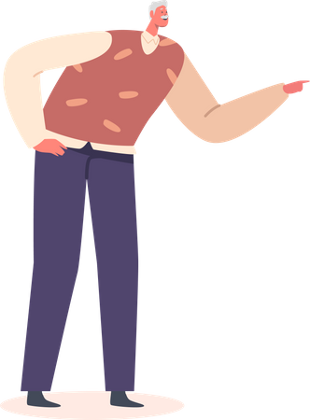
Problem Solving Techniques
When faced with complex situations, people tend to get stuck, and go around a problem in a thousand fruitless circles. The different problem solving techniques allow us to adopt another perspective to clearly see the big picture and get out of the impasse in which we find ourselves.
4. Blocked writer's technique: This technique suggests first deciding where we want to get to: the end or the resolution of the problem. Then, identify the different stages or chapters needed to achieve it. Finally, subdivide the stages into smaller ones, until we have a series of micro-steps that are easy to execute. In this way, we advance little by little towards the final result.

Slide 47
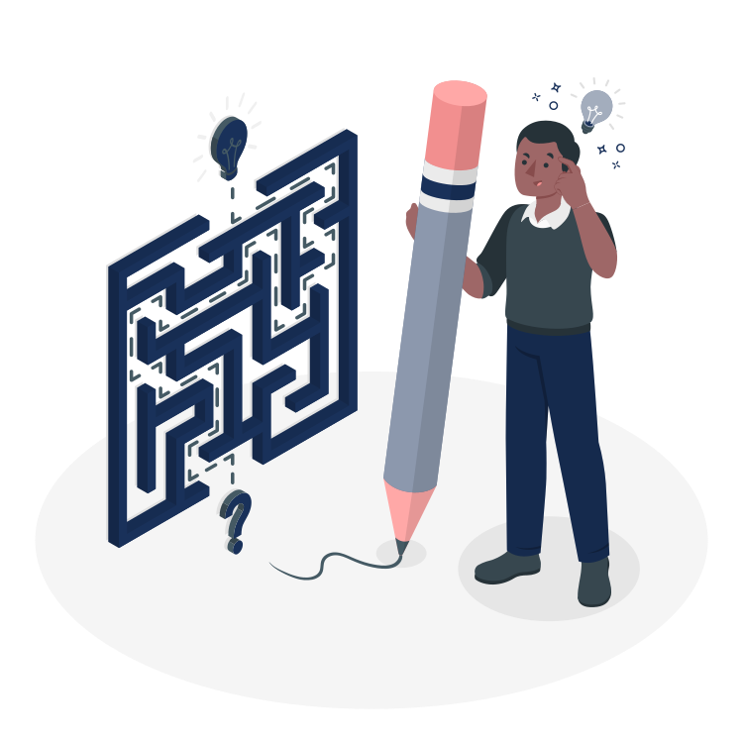
2. Solving Technical Problems
It is essential…
To know how to identify technical problems and be able to solve them with the help of a manual or with available technical information.
We start with basic operating problems to progress to the most complex, but it also includes knowing how to ask for help and assistance and knowing the elements of the computer and the devices.
A basic knowledge of the computer and its maintenance in order to be digitally competent.

Slide 48
Why is it important?
Technical problems can arise at any time and for different reasons, even when working with the latest technologies and devices. It is important to have basic problem-solving skills in order not to be constantly dependent on outside help and to be able to use the digital applications again as quickly as possible.
Example: While working with the computer, the screen suddenly freezes and the device no longer responds to inputs. The computer does not start when you turn it on. A programme on a smartphone, tablet or computer cannot be opened or closed. In all these cases, digitally competent people can assess possible causes because they have a basic understanding of the processes taking place in the background. They also know how to deal with technical problems and can apply different problem-solving strategies and systematically identify the cause of the problem in order to finally solve it.

Slide 49
What to do if you have a virus
STEPS
First, if you don’t already have an antivirus program, install one. Be sure you only have one antivirus program installed because having more than one can cause significant problems. Examples of antivirus software include Bitdefender and Norton.
Once you’ve verified that your antivirus program is running, begin a scan. If you’re unsure how to do this, review the documentation for your antivirus program, which usually can be found on the developer’s website. Some programs offer several types of scans, and you may want to run the most thorough type, usually called a full system scan. This may take several hours. Usually, you do not need to remain at the computer during the scan.

Slide 50
What to do if you have a virus
3. Either during the course of the scan or when it’s complete, the antivirus program will notify you of discovered threats and recommend various courses of action. Usually, the recommended action for each threat is the best choice. If the antivirus is unable to remove any threat, don’t ignore it. Investigate how to proceed with some Internet searches or by contacting a professional. The support team for the antivirus program can often help you at this point.
4. Your antivirus program may be bundled with an anti-malware program. If it isn’t, you may want to install an anti-malware program and run a scan. This can help to find any malware your antivirus may have missed. Antivirus and anti-malware programs scan for slightly different things but they work similarly, so you can follow the same steps in this tutorial.

Slide 51
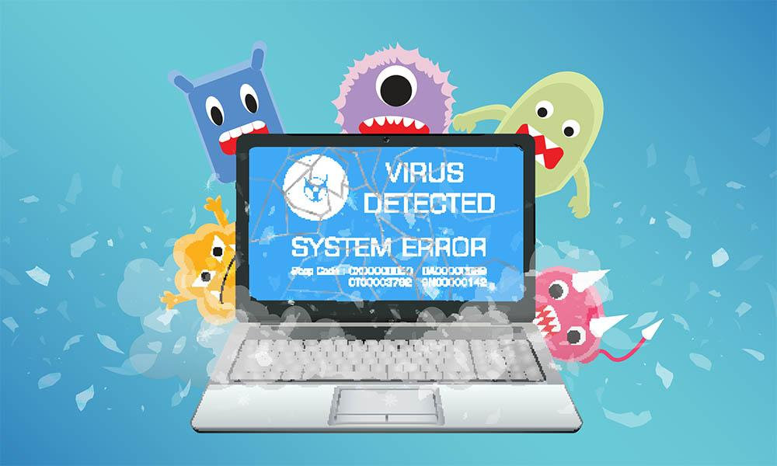
What to do if you have a virus
5. If you are unable to remove the virus, it may be necessary for you to erase the hard drive and reinstall your operating system and programs. At this point, you may want to consider hiring a technical support professional, but it is still possible to do this yourself. If you perform a full reformat of your hard drives during this process, it is almost guaranteed to eliminate even the most pernicious viruses, but all data on your drives will be lost. This is one of many reasons it is crucial to keep regular backups of your data before your computer develops any significant problems.

Slide 52
Activity: Possible solutions
When we are presented with a technical failure in our computer or other technological device, sometimes there is no error message that gives us a clue about what the exact failure is. Match the most common errors with their possible solutions:
TECHNICAL ISSUE | POSSIBLE SOLUTION
No display or black screen | Check the volume of the computer. Check that the speaker is turned on and connected. If you have headphones connected, disconnect them. Restart the computer. Try to connect the speakers on another device (mobile, pc, etc) to rule out that the fault is in the computer.
b) No sound can be heard | Check that the monitor is connected to the network and the computer is turned on. Press the power or sleep button Check that the monitor connection cable is undamaged.

Slide 53
TECHNICAL ISSUE | POSSIBLE SOLUTION
c) Mouse, keyboard or any other controller is not responding | Right-click on the desktop and select display settings. Drop down the screen resolution options and choose the recommended option.
d) Images are too large, too small or blurry | Check that they are connected to the computer In case they are wireless, check that they are turned on and with battery. Check with the manufacturer's information if they are compatible with your computer and operating system. Turn off the computer, connect and disconnect the controller(s) and turn it on again. Check for possible updates through Windows upate
DISCUSSION: What are the most common error(s) you have encountered? What measures did you apply to manage solve those issues? Did they work?

Slide 54
3. Identifying Needs and Technological Responses
It is essential…
To assess needs and to identify, evaluate, select and use digital tools and possible technological responses to solve them.
To adjust and customise digital environments to personal needs (e.g. accessibility).

Slide 55
Why is it important?
Many services can be used digitally today, some of them are offered only digitally. This entails advantages, especially because processes are often shortened and/or simplified. However, this also means that only people with corresponding digital competences in everyday life can benefit from these advantages or use certain services.
Example: Most people have a bank account, need to manage it and carry out banking transactions. However, a bank branch is not always easy to reach nor open if you have time. People with basic digital competences in everyday life know that it is possible to do banking online, independently of time and place. They know the opportunities of accessing the digital banking environment (e.g. the digital signature) and can apply it. People with higher digital competence in everyday life can organise the processes in the virtual space in a way that best suits their personal needs (e.g. make a reasoned decision about the way they want to receive their transaction number or digitally communicate with bank advisors and consultants).

Slide 56
What is Troubleshooting?
Troubleshooting is the process of identifying, planning and resolving a problem, error or fault within a software or computer system. It enables the repair and restoration of a computer or software when it becomes faulty, unresponsive or acts in an abnormal way. The goal of troubleshooting is to determine why something does not work as expected and explain how to resolve the problem.

Slide 57
What is Troubleshooting?
What if your screen in blank, or you can’t close an application?
Whenever you have a problem with your computer, don’t worry!
There are many basic troubleshooting techniques you can use to fix issues like this.
We’ll show you some simple things to try, as well as how to solve common problems you may encounter.

Slide 58
TIPS
Write down your steps: Once you start troubleshooting, you may want to write down each step you take.
Take notes about error messages: If your computer gives you an error message, be sure to write down as much information as possible. You may be able to use this information later to find out if other people are having the same error.
Always check the cables: If you’re having trouble with a specific piece of computer hardware, such as your monitor or keyboard, an easy first step is to check all related cables to make sure they’re properly connected.
Restart the computer

Slide 59
TIPS
3. If your computer does not start, begin by checking the power cord to confirm that it is plugged securely into the back of the computer case and the power outlet.
4. If it is plugged into an outlet, make sure it is a working outlet. To check your outlet, you can plug in another electrical device, such as a lamp.
5. If the computer is plugged in to a surge protector, verify that it is turned on. You may have to reset the surge protector by turning it off and then back on. You can also plug a lamp or other device into the surge protector to verify that it’s working correctly.

Slide 60
Clear your browser’s cache
Your browser’s cache can help to speed up web browsing, but it can also create new problems in some situations. Cached content can also prevent certain parts of a webpage from loading correctly.
If you’re having trouble getting a webpage to load,it’s a good idea to try deleting, or clearing, your browser’s cache. This way, the browser can reload the page with all of the most recent information.

Slide 61
4. Creatively Using Digital Technologies
It is essential…
To use digital tools and technologies to create knowledge and to innovate processes and products.
To engage individually and collectively in cognitive processing to understand and resolve conceptual problems and problem situations in digital environments.

Slide 62
Why is it important?
Information and knowledge are fundamental parts of social interaction- especially in times of the internet and the constant availability of knowledge. Creatively using digital technologies requires, above all, the joint development of this knowledge in order to innovatively design the future.
Example: If you share views on a topic in a forum with other people, on the one hand, new knowledge can arise through the exchange. On the other hand, the forum can act as an information platform and database. Often it also allows joint problem solving, for example, when you turn to the forum community with a specific question. The digital environment thus becomes a space for individual and collaborative learning and development.

Slide 63
Robotics
A Robot is a mechatronic machine (mechanic, electronic and digital) designed to execute complex tasks automatically.
Program: a series of instructions fed to a computer in order to execute a task or series of tasks.
Robotics: is the collection of the techniques and research leading to the conception, design and operation of automatic machines, or robots.

Slide 64
Robotics
The three laws of robotics were introduced in 1942 by science fiction writers Isaac Asimov and John W. Campbell. the laws are:
A robot may not injure a human being or, through inaction, allow a human being to come to harm.
A robot must obey the orders given it by human beings except where such orders would conflict with the First Law.
A robot must protect its own existence as long as such protection does not conflict with the First or Second Law.

Slide 65
It is essential…
To understand where one’s own digital competence needs to be improved or updated.
To be able to support others with their digital competence development;
To seek opportunities for self-development.
To keep up-to-date with digital evolution.

Slide 66
Why is it important?
Digitalisation involves dynamic developments. This results in a constant need for new learning in order to be able to adequately cope with various digital tasks, both at work and in everyday life. Lifelong learning is particularly important in the context of digitalisation.
Example: when you are faced with a digital task in everyday life or at work, which you cannot adequately handle with your current level of competence, you can recognise whether it is necessary to further develop your digital competences.. The skills of this partial competence allow you to determine which competences you need to update or further develop your own competences. On the other hand, you can independently find and use instructions, training or other learning offers to develop your competences.

Slide 67
Activity: True or False?
One of the main goals of problem solving is to identify problems in the use of new technologies and digital tools and know how to solve them.
A person with low digital competences can manage virtual operations such as online bank transactions.
Troubleshooting is the process of identifying, planning and resolving a problem, error or fault within a software or computer system.
A Robot is a mechatronic machine (mechanic, electronic and digital) designed to execute complex tasks automatically.
In order to support the development of people’s digital skills it is not necessary to identify their digital competences gaps.

Slide 68
Disclaimer:
Funded by the European Union. Views and opinions expressed are however those of the author(s) only and do not necessarily reflect those of the European Union or the European Education and Culture Executive Agency (EACEA). Neither the European Union nor EACEA can be held responsible for them.

Slide 69
Key competences for people 50+
Course: Digital Competences

Slide 70
Information and Data Literacy (What is it based on?)
Articulate information needs, to locate and obtain digital data, information and content.
Judge the relevance of sources and their content.
Store, manage and organize data, information and digital content.

Slide 71
What else?
Digital literacy is not just knowing how to use digital tools. It is also about:
Making conscious use of digital tools, information and content
being able to discern what is of quality and what is not,
to learn to search effectively and efficiently,

Slide 72
What else?
Digital literacy is not just knowing how to use digital tools. It is also about:
to select what is relevant from reliable sources based on the purpose pursued (academic, journalistic, business...)
to classify, save and manage information for future applications.

Slide 73
Competences
Browsing, searching and filtering data, information and digital content.
Evaluating data, information and digital content.
Managing data, information and digital content.

Slide 74
1. Browsing, Searching and Filtering Data, Information and Digital Content (What is it for?)
To articulate information needs,
To search for data, information and content in digital environments,
To access and navigate between them,
To create and update personal search strategies.

Slide 75
Examples
You can format and save a picture in the most appropriate format (for example, JPG, PNG, or raw).
You now the pros and cons of storing data in the cloud, on a hard drive or a portable device.
You know how to, for example, store your photos, videos, and documents in the cloud
You are, for example, good at storing content in a way where you can easily find it again
You know, for example, the pros and cons of the many different types of files

Slide 76
Activity: Search Engines
PART 1
Each participant, or by groups type ‘search engine’ into Google. Explore how many types of search engines exist.
PART 2
Search three or four different search engines such as Google, Yahoo, and Duckduckgo. Do the same search across various engines.
Use simple terms, such as smartphone or table.
Describe together the different parts of a search engine: the search bar, images, news, etc. Take note of ads (sponsored links) on the home page or on results pages.

Slide 77
Activity: Search Engines
PART 3
On the whiteboard write a table including the search engines discussed in the previous section. Students will need to find the relevant information for each search engine:
The company that owns it
The year of its founding
Its country of origin
Its economic model
Does it practice the harvesting of user data?
Does it have a social or environmental agenda?
Does it provide other services (mail, music, etc.)
They will have 30 minutes to make their own table in a paper and to fill the information they find. Now create groups of 2 or 3.They will compare their answers and they will take other 10 minutes to write what they had not found.

Slide 78
2. Evaluating data, information and digital content (What is it for?)
To analyse, compare and critically evaluate the credibility and reliability of sources of data, information and digital content.

Slide 79
Examples
You can examine a complex topic, find facts, learning materials, or experts by using relevant search engines.
You can sort search results by date, author, multimedia, or file format using filters.
You think about, for example, whether what you read on the web is actually true
You can, for example, recognise messages or e-mails where the sender appears to be different from who he or she is.
Always consider very carefully how information such as personal interests, profile picture can affect future careers.

Slide 80
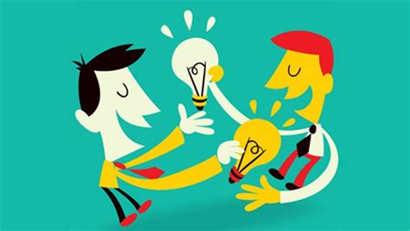
Activity: Sources
PART 1
Group Discussion
What do you think an information source is? Discuss with your group.

Slide 81
Sources
A source is a deliverer of information, the messenger. To know and trust a source is to know the information it carries is true, relevant and useful.
We need to find out: is it trustworthy, reliable, uncertain or doubtful?

Slide 82
Types of Sources
Documentary sources: books, videos, newspapers, brochures, etc. Essentially: any kind of physical or digital document.
Oral sources: discussions, conversations, interviews. Essentially: anything a person can relate to you directly.
Institutional sources: Sources that have public authority, for example, government (ministerial, administrative, etc.). These are structured, organised and distribute official news.
Intermediary sources: organisational sources holding social legitimacy: associations, professional organisations, political parties, syndicates, etc.
Personal sources: these are yours. It is up to you to determine whether they are legitimate or not. You are the one who judges whether the messenger or the information can be trusted or not.

Slide 83
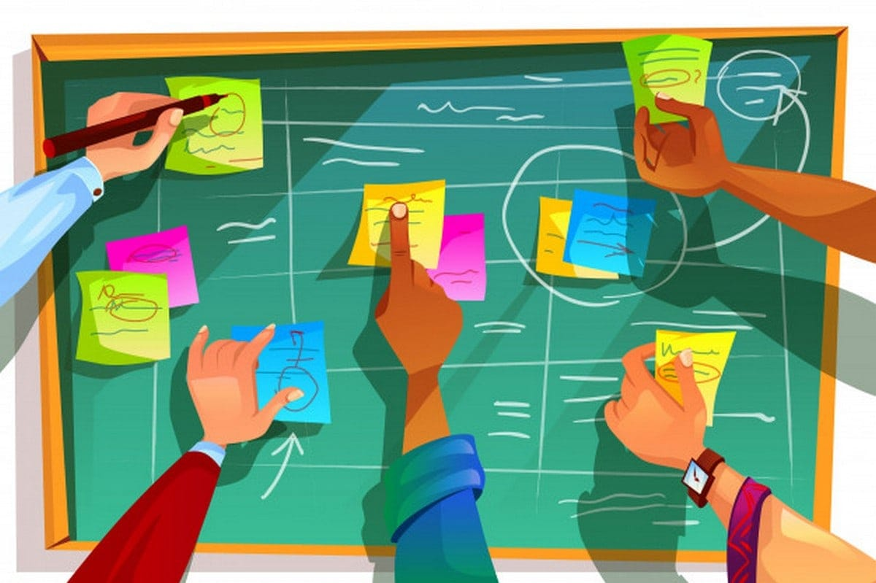
Activity: Sources
PART 2
Levels of sources
Using post-its, write different kinds of sources that you think of. Once you have 5 or 6 examples, put them in the different categories that will appear on the wall.
In groups, discuss whether the different examples can be reliable or not.

Slide 84
3. Managing data, information and digital content (What is it for?)
To organise, store and retrieve data, information and content in digital environments.
To process them in a structured environment.

Slide 85
Examples
Knowing where you download what you find on the Internet or the documents you create.
To have everything well classified to be able to retrieve for instance,and image you liked or a school paper.
Keeping everything on the device
Backup copies of photos, documents
The use of Dropbox, Google Drive or another cloud solution

Slide 86
Disclaimer:
Funded by the European Union. Views and opinions expressed are however those of the author(s) only and do not necessarily reflect those of the European Union or the European Education and Culture Executive Agency (EACEA). Neither the European Union nor EACEA can be held responsible for them.

Slide 87
Key competences for people 50+
Course: Digital Competences

Slide 88
4. Fake News
Fake news, is a type of hoax that consists of pseudo-journalistic content disseminated through news portals, written press, radio, television and social networks and whose objective is disinformation.
They are designed and issued with the deliberate intention of deceiving, misleading, manipulating personal decisions, discrediting or exalting an institution, entity or person or obtaining economic gain or political gain. By presenting false facts as if they were real, they are seen as a threat to the credibility of serious media and professional journalists, as well as a challenge to the receiving public.

Slide 89
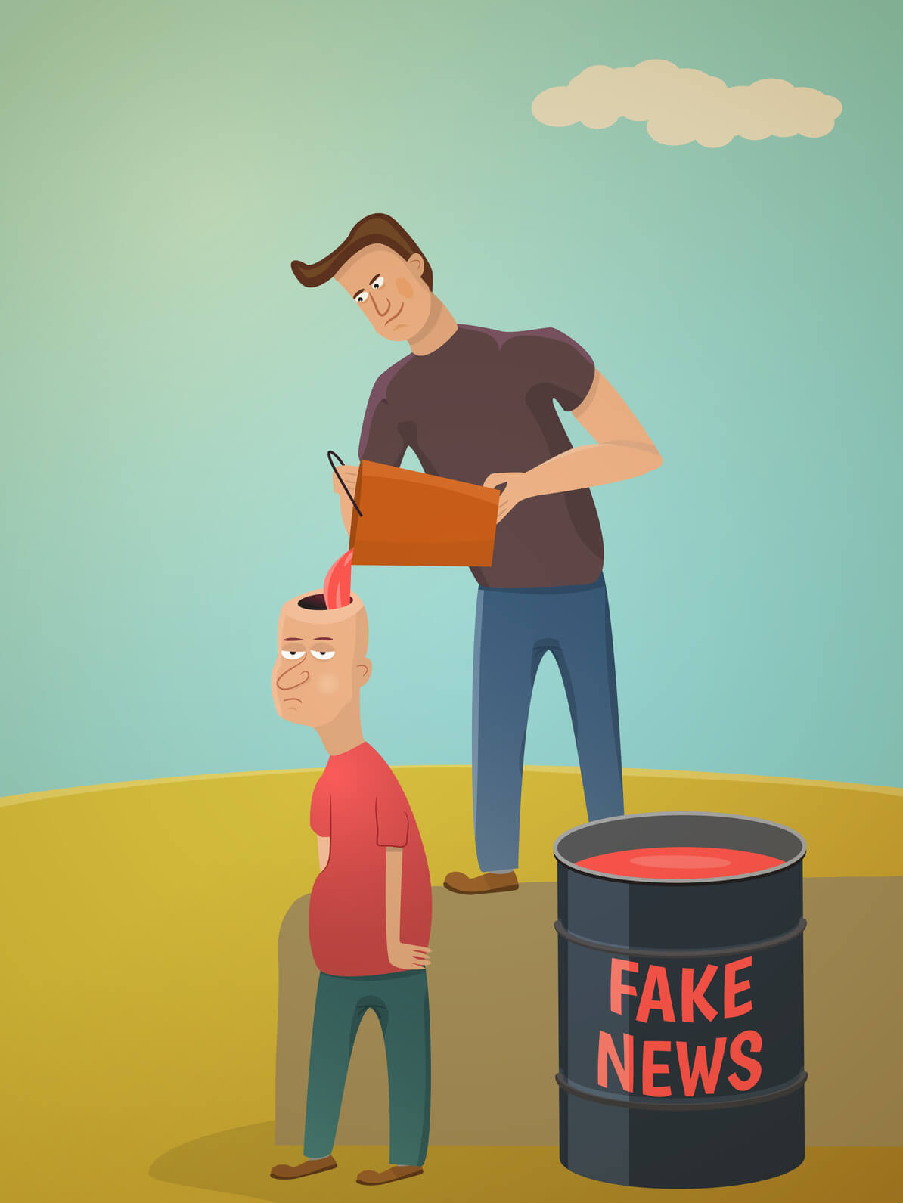
The post-truth
Fake news and post-truth go hand in hand, this concept refers to all information that is not based on objective facts, but rather appeals to the emotions, beliefs or desires of the public.
As a curious fact, the director of the Royal Spanish Academy, Darío Villanueva, commented that this concept will be included in the dictionary, since we are facing a panorama of great changes in information.
''A lie repeated a thousand times becomes a truth'' Göebbels.

Slide 90
Types of bad information
There are different types of misinformation or misinformation that we encounter every day on the Internet and it is important to know how to differentiate between them.
It is not intended to harm anyone.
When genuine sources are impersonated
New content that is predominantly false, designed to mislead and mislead
Genuine content is spread with false context information
Headlines, images or captions do not confirm the content
Information or images are manipulated to deceive
Deceptive use of information to incriminate someone or something
impostor content
fake connection
manipulated content
satire or parody
manufactured content
false context
misleading content

Slide 91
Types of bad information
There are different types of misinformation or misinformation that we encounter every day on the Internet and it is important to know how to differentiate between them.
It is not intended to harm anyone.
When genuine sources are impersonated
New content that is predominantly false, designed to mislead and mislead
Genuine content is spread with false context information
Headlines, images or captions do not confirm the content
Information or images are manipulated to deceive
Deceptive use of information to incriminate someone or something
impostor content
fake connection
manipulated content
satire or parody
manufactured content
false context
misleading content

Slide 92
Learn to deny a Fake News
Once we identify false news, we must learn to deny it effectively and not fall into actions that put us in the same place as the creator of the Fake News.
Do no harm. Before discrediting, you have to make sure that it is truly a fake new.
Using personalized searches in our Internet browser Google gives the option to customize our search in order to show our most reliable sources.
We check the image by dragging it to the upper tab in order to see where the image comes from and if it matches the news.
It is advisable to have a human search engine made up of people who can check the news and spread the truth.
Don't expect everyone to be reached as the spread of fake news is a real business, so it will be an unequal war.

Slide 93
Fallacies that can lead to mistakes.
A fallacy is understood as an argument that seems valid but is not. These fallacies can appear on purpose to try to deceive someone or by mistake. We can find a fallacy but with a correct conclusion, that is, the way of presenting such an argument is wrong.

Slide 94
Fallacies that can lead to mistakes.
ARGUMENT ‘’AD HOMINEN’’ | We assume that a piece of news is true because it is said or defended by a certain person who for us has a high point of wisdom or a high status. Example: Did Pablo say that? Then it must be true, as a child he was the best in class.
FALSE DICHOTOMY | This argument tries to present only two options as the only possible ones, when many more could well appear. Example: Juan did not go to today's exam. He is sick or afraid to fail.
ANECDOTAL FALLACY | This argument tries to use a personal experience or an isolated case, insufficient against a scientific argument. Example: Smoking is not so bad, my grandmother has smoked all her life and has reached 93 years.
FALLACY OF THE APPEAL TO TRADITION | This argument tries to justify itself by basing itself on the fact that it conforms to the customs of a society or its norms. Example: You have to defend bullfighting, it has been around all your life.
AVOIDANCE OF THE BURDEN OF PROOF | It is about assuming that something is false or true without providing any type of argument to support it, refusing to listen to other information. Example: I don't care what you tell me, Covid-19 is a government plan to control us.

Slide 95
Activity: Sherlock Holmes
We are going to work in groups
Each group are going to search some articles that can be about different topics (environmental, political, etc)
When each group has selected their articles, they are going to verify the information about them.
Then, each group will say which articles are not truthful.

Slide 96
Disclaimer:
Funded by the European Union. Views and opinions expressed are however those of the author(s) only and do not necessarily reflect those of the European Union or the European Education and Culture Executive Agency (EACEA). Neither the European Union nor EACEA can be held responsible for them.

Slide 97
Key competences for people 50+
Course: Digital Competences

Slide 98
1. What is Digital Content Creation?
It focuses on…
Creating and editing digital content.
Improving and integrating information and content into an existing body of knowledge while understanding how copyright and licences are to be applied.
Knowing how to give understandable instructions for a computer system.

Slide 99
Digital Content Creation
Creating Digital Content…
is an important part of any digital marketing strategy.
Every part of the content you create including:
newsletters
blog posts
case studies
must be carefully designed to guide your brand prospects, maximize organic links, and increase conversions.

Slide 100
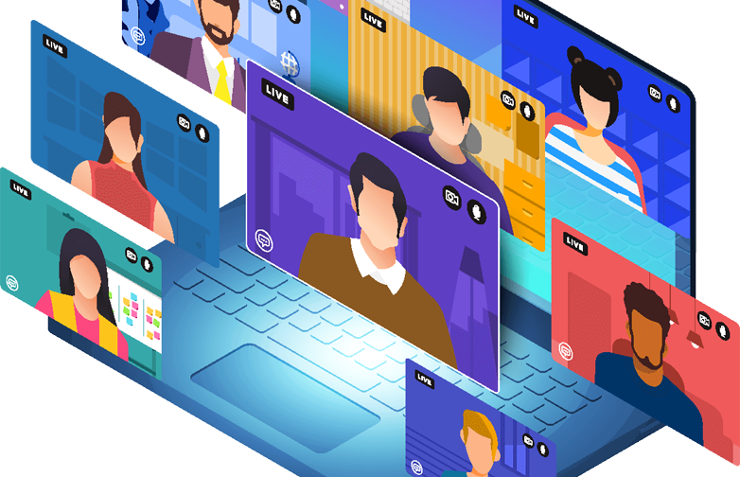
Types of Content
Written content: Blogs, SEO articles, white papers, eBooks, emails, social media posts.
Imagery: Infographics, GIFs.
Audio: Podcasts, audiobooks.
Video: Animations, webinars, talking heads.

Slide 101
Types of Format
Infographics: Best for visualizing processes or displaying statistics, infographics are valuable top-of-funnel content that provide readers with quick, actionable insights.
Blogging: Blogs and articles often form the heart of content marketing campaigns because they are bite-sized enough for readers to consume in a single sitting while also providing the time and space to dive deeply into a particular topic.
Podcasts: Audio formats like podcasts enable brands to add a personal touch to their web presence. Plus, they’re great for repurposing written content.
Videos: Animations, interviews and other video content is highly engaging for both B2C and B2B customers.

Slide 102
Types of Format
Case studies: Providing third-party evidence of your brand’s value, case studies offer decision-makers useful information.
Webinars: This type of visual content provides your audience with detailed information on a single topic while giving viewers the opportunity to ask questions and interact with you directly.
White papers: Another form of written content, white papers typically involve more research than the average blog article.

Slide 103
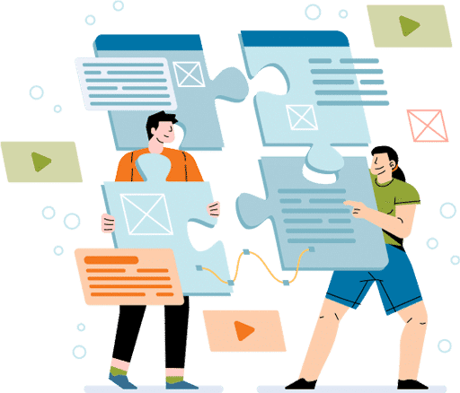
Successful Digital Content Creation
Determine the purpose
Create useful, quality content
Promote content on social media
Use photos and multimedia
Track and analyze content

Slide 104
Activity: Word Cloud
Participants will be provided with a “participation” link from the online platform Mentimeter which they must access through their mobile device or computer.
Through this link, each participant will be able to enter three words to build a word cloud in a collaborative way. So, each participant has to enter three types of digital content that they have learnt and click on “submit”.
3. Once the words have been entered, the word cloud will be appeared completed. Discuss together what types of digital content you have selected and if they are right or not.

Slide 105
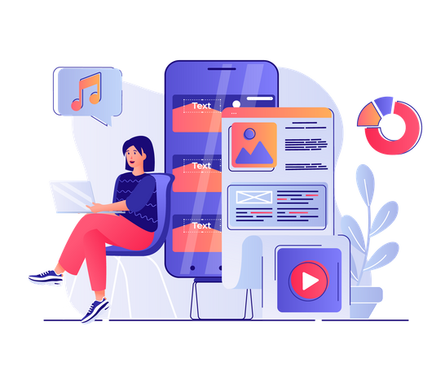
2. Developing Digital Content
It is essential…
To create and edit digital content in different formats
To express oneself through digital means.

Slide 106
Why is it important?
Digitalisation has led to a decreasing use of analogue media in both private and professional contexts. Most people write letters far less often than they send a photo via a messenger, for example. Only digital content can be made available on and distributed via the internet. In addition, digital content is more “sustainable” than analogue content. A digital text exists without a limit in time, while, for example, a printed text can get lost or damaged.

Slide 107
Activity 1 : Creating a Blog
Depending on how many computers are available, students will work alone or in paris. The teacher must show how to create a WordPress account. It is on their own accounts that participants will then post their blog.
STEPS
Step 1: Think about what you want to show in your blog.
Step 2: Go to https://wordpress.com/ to create an account. Fill in your email address, username and password. Participants must provide a valid email address, as they will have to refer to their inbox: WordPress will send them a mail for the validation of their account.
Step 3: Create the blog title and decide on the themes and objective.
Step 4: Choose the free plan
Step 5: Take time to write something you want to share on your blog
Step 6: Add a new post.

Slide 108
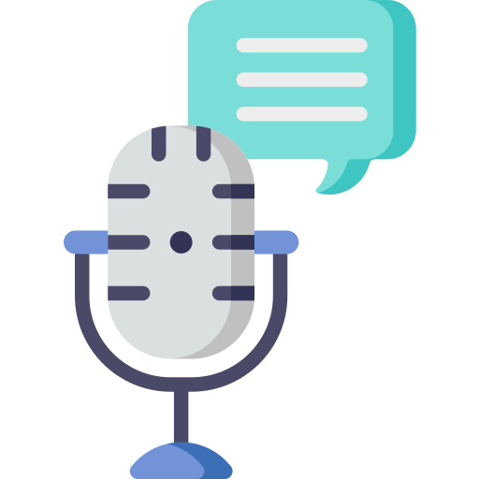
Activity 2: Making a Podcast
Steps
Talk about, if needed, the basics of sound production.
2. Hold a brainstorming session to determine the theme of the podcast and how to organise the following steps. Try choosing something simple and quotidian, for example life at your local library. Or take a theme broad but not easy to approach like: what is it to be young today? Or take a theme more specific like the World Cup, climate change, etc.
3. Participants will have to decide on a name. The show should last 20 minutes. The time can be shorter if there are few students. Everything needs to be timed to the second!
Making a podcast will allow students to put themselves in the shoes of a journalist or podcast. This activity aims to explain what goes in to the preparation of a radio show. Everyone will have a particular role to play while all working towards a common goal.
By the end of this session a theme will be chosen. Workshops 2, 3 and 4 will focus on recording tools and interview techniques. The final one will culminate in the recording of the interview.

Slide 109
Activity 2: Making a Podcast
4. The show will consist of:
a report
a studio interview
a info brief
a debate
the presenter’s speaking time
5. Choose at random each participant’s role.
6. The teacher manages proceedings but will not have another specific role in the production. There will be: presenters, reporter, interviewers, journalist, etc.
7. Once the theme is decided, determine the content of each part of the show. For this, each student will do research. They can divide themselves into groups of 2 or 3. They need to find:
A reporting subject (there can be two subjects if there are many participants)
A debate subject
A person to interview

Slide 110
Activity 2: Making a Podcast
For the info brief, everyone can write down ideas. It will be the journalist in charge who will decide what they want to develop. Leave two hours for the groups to research using the available resources: computers, books, magazines, etc. Insist that the more the exchange ideas between them, the more those ideas will develop. After two hours, discuss what they came up with. Each group will propose their ideas for a report, an invitee (has to be realistic) and for the debate. They will defend their ideas.
Their goal is to have their ideas accepted for the show. When everyone has defended their ideas, go to a vote to determine the subjects. For example: The invitee: A person who has established an organisation to support victims of sexual harassment The subject: A day with the local women’s soccer team, focusing on addressing sexist prejudice in sport The round table: Where should we draw the line between humour and sexism?

Slide 111
Activity 2: Making a Podcast
Possible order of the show
Introduction/summary: 1 minute
Info brief: 2 minutes
Report intro: 1 minute
Report: 1.5 minutes
The presenter questions the journalist on the subject report: 2 minutes
The presenter introduces the interview: 30 seconds
Interview: 4 minutes
Debate: 7 minutes
Conclusion: 1 minute

Slide 112
3. Integrating and re-elaborating digital content
It is essential…
To modify, refine, improve and integrate information and content into an existing body of knowledge.
To create new, original and relevant content and knowledge.

Slide 113
Why is it important?
A large number of citizens use the internet to meet their daily information needs. However, the availability and quality of knowledge and information are not self-evident on the internet. If many people contribute knowledge, new knowledge can be generated or the quality of already available content can be improved. On the other hand, knowledge can be made accessible to many people. This is then called a “democratisation of knowledge”.
The amount of information available on the internet is constantly increasing. Internet users themselves are also constantly creating new content (“user-generated content”). This content is either created together online or published by individuals.

Slide 114
6 steps for a profitable digital content creation
1. Understand the Key Fundamentals and Foundations of Digital Content Strategy
Know Your Content Goals
Know Your Content Differentiation Factor (CDF)
Know Your Topic Area(s)
2. Understand Your Audience
Do Audience Research
Create Audience Personas for Your Content Strategy
3. Know How SEO Fits into a Digital Content Strategy
Research Targeted Keywords Your Ideal Buyer Is Searching

Slide 115
Activity 1: Discussion
Read and discuss the following questions:
What is a selfie?
How often do you take selfies? Why do you do that?
How might people perceive someone who is known for posting a lot of selfies?

Slide 116
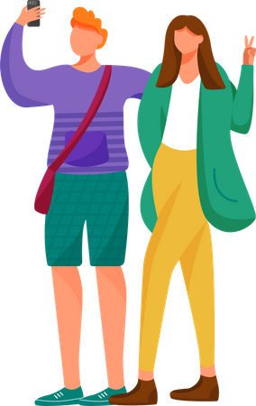
Activity 2: Let’s take a selfie!
In this activity we are going to learn to make the best selfie.To do so, each participant will use his/her phone and has to follow the instructions below:
Set the front facing camera to give you a direct shot at your face not whatever is in front of you.
Think about the image you want to give to others and check the background. Find where you want to take your selfie and make sure you smooth out anything you feel fit too and choose a pose or feel free to try out multiple poses if you feel ambitious.
Take into account the light, the position of the camera, effects, and other relevant aspects:

Slide 117
Activity 2: Let’s take a selfie!
Wipe your lens
Remember to focus (all you have to do is tap your display where you want to focus)
Avoid the zoom (to avoid pixelated photos)
4. Take your selfie !!
Participants will be encouraged to choose the selfie they consider the best one !

Slide 118
Disclaimer:
Funded by the European Union. Views and opinions expressed are however those of the author(s) only and do not necessarily reflect those of the European Union or the European Education and Culture Executive Agency (EACEA). Neither the European Union nor EACEA can be held responsible for them.

Slide 119
Key competences for people 50+
Course: Digital Competences

Slide 120
4. Copyright and Licenses
It is essential…
To understand how copyright and licenses apply to data, digital information and content.

Slide 121
Meaning of Copyright
Copyright refers to the rights that belong to the person who created (or who otherwise holds the relevant rights) a work (e.g. drawing, photo, play, article, video, song).
CC License: Creative Common License
Creative Commons licenses give everyone from individual creators to large institutions a standardized way to grant the public permission to use their creative work under copyright law.

Slide 122
Why is it important?
Just because texts, images, graphics, etc., are easy to find and freely accessible on the internet, they do not belong to anyone and can therefore not be used as desired for their own purposes. The person who created the content is referred to as the author and is usually also the owner of the work. A work providing a minimum degree of individuality and originality is referred to as a person’s intellectual creation and is thus automatically protected by copyright.
So, copyright law protects the (intellectual) property of individuals. Digitally competent people should therefore be aware of the legal situation and be able to deal properly with works created by others on the internet. If you create content yourself and make it public, knowledge about your own rights as an author as well as the opportunities of licensing your own work is essential.

Slide 123
Types of Licenses
Attribution-NoDerivs (CC BY-ND)
This license lets others reuse the work for any purpose, including commercially; however, it cannot be shared with others in adapted form, and credit must be provided to you.
Attribution-NonCommercial (CC BY-NC)
This license lets others remix, adapt, and build upon your work non-commercially, and although their new works must also acknowledge you and be non-commercial, they don’t have to license their derivative works on the same terms.

Slide 124
Types of Licenses
Attribution-NonCommercial-ShareAlike (CC BY-NC-SA)
This license lets others remix, adapt, and build upon your work non-commercially, as long as they credit you and license their new creations under the identical terms.
Attribution-NonCommercial-NoDerivs (CC BY-NC-ND)
This license is the most restrictive of our six main licenses, only allowing others to download your works and share them with others as long as they credit you, but they can’t change them in any way or use them commercially.

Slide 125
Activity 1: Licenses
Adults will draw a cactus on an A4 sheet to be signed by them. This signature will define how they would like to be known by their audience (a pseudonym or something else). Invite participants to describe it to others, in their own words, what they would allow or not allow to be done with their work. Possible questions:
Would you allow a corporation to use your cactus to advertise their product?
Would you accept that they be used by teachers in their fine arts classes?
Would you agree that they be used for a book cover?

Slide 126
Activity 2: Copyright
In this activity, you will present five situations to participants. They will need to decide in groups whether the use of the work in each situation respects copyright law. The groups with the right response will win a point. At the end, check the totals to determine the winner.
Scenario 1: Estelle, 9 years old
Estelle downloads a photo of a pumpkin from the site flickr.com. The photographer indicated that the photo has been distributed under the license Creative Commons CC BY-NC. Estelle modifies the photo by adding a ghost, then posts it on her blog mentioning the name of the original author.
Answer: Estelle is allowed to use it, change it and post it on our blog since she cited the name of the original author. However, she cannot use the photo for commercial objectives. If we take it for granted that Estelle’s blog does not generate revenue, she has respected copyright. There will be no going to prison for Estelle.

Slide 127
Activity: Copyright
Scenario 2 : Paul, 11 years old
Paul finds a photo of a volcano on wikimedia. The photographer indicated that the photo is under the Creative Commons licensing CC BY-BC-SA.He snips the photo to use it as the banner photo for his new website. He makes sure to add the name of the author and indicate the licensing.
Answer: Paul is allowed to copy the photo, change it and use it as the banner of his website, since he has properly cited the name of the original author. Since he isn’t allowed to use it for commercial purposes, we will take it for granted that his website does not generate profits. In order to conform to copyright, he must add CC BY-NC-SA in order to indicate the licensing to other users. The photo will thus be distributed under the same rights that were accorded to it initially. For this reason, he has properly respected copyright.

Slide 128
Activity: Copyright
Scenario 3 : Tom, 10 years old
Tom is good at photography. He has found a photo online that was taken last year. There is no mention of author nor the © symbol. Tum assumes the photo is in public domain and that he can use it. He then posts it on his website.
Answer: A work that doesn’t indicate the copyright licensing does not automatically belong to the public domain. Most countries are signatories of the Berne Convention for the protection of literary and artistic works. This convention has it that almost all published original works are protected by copyright whether it is mentioned or not. Therefore, even if a website does not precisely mention licensing nor copyright nor the © symbol, the author of a work reserves the exclusive right to print, distribute and copy it. If Tom wants to use or modify the photo, he must get permission from the author and pay fees if required.

Slide 129
Activity: Copyright
Scenario 4: Madeleine, 9 years old
Madeleine finds a video of a cat birthing kittens on YouTube. The video is protected by copyright. Madeleine is working on a video for a science project on cats. She uses an extract from the YouTube video in her project and includes the name of the original author.
Answer: The video is used in the context of an educational project. Only the portion of the video necessary is used. Its use has changed the original context and has added value to the new context, i.e., it does not represent a simple copy of the original. The original creator’s name has been mentioned. As the video is not explicitly placed under Creative Commons licensing, this means it uses YT’s standard licensing. Madeleine is therefore allowed to use a portion of it for her project. Where required, she can also circulate it in its entirety but only via YT.

Slide 130
Activity: Copyright
Scenario 5 : Marie, 13 years old
Marie is preparing a digital portfolio of her visual art. She has posted photos of her works on the homepage of her website. To improve the presentation, she has added background music to her site. She has added a song by the Flaming Lips which will play on repeat. She knows that the song is protected by copyright.
Answer: The song cannot be used under these conditions. The song is being used for a purpose outside an educational or research context, the use has not recontextualised the work, nor does it add value: it is a simple copy of the original song. The use of the song in this way could cause financial loss to the copyright holder, since their name is not mentioned alongside the availability of the song on Marie’s website.

Slide 131
5. Programming
It is essential…
To plan and develop a sequence of understandable instructions for a computing system,
To solve a given problem or perform a specific task.

Slide 132
Why is it important?
Today’s world cannot be imagined without apps, computers, programmes, websites, smartphones and many other technologies. To understand how these things work requires at least a basic understanding of programming and computational thinking as a basis. This involves the ability to understand that programming requires analysing problem-solving steps, identifying patterns and defining processes. In order to write various codes, different programming languages are needed as a further step.
Digitally competent people are able to understand digital processes in a computer system or programme and have a basic understanding of programming. Computational thinking is closely related to actual programming. This involves, for example, defining problem-solving steps, that should take place in a certain order (parallel or sequential). This allows individuals to create comprehensible instructions for a computer programme or app and to solve digital problems.

Slide 133
Key Computer Programming Terms
Command: an instruction for a computer.
Sequence: A sequence is a series of actions that is completed in a specific order to complete a task.
Program: an algorithm/sequence that is written for a computer.
Selection: A decision within a computer program when the program decides to move on based on the results of a event.
Loop: The repetition of a block of statements within a computer program.
Behind all of the software we use on a daily basis, there's a code being run with all sorts of terms and symbols. Surprisingly, it can often be broken down into three simple programming structures called sequences, selections, and loops.

Slide 134
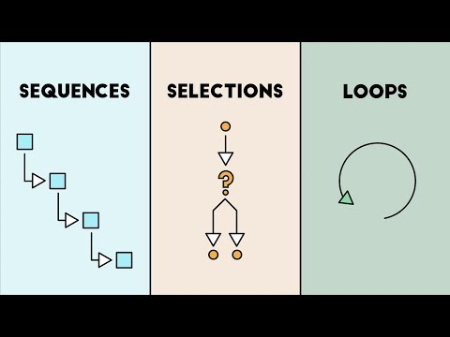
Sequences, Selections and Loops

Slide 135
How it works?
A sequence we do every day is a morning routine. You might wake up, drink some water, take a shower, eat breakfast, and so on. Everyone's routine is different, but they're all made up of a sequence of various actions.
Selections are a bit different. Instead of following a specific order of events, they ask a question in order to figure out which path to take next. Let's say you go to brush your teeth, and you find that you're out of toothpaste. You'd then ask, "Do I have any more toothpaste?" If the answer is no, then you would add it to your shopping list. But if the answer is yes, you would just use the toothpaste. This is really all a selection is doing: answering a question based on what it finds.

Slide 136
How it works?
3. The third programming structure is a loop. Like selections, loops ask questions. However, the difference is that they ask the same question over and over and over again, until a certain task is complete.
For example, take the act of hammering a nail. Even though you may not realize it, you're constantly asking yourself, "Is the nail all the way in?" When the answer is no, you hammer the nail again. You continue to repeat this question until the answer is yes, and then you stop. Loops allow programmers to efficiently code repetitive tasks instead of having to write the same actions over and over again.

Slide 137
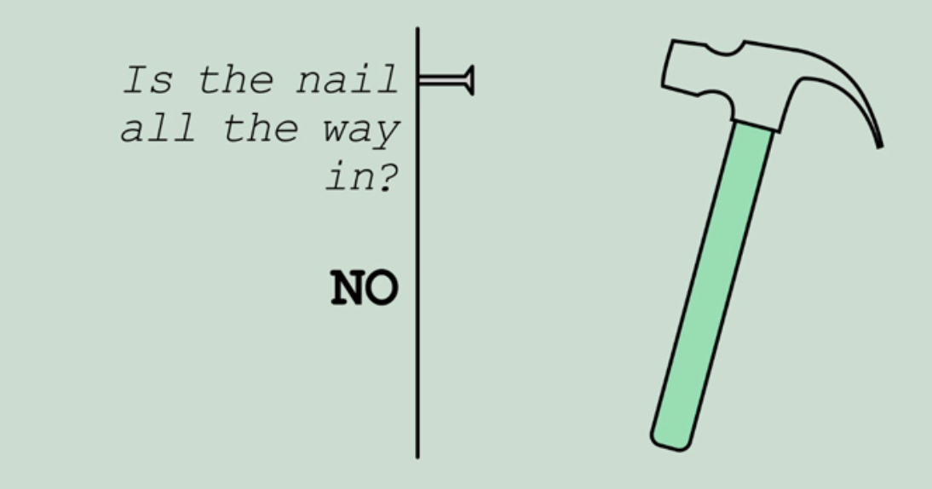
How it works?
These three programming structures may seem pretty simple on their own, but when combined they can create some pretty complex software !!

Slide 138
Activity: Think and Discuss
Take some minutes to think about actions or activities that you do on a daily basis or with certain frequency (e.g. bake a cake) and provide a list of statements in order. For instance, if you usually cake a bake, what is the sequence of statements you follow until you complete that task?
Could you also mention an activity in which it is repeated a block of statements (repetition)?

Slide 139
Disclaimer:
Funded by the European Union. Views and opinions expressed are however those of the author(s) only and do not necessarily reflect those of the European Union or the European Education and Culture Executive Agency (EACEA). Neither the European Union nor EACEA can be held responsible for them.

Slide 140
Key competences for people 50+
Course: Digital Competences

Slide 141
Communication and Collaboration (What is it based on?)
Interaction with others
communication by using digital technologies
awareness of cultural and generational diversity
participation in society through public and private digital services and participatory citizenship.

Slide 142
What does participatory citizenship mean ?
It means that a citizen is active at different levels (local, national) in addressing social issues that are relevant to the community e.g. learning how governments work or being aware of current affairs.

Slide 143
Competences
Interacting through digital technologies
Sharing through digital technologies
Engaging in citizenship through digital technologies
Collaborating through digital technologies
Netiquette
Managing digital identity

Slide 144
1. Interacting through digital technologies (What is it for?)
To interact through a variety of digital technologies
To understand appropriate digital communication means for a given context.

Slide 145
Examples
Understanding the pros and cons of the internet's possibilities for political debates and sharing political messages. For example, viral media.
For example, I know professional or social networks such as Meetup, Pinterest, Flickr, LinkedIn, Blogster, Youtube and Twitter.
For example, I often comment on newspaper articles, write on a blog, share posts on social media or participate actively in a professional network.

Slide 146
Activity: Organising Information
The goal of this activity is to learn to organise the information we know about people, places and news online. By reading a phrase, a headline, an article, etc., they will have to be able to make categories associated with keywords. For this, divide participants into groups of three:
The first person says one phrase from the list below
The second responds as quick as possible with the first word that comes to mind
The third writes the new word

Slide 147
Activity: Organising Information
LIST 1
Shawn Mendes
Global warming
Hitler
Donald Trump
Paris
LIST 2
Sleeping beauty
Minister of Justice
Assisted reproductive technology
Endangered species
Bird flu
LIST 3
First World War
South Africa
Bizum
Ryanair fired 900 pilots last week
Instagram

Slide 148
2. Sharing through digital technologies (What is it for?)
To share data, information and digital content with others through appropriate digital technologies,
To act as an intermediary,
To know about referencing and attribution practices.

Slide 149
Examples
You have the ability to express an opinion or a feeling by using a certain tone when writing a text.
Writing an email quickly and that conveys the meaning clearly and without misunderstandings.
Know the principles of digital collaborations and understand how to coordinate a project with a team.
You are familiar with and can use a variety of digital collaboration tools for working together in a group.

Slide 150
3. Engaging in citizenship through digital technologies (What is it for?)
To participate in society through the use of public and private digital services.
To seek opportunities for self-empowerment and for participatory citizenship through appropriate digital technologies.

Slide 151
Examples
Doing paperwork online like submitting the personal income tax return, paying fines,
doing business with the bank,
buying online,
use of Paypal,
use of a digital certificate.

Slide 152
Activity: Persuasive Ads
Create a flyer/poster or t-shirt with the call-to-action being to stand up against cyberbullying.
You can use applications like Canva or Google Drawings, and create paper-based posters.
Show the result with the rest of the class.

Slide 153
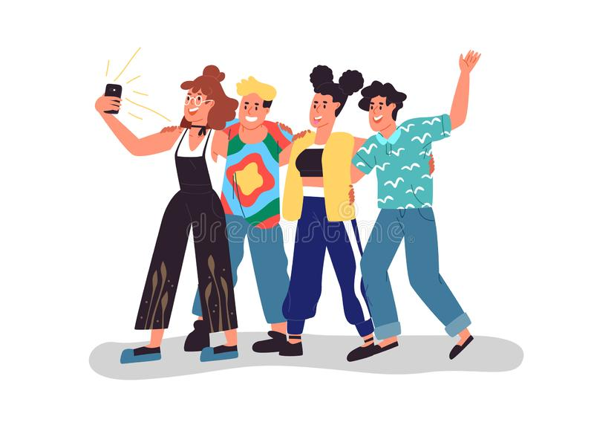
Who do you chat with?
Have you ever chatted with someone online? Who do you chat with? How often?
What risks can there be? Make a list and share it with your partner.

Slide 154
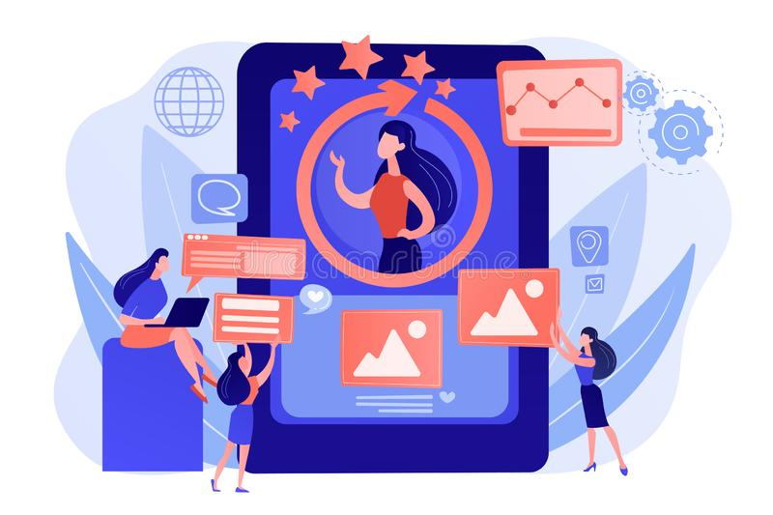
4. Digital Identity (What is it for?)
A digital identity is all the information that a person or an organisation has online. This information can be:
Date of Birth
ID Numbers
Photos, likes, comments on Social Media
Search Queries

Slide 155
4. Digital Identity (Why is it important?)
Your digital identity is what you show to the rest of the world and what distinguishes you from other people
A professional profile could help you to find a job
You can share your opinions or ideas on social media
Fosters communication between young people

Slide 156
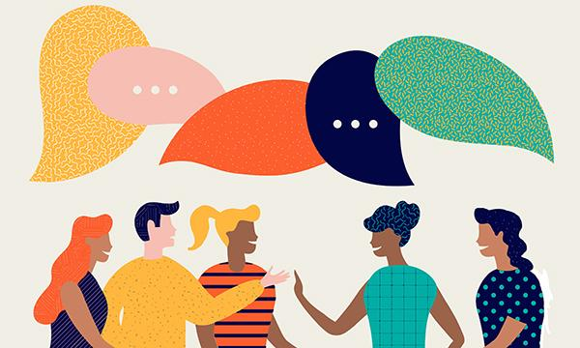
Activity 1: Online & Offline
Form groups of 3 or 5 and discuss:
Is there a difference between how you portray yourself online and how you present yourself in real life?
Make a list of the things you do online that you wouldn’t do face-to-face.
Share your list with your group and see what you have in common.

Slide 157
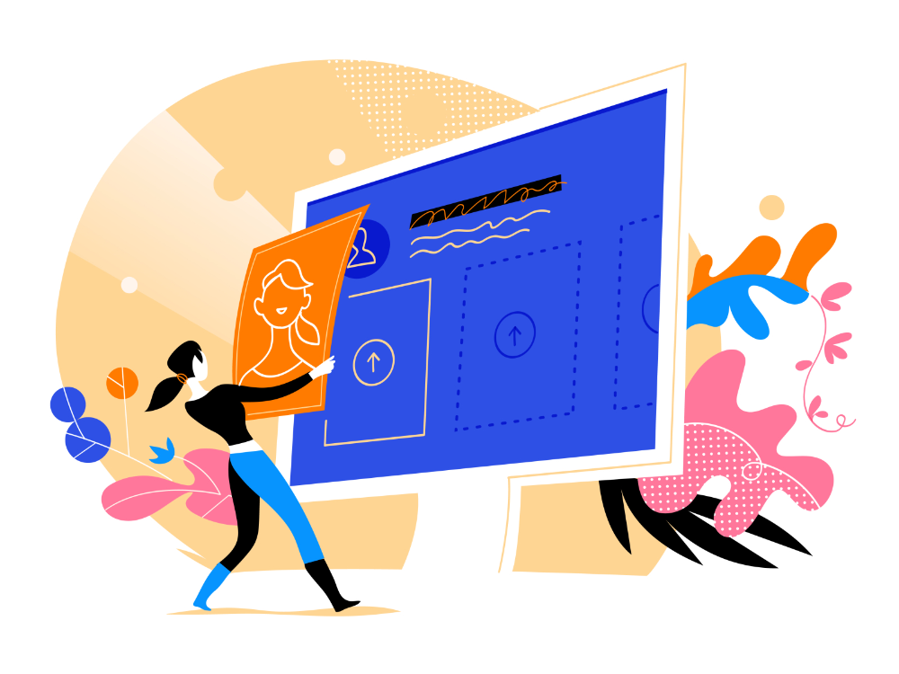
How to Improve your Digital Identity
Think about what you want to share online
Remove everything that makes you uncomfortable
Distinguish between:
Professional and personal
Public and private

Slide 158
Activity 2: A Good Profile
On a piece of paper, create your own profile that is focused on be leader in the session.
You can put your personal information, your skills, if you have any work experience…
Don’t include anything that is not ‘’professional’’
Then, in groups share your profiles and decide which one you like the most.
The most voted will be presented to the rest of the class.

Slide 159
Disclaimer:
Funded by the European Union. Views and opinions expressed are however those of the author(s) only and do not necessarily reflect those of the European Union or the European Education and Culture Executive Agency (EACEA). Neither the European Union nor EACEA can be held responsible for them.

Slide 160
Key competences for people 50+
Course: Digital Competences

Slide 161
5. Collaborating through digital technologies
To use digital tools and technologies for collaborative processes, and for co-construction and co-creation of resources and knowledge.

Slide 162
Components
People :You must develop workflows and establish practices that ensure everyone is communicating appropriately about different assignments so they’re not producing unnecessary work or duplicating their efforts.
Collaborative tools: Your choice of technology along with how well-trained employees are in using it will determine whether you can effectively and efficiently collaborate digitally.
Devices : are also important components of digital collaboration.

Slide 163
Activity 1: Discover
Head to the official site: openstreetmap.org.
If it’s your first time using the service:
Create an account. You can follow this activity without an account, but you will not be able to publish your changes online.
If you are using a device on which OsmAnd hasn’t been used before:
Install the OsmAnd app on the phones and/or devices you will use for this workshop
Download the maps (see below)
Activate the OpenStreetMap Editing plugin (see below)
If you are using a device on which OsmAnd has been used before:
Open the app and check that the maps are up to date

Slide 164
Explore OSM
Once on the homepage, use the search bar to find your city. Use the + and – buttons on the right to change the zoom level and show different scales:
All information visible on the map, each street traced, each building contour, was added by volunteer users. It is these people that form the OSM’s community. It is also possible to contribute to the database without weekend excursions for example by adding simple information on a place simply using your smartphone, tablet or computer. This is what we will do during this workshop. This sheet will show you how to add information to OSM that everyone can then consult and edit. As the internet has no borders, information added can be viewed by anyone, regardless of where they are.

Slide 165
Activity 2: Contribute to wikipedia
You can contribute to wikipedia with:
proofread articles
illustrate articles
improve layouts
review introductions
To do this activity you have to:
Do some research about a topic you like
Make sure the information is trustful
Ask partners for opinion
Contribute to wikipedia!

Slide 166
Netiquette
To be aware of behavioral norms and know-how while using digital technologies and interacting in digital environments.
To adapt communication strategies to the specific audience and be aware of cultural and generational diversity in digital environments.

Slide 167
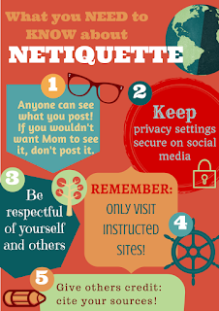
Examples
Avoid posting inflammatory or offensive comments online.
Respect others' privacy by not sharing personal information, photos, or videos that another person may not want published online.
Never spam others by sending large amounts of unsolicited email.
Show good sportsmanship when playing online games, whether you win or lose..
Don't swear or use offensive language.
Avoid replying to negative comments with more negative comments. Instead, break the cycle with a positive post.
Thank others who help you online.

Slide 168
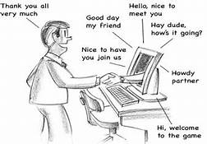
Activity: Online behaviour
We are exposed to all kinds of online content, some of it with negative messages that promote bad behavior.
Have you (or anyone you know) seen someone be negative on the web? How did that make you feel?
Have you (or anyone you know) ever experienced a random act of kindness on the web? How did it make you feel?
What simple actions can we take to turn negative interactions into positive ones?

Slide 169
Card game
We will have different cards with comments and students have to classify the cards into three categories:
Comments with a positive tone
Comments with a negative tone
Comments with a context-dependent ambiguous tone
Then, once the comments are sorted, they will give their thoughts on the following:
which of the three comments that have the broadest number of different interpretations
which of the three comments that are most susceptible to cause conflict if they are misinterpreted
Finally, ask them to think of different possible interpretations for each comment.

Slide 170
Card game
Did you see his clothes?
I can’t believe this!
She is weird.
What were you thinking?
Today has been amazing:)
Hmm…
7. I am not sure
8. That is crazy!
9. I don’t like him.
10. What a nerd.
11. She is a great friend.
12. I am disappointed
13. This is not like him…

Slide 171
Managing Digital Identity
To create, and manage one or multiple digital identities.
To be able to protect one’s own reputation and to deal with the data that one produces through digital tools, environments and services.

Slide 172
How Can You Help Protect Your Digital Identity?
Limit sharing your Social Security number
Use strong and unique passwords on each of your online accounts
Don’t use unprotected webpage
Don’t share your login credentials with others
Shred documents containing personal information before discarding
Don’t use public or unprotected WIFI networks
Review permissions and privacy policies
Update your software regularly

Slide 173
Activity: Create a digital identity
Each group member will have to create their own digital identity. To do this, they fill in the blank fields of the document in annex.Give out a blank digital identity sheet (in annex) to each participant. If you have enough time, participants will be able to include more photos or draw pictures to explain which images they might share to add to their digital identity.
Remember that you don’t need to put true information, the things they do include have to make them recognisable online there has to be a certain logic to the information.
Emphasise that what counts is to be recognisable and that giving out true information carries risks. People online might use your personal information in order to pass themselves off as you. We call this identity theft. Brands and companies can also harvest information on you in order to target ads and products that you may be more susceptible to buy!
When they are finished, allow them to present their virtual identities. Question them on the choice to include or omit true information.

Slide 174
Example
This is an example of a simple sheet, but you would have to add more things like:
Physical descriptions
Hobbies
Favourite subjects at school
Personality traits

Slide 175
Disclaimer:
Funded by the European Union. Views and opinions expressed are however those of the author(s) only and do not necessarily reflect those of the European Union or the European Education and Culture Executive Agency (EACEA). Neither the European Union nor EACEA can be held responsible for them.

