Slide 1
Key competences for people aged 50+
Course: Entrepreneurship
Self-awareness - the art of self-insight
Module 1

Slide 2
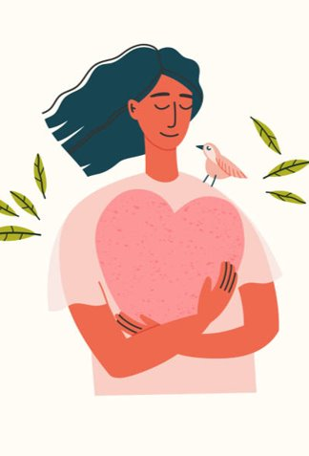
"Self-awareness is the development of a personality that is made beautiful by happiness and love."
- August Witti

Slide 3
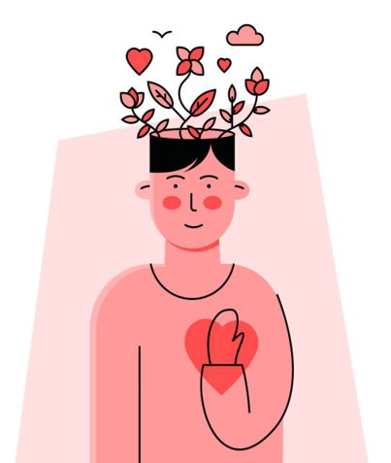
SELF-AWARENESS
as an element of
EMOTIONAL INTELLIGENCE

Slide 4
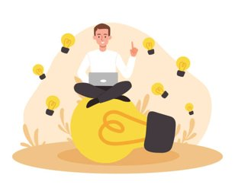
SELF-AWARENESS - MONITORING OUR INTERNAL AND OUTSIDE WORLD.
INTERNAL SELF-AWARENESS:
Observation of own emotions, reactions, values, ambitions, expectations, desires, aspirations.
Being aware of one’s own strengths and weaknesses. Moreover, it is understanding what influence we have on others.
EXTERNAL SELF-AWARENESS:
Indicates to what extent we realize how we are perceived by others according to the above-mentioned categories.

Slide 5
5 COMPONENTS OF EMOTIONAL INTELLIGENCE - (Daniel Goleman)
DANIEL GOLEMAN
AMERICAN PSYCHOLOGIST
SCIENCE JOURNALIST
AUTHOR OF THE BESTSELLER "EMOTIONAL INTELLIGENCE"
In his book, he pointed out 5 elements of emotional intelligence.

Slide 6
EMOTIONAL INTELLIGENCE –
“The capacity for recognizing our own feelings and those of others, for motivating ourselves, and for managing emotions well in ourselves and in our relationships.” (Daniel Goleman)

Slide 7
The 5 Components of Emotional Intelligence:
Self-regulation (control over your emotions, self-control, conscientiousness, innovation)
Empathy (recognition of others’ emotions)
Social skills (control over the relationship with another person)
Motivation (self-motivating, commitment, initiative, optimism)
Self-awareness (knowing your own emotions, correct self-esteem, self-confidence)

Slide 8
BENEFITS OF SELF- AWARENESS (EXERCISE - BRAINSTORMING)

Slide 9
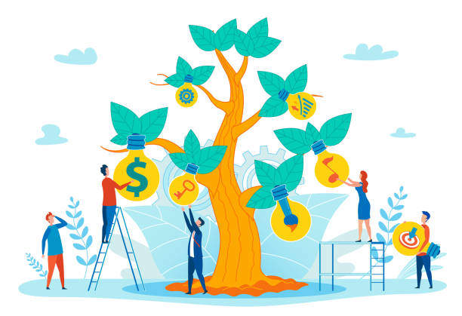
Understanding your own thoughts and feelings
Strengthening self-discipline
Increased self-esteem
Changing habits
Establishing good relationships
Strengthening self-discipline
Greater agency in decision-making
The ability to listen
More effective learning

Slide 10
8 PILLARS OF INTERNAL CONFIDENCE
Pillar 1 Self-awareness
Pillar 2 Self-acceptance
Pillar 3 Self-satisfaction
Pillar 4 Self-confidence
Pillar 5 Value
Pillar 6 Confidence in yourself
Pillar 7 Responsibility for your own life
Pillar 8 Positive attitude

Slide 11
HOW TO TAKE CARE OF OUR SELF-AWARENESS?
REGENERATION OF OUR BODY IS A VERY IMPORTANT FACTOR. WHEN WORKING ON SELF-CONSCIOUSNESS, WE NEED TO BE RESTED BECAUSE WITH INTENSIVE SELF- ANALYSIS, OUR ENERGY DEPOSIT QUICKLY VANISHES.
DON'T GIVE UP TO DEFENSE MECHANISMS DISTURBING THE RECEPTION OF REALITY,
TRUTH
WHEN WE DON'T WANT TO SEE SOMETHING, WE OFTEN HAVE TO PRETEND THAT WE DON'T CARE ABOUT SOMETHING, BECAUSE OF EMOTIONS , FEELINGS THAT MAY BE UNCOMFORTABLE, PAINFUL, WITH WHICH SOMETHING NEEDS TO BE DONE.
(EXERCISE)

Slide 12
WAYS TO INCREASE YOUR SELF-AWARENESS
STOP making the distinction between good and bad emotions
FEEL your emotions in your body
KNOW who or what is your “trigger”
KEEP an emotional diary

Slide 13
WAYS TO INCREASE SELF-AWARENESS
LOOKING FOR NEW EXPERIENCES
RECOGNIZING COGNITIVE DISTORTIONS
ANALYSIS OF VALUES
SEEKING OPINIONS FROM YOUR LOVED ONES ABOUT YOUR ATTITUDES, CHARACTERISTICS OR BEHAVIOURS

Slide 14
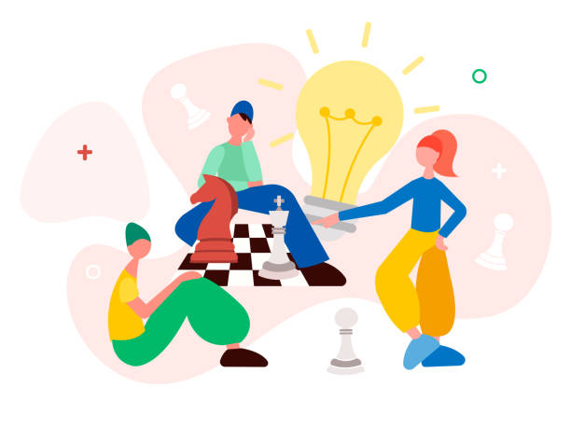
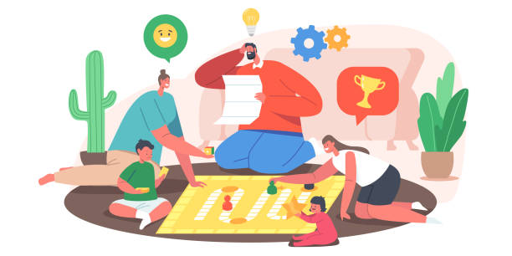
COGNITIVE PROCESSES ARE THE BASIS IN BUILDING SELF-AWARENESS.
COGNITIVE PROCESSES INCLUDE, AMONG OTHERS, THINKING, MEMORY, ATTENTION, PERCEPTION, INDEPENDENT PROBLEM-SOLVING, CONCEPT CREATION, INDEPENDENT PLANNING.

Slide 16
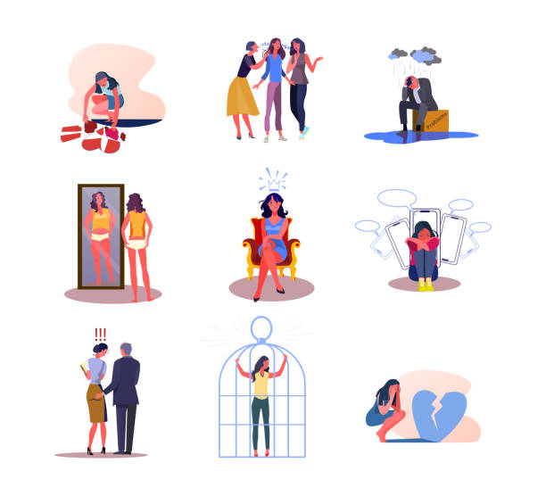
BELIEFS THAT FACILITATE AND LIMIT EFFECTIVE ACTION
LIMITING BELIEFS - HARMFUL BELIEFS THAT DO NOT SERVE US, HINDER OUR EMPOWERMENT, E.G.:
"I AM TOO OLD FOR THIS" ,
"I'M NOT SUITABLE FOR THIS"
"I DON'T DESERVE THIS"
"I CAN NOT AFFORD IT",
"I HAVE NO LUCK"
ETC.

Slide 17
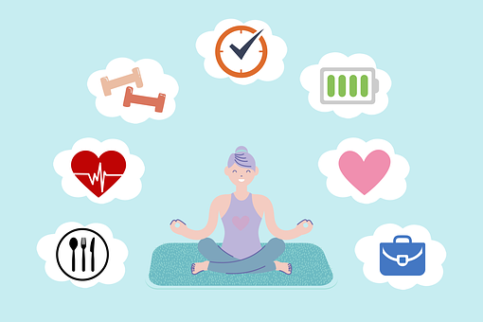
FACILITATIVE BELIEFS - POSITIVE, SUPPORTING, e.g.:
"I BELIEVE, I WILL GET THIS JOB",
"WHEN, IF NOT NOW",
"I CAN HANDLE IT",
"I DESERVE ALL THE GOODNESS I GET"
"EVERYTHING I NEED I ALREADY HAVE IN ME" ETC.

Slide 18
UNMASKING THE HABITS THAT HINDER EFFECTIVE ACTION
HABITS

Slide 19
WHAT CAN I DO TO MAKE MY ACTIONS EFFECTIVE?
STEPHEN COVEY DESCRIBED 7 HABITS THAT LEAD TO CONSTANT AND INTEGRATED GROWTH OF PERSONAL EFFICIENCY.
N1 - BE PROACTIVE
N2 - START WITH A VISION OF THE END
N3 - DO THE MOST IMPORTANT THING FIRST
N4 - THINK IN WIN-WIN CATEGORIES
N5 - FIRST UNDERSTAND, THEN BE UNDERSTOOD
N6 - SYNERGY
N7 - SHARPENING THE SAW

Slide 20
Disclaimer:
Funded by the European Union. Views and opinions expressed are however those of the author(s) only and do not necessarily reflect those of the European Union or the European Education and Culture Executive Agency (EACEA). Neither the European Union nor EACEA can be held responsible for them.

Slide 21
Key competences for people aged 50+
Course: Entrepreneurship
Advantages of knowing one’s strengths and weaknesses
Module 1

Slide 22
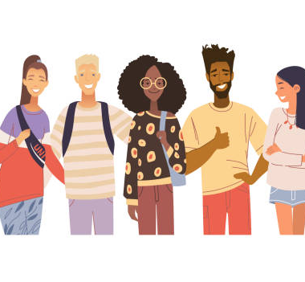
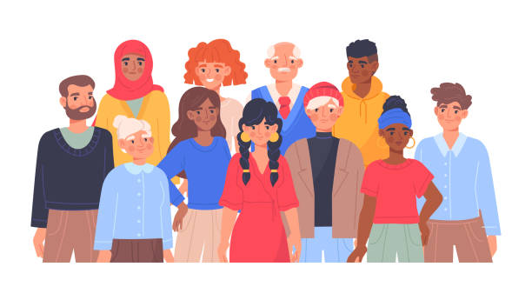
HUMAN PERSONALITY
A characteristic, relatively constant way of how an individual reacts to the social and natural environment, as well as the way of interacting with it.

Slide 23
FACTORS AFFECTING PERSONALITY
TEMPERAMENT
EDUCATION
ENVIRONMENT

Slide 24
BIG FIVE – THE BIG 5 PERSONALITY TRAITS

Slide 25
1. AGREEABLENESS
People characterized by this trait are positive about the world. As a rule, these individuals are very trusting, sincere, acting for the benefit of others. These people do not like conflicts.

Slide 26
2. OPENNESS TO EXPERIENCE
Open people can infect others with their warmth, they have no problem talking about feelings, they are aware of their own emotions. They are mostly creative people, hungry for experiences: those concerning their inner and outer world, they like novelties, new ideas.

Slide 27
3. CONSCIENTIOUSNESS
People who are very organized, dutiful, disciplined, have clearly defined goals they strive for. They are characterized by commitment and responsibility.

Slide 28
4. EXTRAVERTISM
Lively, sociable people, often talkative. They like to be among people and are often perceived as dominant, in the centre. Extroverts are full of energy, action-oriented, they feel bad in solitude, they can win people over.

Slide 29
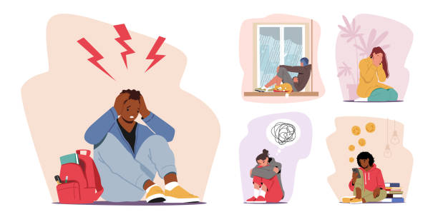
5. NEUROTISM
Neurotic people are more likely to feel emotions such as anxiety, anger, fear, sadness, guilt. They are sensitive and experience everyday stress more acutely and do not always cope well with it. They are quite shy people.

Slide 30
PERSONALITY PROFILE

Slide 31
BENEFITS
Recognizing our strengths and weaknesses
Becoming more aware of our behaviour and reactions, so we can prevent stress situations
Understanding our versatility, expectations of others become more matching with what they have, what they can offer/ provide us
Communication with others is significantly improved

Slide 32
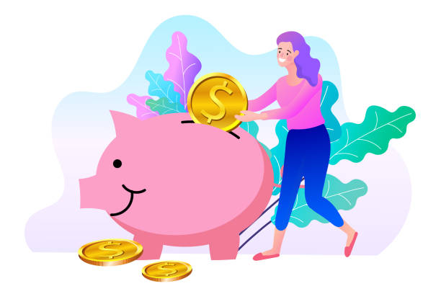
INDIVIDUAL LIFE VALUES AND GOALS
AUTHENTICITY
BALANCE
IDENTITY
COMMUNITY
FRIENDSHIP
KINDNESS
SCIENCE AND KNOWLEDGE
LEADERSHIP
LOYALTY
RESPECT
SPIRITUALITY
MATERIAL VALUES
RECOGNITION

Slide 33
SWOT ANALYSIS

Slide 34
WHAT IS A SWOT ANALYSIS?
SWOT ANALYSIS – IS ONE OF THE MOST POPULAR TOOLS / METHODS FOR ORGANIZATION ANALYSIS. IT IS USED TO IDENTIFY ALL STRENGTHS AND WEAKNESSES, OPPORTUNITIES AND THREATS IN ORDER TO DEVELOP A COMPANY STRATEGY.

Slide 35
PERSONAL SWOT ANALYSIS
However, the SWOT method can also be used to determine your personal positive or negative sides.
A personal SWOT analysis is a mini-tool that will fully help you reach your goal and not lose potential opportunities.

Slide 36
S (STRENGHTS)
W (WEAKNESSES)
O (OPPORTUNITIES)
T (THREATS) POTENTIAL HAZARDS

Slide 37
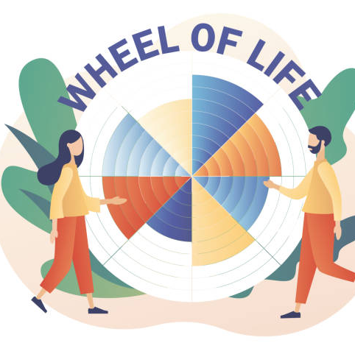
WHEEL OF LIFE
Paul J. Meyer, founder of the Success Motivation Institute in 1960.
Paul J. Meyer was a leader and pioneer in the coaching industry. He has built many programs to help people achieve their goals, manage their time, and be a better leader. Today, there are many versions of this technique and it is used for many purposes.

Slide 38
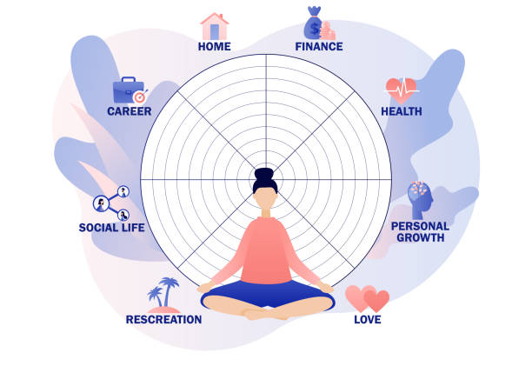
WHEEL OF LIFE –
in other words, the wheel of balance, the coaching wheel of values. It is a method for anyone who wants to look at their quality of life, check in which areas they are fulfilled and which are those requiring certain actions.

Slide 39
THIS METHOD IS WORTH USING WHEN:
WE FEEL A CONTRADICTION OF VALUES
WE ARE FACING AN IMPORTANT DECISION
WE FEEL PROBLEMS IN RELATIONSHIPS
PERSONAL DEVELOPMENT IS IMPORTANT FOR US
WE EXPERIENCE REPETITIVE PATTERNS, ETC.

Slide 40
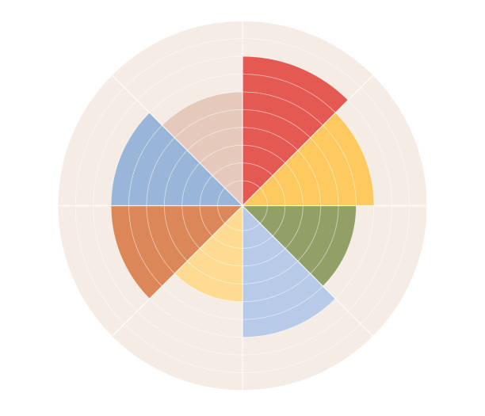
BENEFITS :
It's not complicated
It helps define a value system
It helps to determine the level of satisfaction in a given area of life
It makes you aware of the causes of certain contradictions
It motivates you to make some changes
It helps in making decisions
It is conducive to the introduction of life balance
It helps you prepare for a job interview

Slide 41
Disclaimer:
Funded by the European Union. Views and opinions expressed are however those of the author(s) only and do not necessarily reflect those of the European Union or the European Education and Culture Executive Agency (EACEA). Neither the European Union nor EACEA can be held responsible for them.

Slide 42
Key competences for people aged 50+
Course: Entrepreneurship
Module 1

Slide 43
THE MAGIC OF CREATIVITY

Slide 44
PATTERNS IN THE PROCESS OF CREATIVE THINKING

Slide 45
CREATIVE THINKING
IT IS A COMPLETELY DIFFERENT WAY OF THINKING, ACTING, CREATING THAN THE WAY WE MOST OFTEN USE.
IT IS RECOGNIZED THAT CREATIVE
THINKING IS INHERENT AND
DECLINES WITH AGE.
THE PROCESS OF CREATIVE
THINKING IS LINKED WITH CREATIVITY.
FACTORS AFFECTING THE PROCESS
OF CREATIVE THINKING ARE:
EXPERIENCE
INTELLIGENCE
EMOTIONS
TRAINING

Slide 46
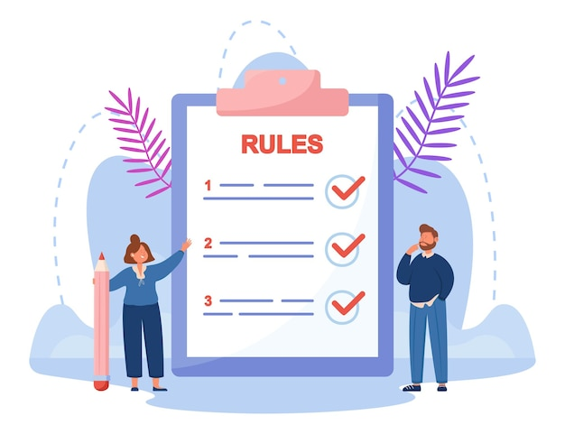
PRINCIPLES OF CREATIVE THINKING
1. PRINCIPLE OF DIVERSITY
2. PRINCIPLE OF DEFERRED VALUATION
3. THE PEOPLE PRINCIPLE
4. PRINCIPLE OF TIMELINESS

Slide 47
THE ESSENCE OF CREATIVE THINKING
1. DEVELOPMENT OF GOAL-SETTING SKILLS
2. COGNITIVE DEVELOPMENT
3. BUILDING MOTIVATION IN THE CREATION PROCESS
4. REINFORCING TRUST AND ONE’S OWN POSSIBILITIES
5. RISK-TAKING
6. GIVING UP YOUR OWN LIMITATIONS
7. FIGHTING DESTRUCTIVE BELIEFS 8. MAKING CONSCIOUS DECISIONS, MAKING CHOICES THAT SERVE US

Slide 48
SCHEME OF THE CREATIVE THINKING PROCESS
1. PREPARATION
2. ASK YOURSELF
3. SEARCH/REFLECT
4. INCUBATION
5. EUREKA MOMENT
6. EVALUATION
7. IMPLEMENTATION

Slide 49
LIMITATIONS OF THE CREATIVE PROCESSES

Slide 50
ONE-SIDEDNESS
EXCESSIVE
KNOWLEDGE
PATTERNS
IMPATIENCE
​

Slide 51
TOOLS OF CREATIVE WORK
BRAINSTORM

Slide 52
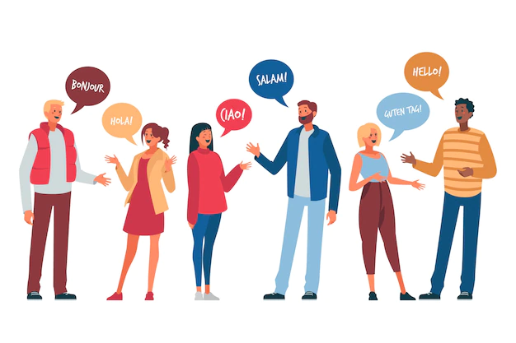
METHOD 635

Slide 53
MIND MAP

Slide 54
ISHIKAWA DIAGRAM

Slide 55
METHODS OF STIMULATING YOUR OWN CREATIVITY

Slide 56
1. UNDERSTAND THE STEPS OF CREATIVE THINKING

Slide 57
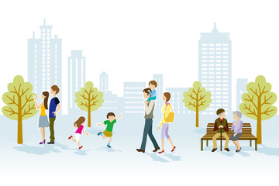
^{2. WALKING AND WALKING OUTSIDE}

Slide 58
3. FREQUENT BREAKS AT WORK STIMULATE CREATIVE THINKING

Slide 59
4. KNOWLEDGE DIVERSIFICATION

Slide 60
5. READING FREQUENTLY

Slide 61
6. WRITING EVERYTHING DOWN MANUALLY

Slide 62
7. CREATE WHILE SLEEPING

Slide 63
TOOLS SUPPORTING THE PROCESS OF GENERATING IDEAS

Slide 64
DESIGN THINKING - step by step
STEP 1 - EMPATHY
STEP 2 - DEFINING THE PROBLEM
STEP 3 - LOOKING FOR SOLUTIONS
STEP 4 - PROTOTYPING
STEP 5 - TESTING

Slide 65
S (substitute)
C (combine) A (adapt) M (modify / magnify / minify)
P (put to other uses)
E (eliminate)
R (reverse / rearrange)

Slide 66
LOTUS FLOWER

Slide 67
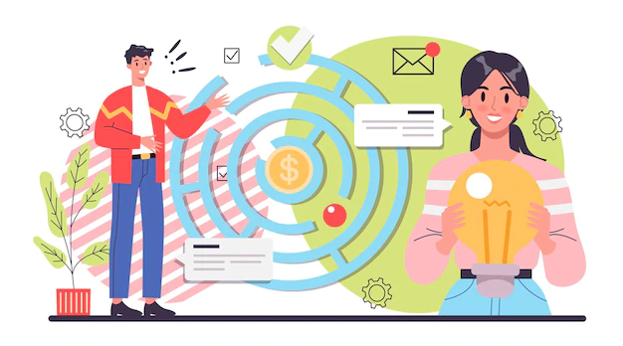
METHODS OF CREATIVE PROBLEM SOLVING
Workshop work on specific problems
Analysis of cases and business trends
Individual exercises
Work in teams
Discussions, inspiration (theory) supported by numerous real-life examples
Drawing and graphic illustration of thoughts

Slide 68
3 DISNEY CHAIRS
THE DREAMER'S CHAIR
THE REALIST'S CHAIR
THE CRITIC’S CHAIR

Slide 69
5xWHY ?
Why did you oversleep to work?
Because I didn't set an alarm clock yesterday as I usually do.
Why didn't you set an alarm clock yesterday?
Because I stayed up late until I finally fell asleep.
Why did you stay up late?
Because I had to prepare an initial outline for the work.
Why so late?
Because I'm overloaded with responsibilities.
Why are you overloaded with responsibilities?
Because I took on too many projects at work.

Slide 70
TURNING CRITICISM INTO EFFECTIVE EVALUATION

Slide 71
Disclaimer:
Funded by the European Union. Views and opinions expressed are however those of the author(s) only and do not necessarily reflect those of the European Union or the European Education and Culture Executive Agency (EACEA). Neither the European Union nor EACEA can be held responsible for them.

Slide 72
Key competences for people 50+
Course: Entrepreneurship,
Module 2 "Ecology in my life"

Slide 73
CLIMATE CHANGE
- GLOBAL WARMING

Slide 74
"Climate change" means a change of climate which is attributed directly or indirectly to human activity that alters the composition of the global atmosphere and which is in addition to natural climate variability observed over comparable time periods.
(UNITED NATIONS FRAMEWORK CONVENTION ON CLIMATE CHANGE - Article 1( 2))

Slide 75
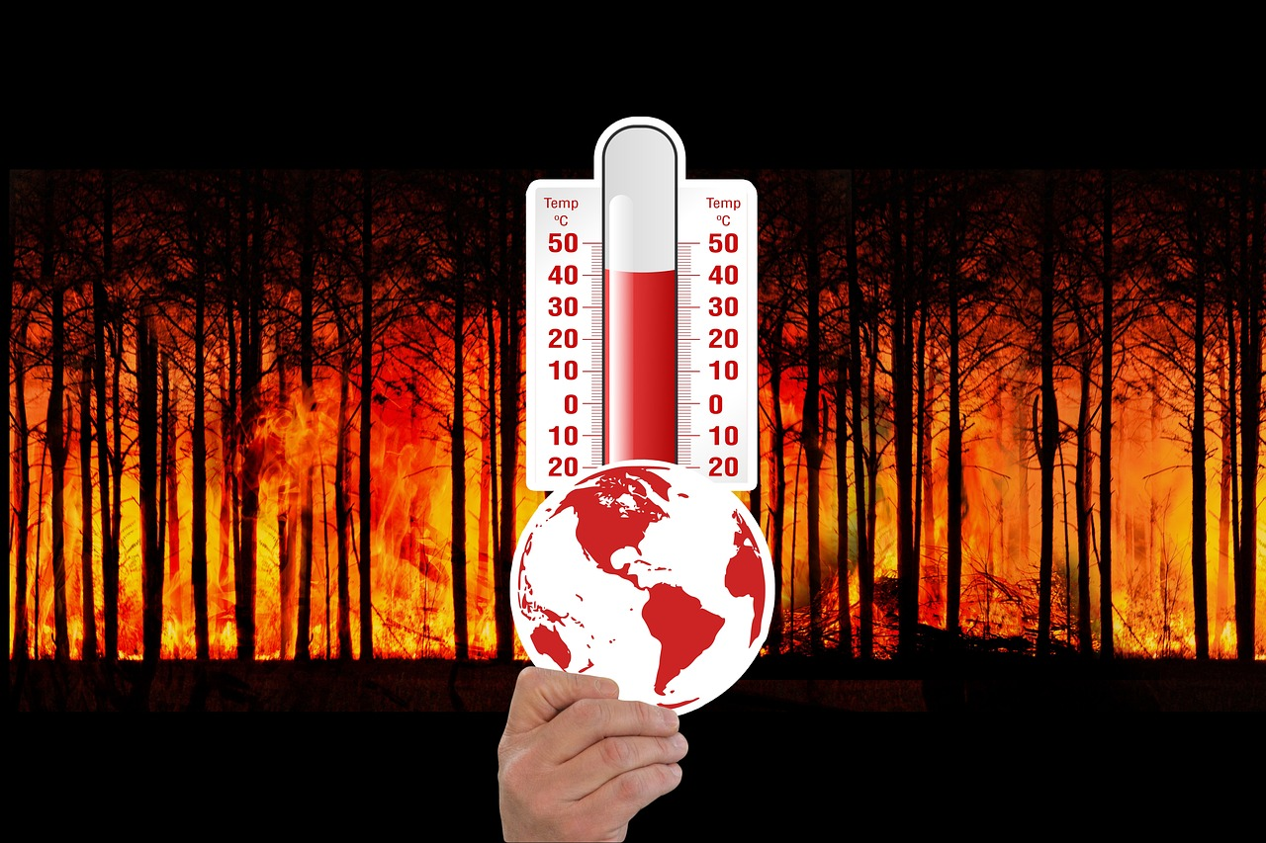
Effects of global warming:
Solar energy is accumulated in in the troposphere, and above all in the waters of the oceans, contributing to the increase in the average temperature around the globe.

Slide 76
Increased energy in the troposphere is:
increase in average temperature,
reduction of snow cover,
change of directions of air masses movement,

Slide 77
increase in wind strength,
changing the direction of ocean currents,
reducing the average amount of precipitation,
increase in torrential rainfall.
https://klimada2.ios.gov.pl/files/2021/Adaptacja%20do%20zmian%20klimatu%20na%20gruncie%20UNFCCC.pdf

Slide 78
The unprecedented intensity and speed of changes taking place in the natural environment is the result of the rapidly increasing temperature of the troposphere.
The speed of environmental change is a phenomenon to which the long-term process of natural evolution may not find an answer.
The adaptive potential of natural and anthropogenic systems to the effects of climate change is directly proportional to their adaptive capacity over time.
https://klimada2.ios.gov.pl/files/2021/Adaptacja%20do%20zmian%20klimatu%20na%20gruncie%20UNFCCC.pdf

Slide 79
Biodiversity is:
variety of ecosystems (natural capital), species and genes in the world or in a particular habitat.
It is essential to human wellbeing, as it delivers services that sustain our economies and societies.
Biodiversity is also crucial to ecosystem services — the services that nature supplies — such as pollination, climate regulation, flood protection, soil fertility and the production of food, fuel, fibre and medicines.
https://www.eea.europa.eu/themes/biodiversity/intro

Slide 80
Why is biodiversity important?
Healthy ecosystems provide us with everything we take for granted. Plants convert solar energy, making it available to other life forms. Bacteria and other living organisms break down organic matter into nutrients, providing plants with a healthy soil to grow in. Pollinators are essential for plant reproduction, guaranteeing food production. Plants and oceans absorb carbon dioxide. The water cycle is largely based on living organisms.
In short, biodiversity gives us clean air and water, good quality soil and pollination for crops, helps us fight and adapt to climate change, and reduces the impact of natural disasters.
https://www.europarl.europa.eu/news/en/headlines/society/20200109STO69929/loss-biodiversity-meaning-and-cause

Slide 81
Up to 200 species go extinct every day!

Slide 82
Human activities causing pollution, changes in habitats and climate change put pressure on species and ecosystems. According to scientists, 1 million species of plants, insects, birds and mammals around the world are currently threatened with extinction.
https://www.consilium.europa.eu/pl/policies/biodiversity/

Slide 83
Acid rain damages the leaves and roots of plants (AR - precipitation with a pH lower than 5.6; it is formed as a result of the reaction of water vapor contained in the air with oxides (sulphur, carbon, nitrogen).

Slide 84
Research conducted by the International Union for Conservation of Nature (IUCN) showed that between 1500 and 2009, 875 species disappeared permanently from the Earth. However, this value seems to be very underestimated, especially in relation to modern times, i.e. from the mid-15th to the beginning of the 20th century. The state of knowledge at that time did not allow to recognize and describe a large number of species.

Slide 85
The number of species that exist on our planet today and those that are dying out can only be approximated. Optimistic reports say that between 500 and 5,000 of them die annually. Others, created by estimating the number of extinct species based on the area of destroyed natural habitats, set the rate of extinction at 50, 100, 150 and even 350 species per day, which gives a number of 20,000-50,000, or even 120,000, per year.

Slide 86
A drastic increase in the rate of extinction of species has been observed since the beginning of the 20th century, and this process is constantly intensifying. For this reason, it is sometimes said that we are witnessing the sixth mass extinction, also known as the Holocene.
https:// zpe.gov.pl/a/zagrorzenia-bioroznorodnosci/D19ogvFoa

Slide 87
Main causes of biodiversity loss:
Change of land use (e.g. deforestation, intensive monoculture, urbanisation)
Direct exploitation such as hunting and overfishing
Climate change
Environment pollution
Invasive alien species
https://www.europarl.europa.eu/pdfs/news/expert/2020/1/story/20200109STO69929/20200109STO69929_en.pdf

Slide 88
As a result of the growth of human populations and the growing demand for meat and hides:
Hunting for selected species has often been so intense that it has led to their extinction.
In the 17th century, the auroch (Bos primigenius) was extirpated in Europe, the dronta dodo bird (Raphus cucullatus) was extirpated on the island of Mauritius, and the last sea cow (Hydrodamalis gigas) was hunted near Bering Island in the 18th century. In the 20th century, the North American migratory pigeon (Ectopistes migratorius) was extirpated.
https://zpe.gov.pl/a/zagrorzenia-bioroznorodnosci/D19ogvFoa

Slide 89
Food was also obtained through agriculture. Huge areas were devoted to plant cultivation and animal grazing. Natural resources were exploited more and more intensively, which also had a negative impact on the environment.
Fishing has also become a threat to biodiversity: today, nearly 30% of the world's fisheries are constantly overfished, and another 50% are exploited so intensively that they will soon be unable to regenerate.
Subsequent negative changes in the natural environment, especially its pollution and degradation, have been and still are taking place under the influence of the development of industry, transport, construction, municipal economy, and now also tourism.
https://zpe.gov.pl/a/zagrozenia-bioroznorodnosci/D19ogvFoa

Slide 90
The most important cause of the decline in biodiversity is the constant reduction of the area of natural ecosystems. Deforestation is the biggest problem, because forests are the most valuable ecosystems on Earth from the point of view of biodiversity.
They are a refuge for about 75% of land species living on our planet.
They are the second global supplier of oxygen after the oceans and a specific reservoir of drinking water.
They also act as a natural air filter.
In addition, they prevent soil erosion and stabilize the climate.
And their maintenance is important for stopping global warming because they absorb huge amounts of CO2.
https://zpe.gov.pl/a/zagrozenia-bioroznorodnosci/D19ogvFoa

Slide 91
Each tree is a habitat for numerous organisms creating a specific biocenosis. Deforestation means the loss of all these functions, and thus the disappearance of a huge number of species and the relationships with which they are linked.
An important reason for the threat to biodiversity is also the disappearance of swamp, marsh and peatbog ecosystems. These areas are drained and used in agriculture for growing crops. Drainage measures, which lower the water level, contribute to the loss of habitats by numerous water and wetland birds, and also lead to the extinction of amphibians that breed in these areas.
https://zpe.gov.pl/a/zagrozenia-bioroznorodnosci/D19ogvFoa#:~:text=Istotnym%20powodem%20zagro%C5%BCenia,na%20tych%20obszarach

Slide 92
Another reason for the decline in global biodiversity is the introduction of alien, invasive species into natural ecosystems.
Globally, this has led to the loss of about half of native species. Many alien species are introduced by man consciously, considering them useful in agriculture, forestry, horticulture, others accidentally. This is especially favoured by the development of international and intercontinental transport and tourism.
Invasive species are defined as alien species in a given ecosystem, usually originating from other climatic zones, which have found very favourable development opportunities in new conditions. Because of this, they began to reproduce en masse and dominate the ecosystems. They also usually have the ability to spread very quickly.
https://view.genial.ly/5e9765cf682dd50db8837a5f/presentation-human-influence-on-biological-diversity _
https://zpe.gov.pl/a/zagrozenia-bioroznorodnosci/D19ogvFoa

Slide 93
In Poland, invasive species include, for example, the American mink (Neovison vison) and the raccoon (Procyon lotor) - animals that escaped from fur farms or were released from them and created numerous populations. They easily adapt to new conditions, are very prolific, threaten birds nesting on the ground and many mammals. They also inhabit national parks and other protected areas, where attempts are made to eliminate them.
The Sosnowsky's hogweed (Heracleum sosnowskyi) is also an invasive species, which was supposed to be cultivated for its medicinal values and used as fodder, but has proved harmful to humans and cattle through its scorching properties. In turn, its dynamic spread has become a serious threat to the native flora.
https://zpe.gov.pl/a/zagrozenia-bioroznorodnosci/D19ogvFoa

Slide 94
The increase in global temperature is also causing another serious problem that has been observed since the 1970s, i.e. the progressive melting of the polar ice caps. The ice-bound shores of Alaska, which are a breeding and rearing place for walruses, are gradually melting, which means that pregnant females are forced to look for new, unaltered areas. As a result, they crowd on small beaches still covered with ice, forming herds of several tens of thousands of individuals.
The disappearance of the ice cover also affects the populations of the Adélie penguin (Pygoscelis adeliae). These birds prey on krill by diving from the ice floe, usually close to the breeding colony. Due to the fact that coastal ice floes are melting faster and faster, and krill exist only under the ice, birds have to feed further and further from the shore. For this reason, they leave their chicks for a long time, which is the reason for their increased mortality.
https:// sp16.piotrkow.pl/content/artykuly/files/Biologia%208%20a,c,d%20%2001-04.06.2020.docx , https://zpe.gov.pl/a/zagrorzenia- biodiversity/D19ogvFoa

Slide 95
Do you know that…?
About 80% of the world's biodiversity is associated with forests.
Ca. 1.6 billion people depend directly on forests for food, shelter, energy, medicine and income.
Every year, 10 million hectares of forest are lost worldwide – roughly the size of Iceland – which is responsible for 12 to 20 percent of the increase in global greenhouse gas emissions that contribute to climate change.
Land degradation affects nearly 2 billion hectares – an area larger than South America.
https://klimada2.ios.gov.pl/chronmy-lasy/

Slide 96
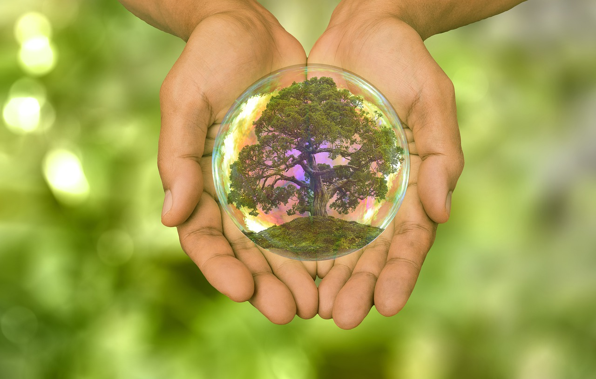
Sustainable development

Slide 97
We did not inherit the Earth from our ancestors. We only borrowed it from our children. Source: no clear author, the saying appears among Indian and Chinese proverbs, it was also used by Antoine Marie Roger de Saint-Exupéry and Lester Brown

Slide 98
Sustainable development
Sustainable development is intergenerational solidarity consisting in finding such solutions that guarantee further growth, which allow for active inclusion in development processes of all social groups, while giving them the opportunity to benefit from economic growth.
https://www.gov.pl/web/rozwoj-technologia/zrownowazony-rozwoj

Slide 99
Initially, discussions on sustainable development were limited to the need to reduce the negative impact of economies on the natural environment.
Over the years, the concept has gained a fuller understanding, aligning the essence of the three factors of development: respect for the environment, social progress and economic growth.
Currently, the concept of sustainable development is increasingly entering the mainstream of discussions on socio-economic development, becoming a horizontal principle, reflected in all development policies.
https://www.gov.pl/web/rozwoj-technologia/zrownowazony-rozwoj

Slide 100
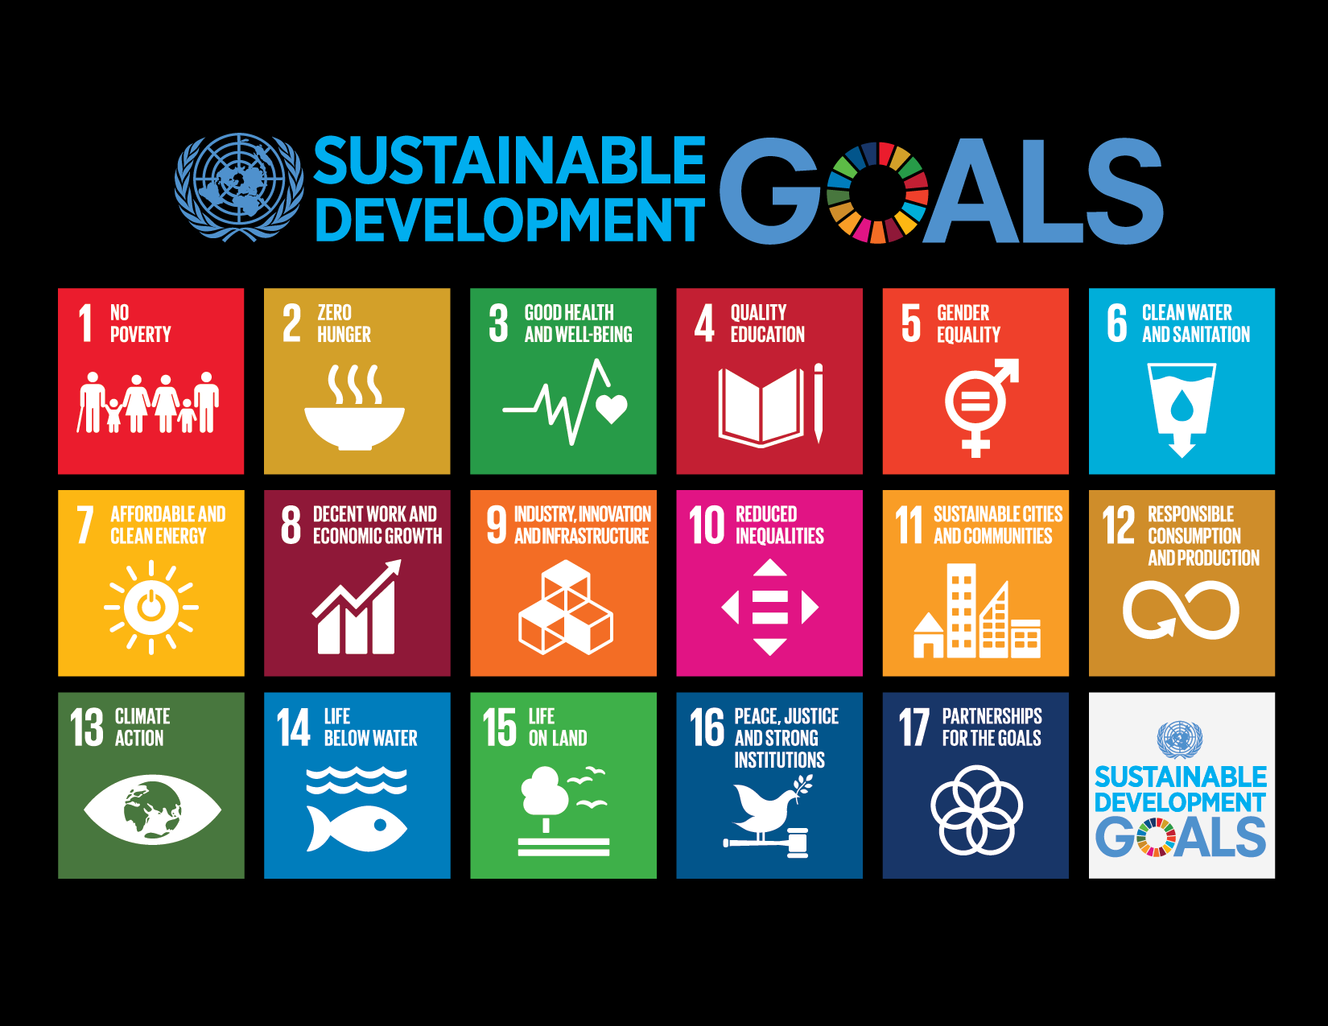

Slide 101
Sources:
https://www.gov.pl/photo/68534860-e12a-49ef-91d9-9313cd3e36d5
https://www.un.org/sustainabledevelopment/news/communications-material/
http://www.un.org.pl/
https://www.un.org/sustainabledevelopment/
https://www.un.org/development/desa/dspd/2030agenda-sdgs.html

Slide 103
Today, more than 2 billion people live in areas where there is a risk of limited access to drinking water.
It is estimated that by 2050, at least one in four people in the world will live in a country with a chronic or periodic shortage of drinking water.
Drought affects some of the poorest regions of the world, which only intensifies the occurrence of hunger and malnutrition.
https://www.un.org.pl/cel6

Slide 104
Facts
Every fourth health care facility lacks basic water services.
3 out of 10 people do not have access to safe drinking water and 6 out of 10 people do not have access to safe sanitation.
At least 892 million people still practise open defecation.
Between 1990 and 2015, the number of people using improved drinking water sources increased from 76% to 91%.
More than 40% of the world's population still suffers from water scarcity and this proportion is expected to continue to increase. More than 1.7 billion people live in river basins that use more water than they add.
https://www.un.org.pl/cel6

Slide 105
2.4 billion people lack access to basic sanitation facilities such as toilets and latrines.
More than 80% of untreated wastewater generated by human activities discharges into rivers or the sea.
In 80% of households without access to water, women and girls are responsible for fetching water from the local area.
Every day, an average of 1,000 children die from diarrhea and its complications, which are preventable waterborne or sanitation related diseases.
About 70% of the water used for irrigation comes from rivers, lakes and underground water sources.
Floods and other water-related disasters account for 70% of all fatalities caused by natural disasters.

Slide 106
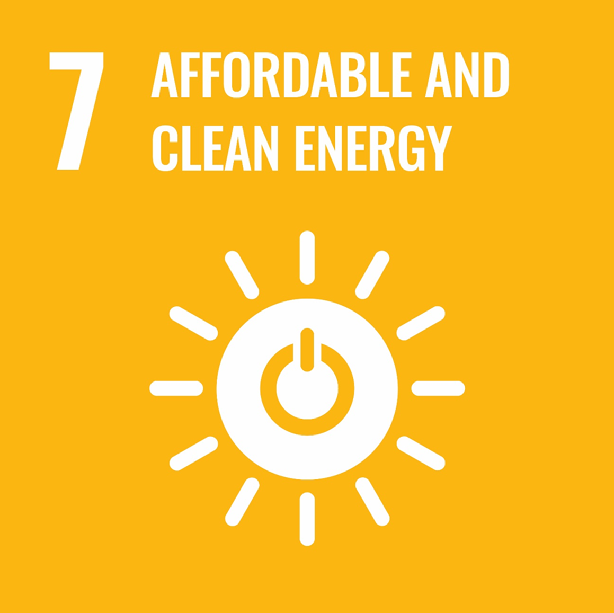

Slide 107
Facts
13% of the world's population still has no access to modern electricity.
3 billion people depend on coal, wood and charcoal, and animal waste for cooking and heating.
Energy is the main cause of climate change, accounting for around 60% of global greenhouse gas emissions.
In 2012, pollution from burning fuel fuel caused 4.3 million deaths, 60% of which were women and girls.
In 2015, the share of renewable energy in total energy consumption reached 17.5%.
https://www.un.org.pl/cel7

Slide 108
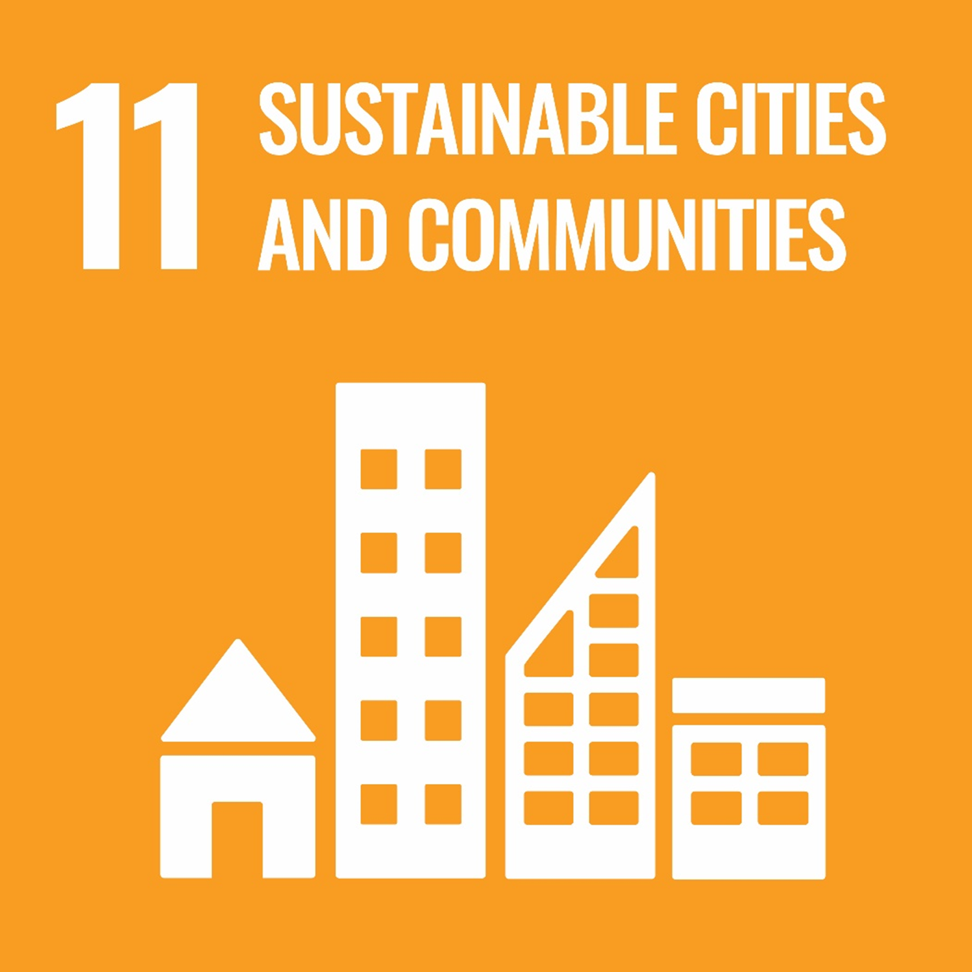

Slide 109
Facts:
Today, 3.5 billion people – half of the human population – live in cities, and by 2030, it is projected that 5 billion people will live in cities.
In the coming decades, developing countries will account for 95% of urban expansion.
Today, 883 million people live in slums, mainly in East and Southeast Asia.

Slide 110
Cities in the world occupy only about 3% of the Earth's area, while they consume 60-80% of energy and produce 75% of carbon dioxide emissions.
Rapid urbanization has an impact on freshwater resources, wastewater, the environment and public health.
In 2016, 90% of city dwellers breathed polluted air. 4.2 million people died as a result of air pollution. More than half of the world 's urban population was exposed to levels of air pollution at least 2.5 times higher than the legal limit.
https://www.un.org.pl/cel11

Slide 111
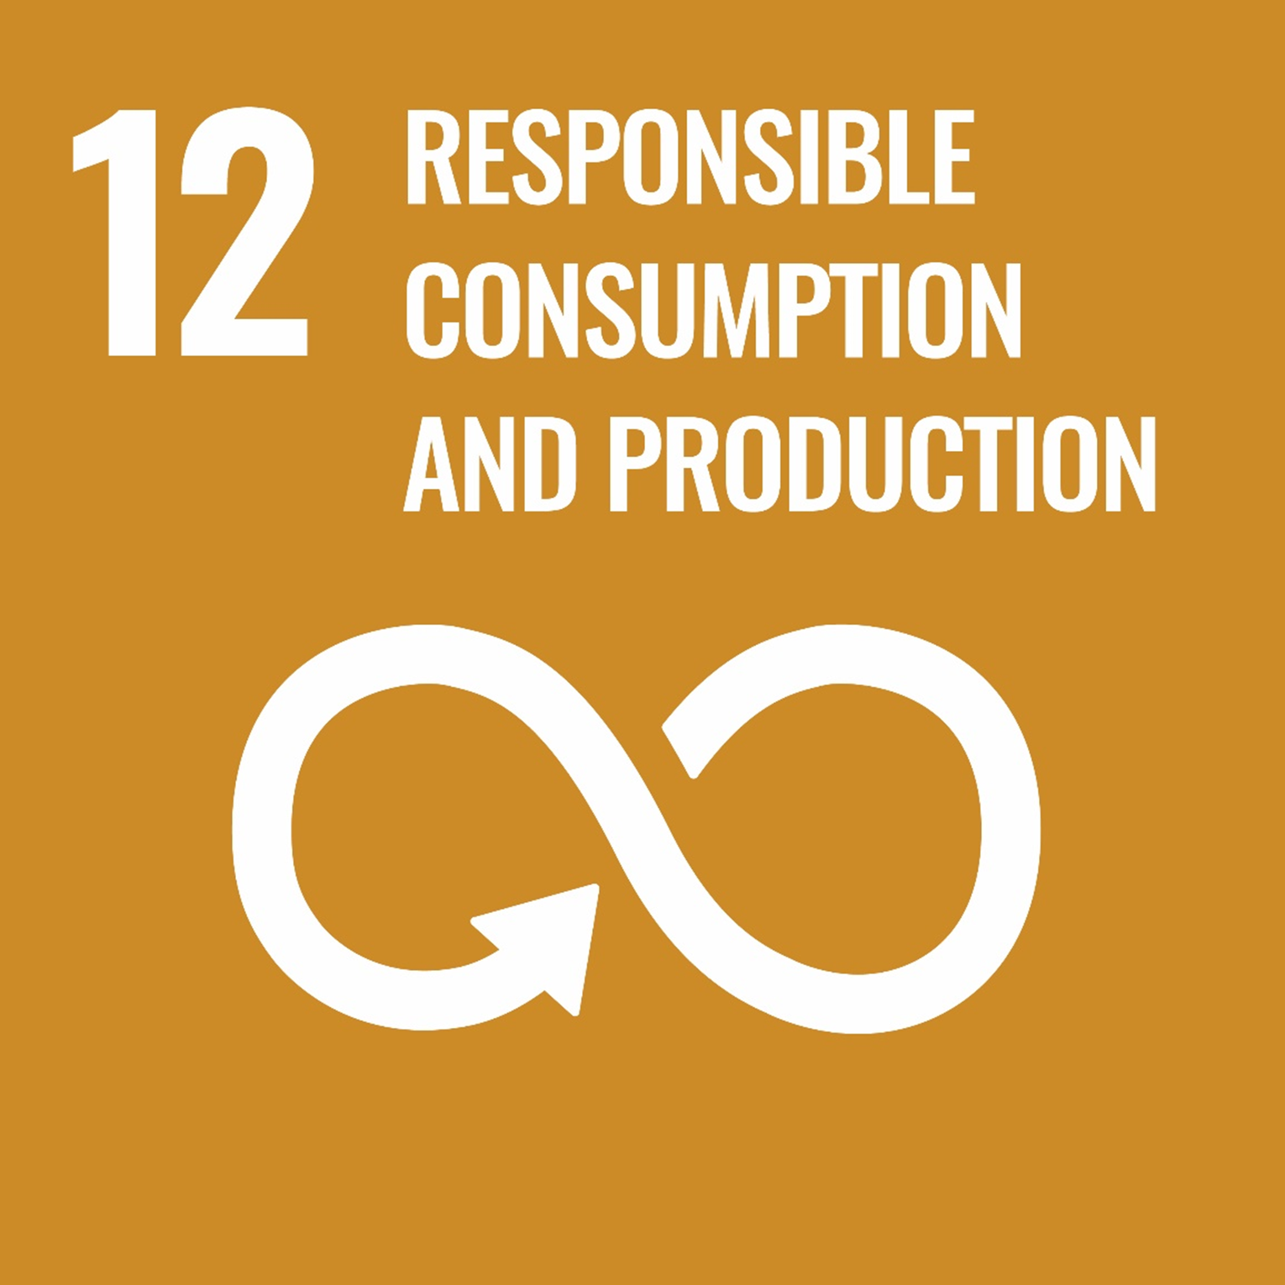

Slide 112
Facts:
If, according to estimates, the world's population will increase to 9.6 billion by 2050, then we will need natural resources in quantities corresponding to three times the resources of our planet in order to maintain our current lifestyle.
With the increased use of non-metallic minerals in infrastructure and construction, there has been a significant improvement in the standard of living. The material footprint per capita in developing countries increased from 5 metric tons in 2000 to 9 metric tons in 2017.
93% of the world's top 250 companies report on their sustainability activities.
https://www.un.org.pl/cel12

Slide 113
Energy
If people around the world used energy-saving light bulbs, $120 billion would be saved annually.
Despite the development of technologies promoting the efficient use of energy, its consumption in OECD countries will increase by 35% by 2020. Energy used for commercial and residential purposes is the second largest area of its global consumption after transport.
In 2002, the car market in OECD countries consisted of 550 million vehicles, of which 75% were private cars. By 2020, the number of private cars is expected to increase by 32%. At the same time, the mileage rate will increase by 40% and the number of flights will triple.
Households consume 29% of global energy and contribute 21% of carbon dioxide emissions
In 2015, the share of renewable energy in total energy consumption was 17.5%.
https://www.un.org.pl/cel12

Slide 114
Food
Not only food production has a large environmental impact (agriculture, food processing). Also, households, through the choice of food products, diet and habits, influence their environment, the amount of energy consumed and food wasted.
Each year, about a third of all food produced – 1.3 billion tons of food, worth about $1 trillion – is wasted in homes or stores, or due to poor transportation and harvesting practices.
2 billion people worldwide are overweight or obese.
Land degradation and declining soil fertility, unsustainable use of water, overfishing and degradation of the marine environment all reduce the environment's ability to provide us with food.
Globally, the food sector consumes 30% of the energy consumed and is responsible for 22% of total greenhouse gas emissions.
https://www.un.org.pl/cel12

Slide 115
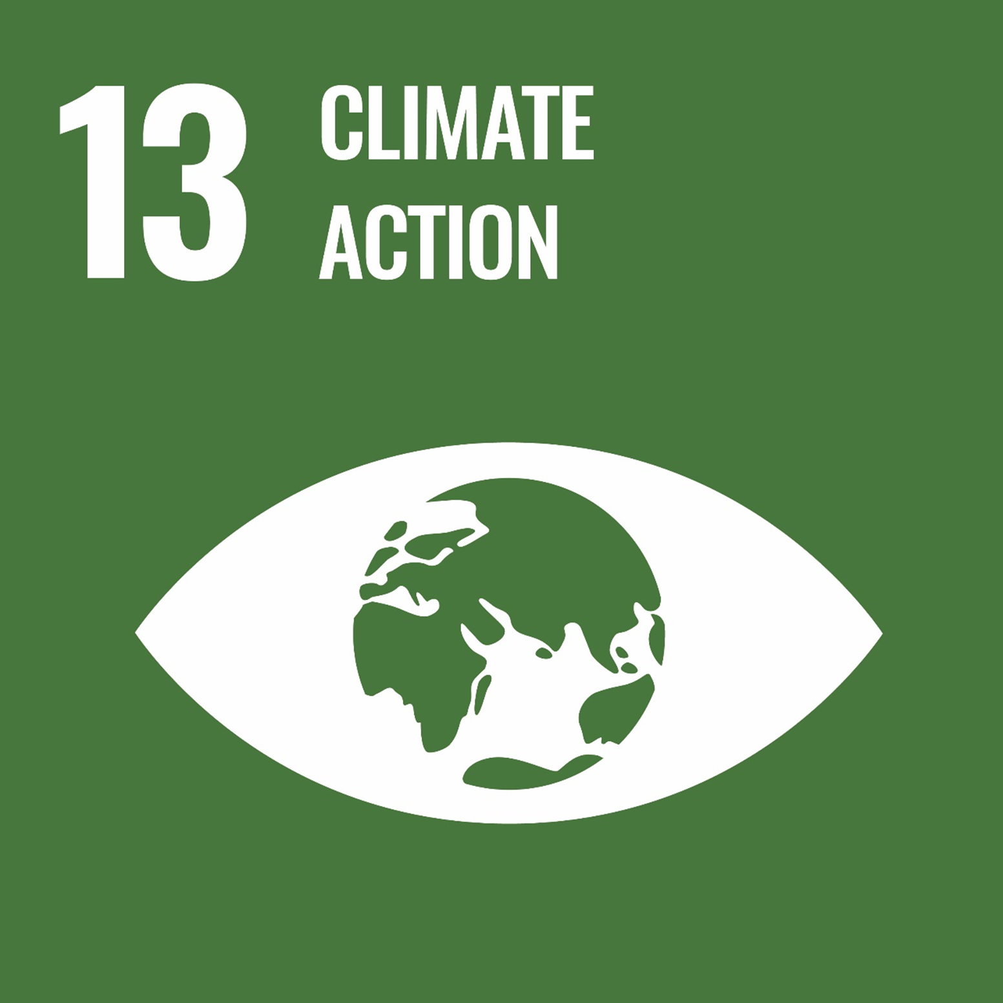

Slide 116
Facts:
Between 1880 and 2012, the global average temperature increased by 0.85⁰Celsius. To illustrate, a 1⁰ Celsius increase in temperature results in a 5% reduction in grain yield. In the years 1981-2002, due to climate warming, there was a significant reduction in the level of harvest of corn, wheat and other significant crops in the amount of 40 megatons per year.
Ocean temperatures have risen, snowfall has decreased, ice cover has decreased, and sea levels have risen. Between 1901 and 2010, the world's average sea level rose by 19 cm as the oceans expanded due to global warming and melting of glaciers. Since 1979, the amount of ice in the Arctic Sea has been steadily decreasing. Every decade, 1.07 million km² of the ice cover melts.

Slide 117
Assuming that the current level of concentration and the volume of greenhouse gas emissions are maintained, at the end of this century the temperature on Earth will increase by more than 1.5⁰ Celsius compared to the years 1850-1900. At the same time, the temperature of the ocean waters will increase and the ice cover will continue to melt. It is estimated that by 2065 the average sea level will reffects of climate change ise by 24-30 cm, and by 2100 by 40-63 cm. Most of the will persist for centuries to come, even if we manage to curb greenhouse gas emissions.
Global carbon dioxide emissions have increased by almost 50% since 1990.

Slide 118
Between 2000 and 2010, global carbon dioxide (CO₂) emissions grew faster than in any of the previous three decades.
It is still possible, using a wide range of technological measures and changing behavioural patterns, to reduce the rate of increase in the Earth's average temperature by 2⁰ Celsius compared to pre-industrial levels.
Institutional and technological changes give a greater than zero chance that the global warming rate will not exceed this threshold.
https://www.un.org.pl/cel13

Slide 119
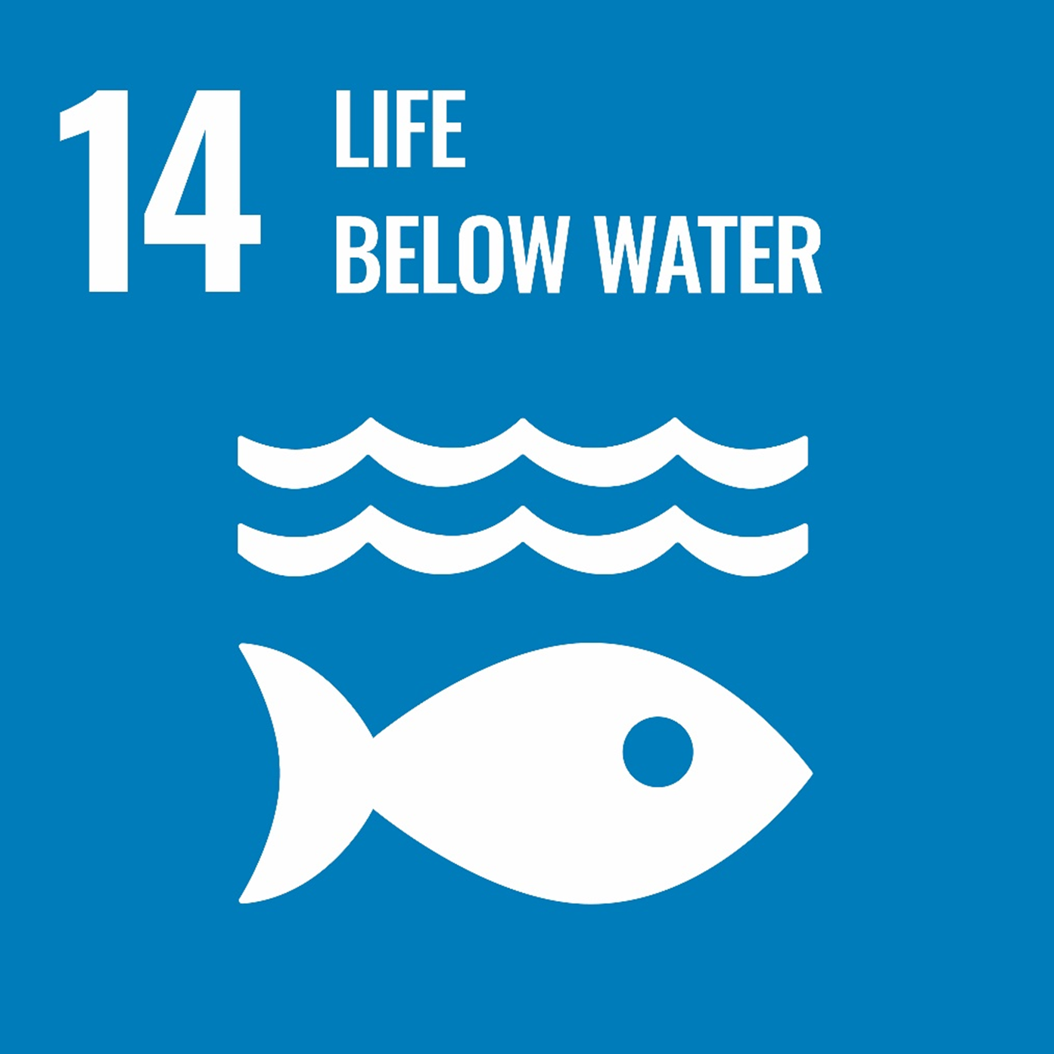

Slide 120
Facts:
The oceans cover three-quarters of the Earth's surface, contain 97% of the world's water, and make up 99% of the Earth's habitable space.
Over three billion people rely on marine and coastal biodiversity to stay alive.
On a global scale, the annual market value of marine and coastal resources and industrial production is estimated at USD 3 trillion or about 5% of global GDP.
There are nearly 200,000 identified species in the oceans, but the actual number may be in the millions.

Slide 121
The oceans absorb around 30% of the carbon dioxide produced by human activities and thus mitigate the effects of global warming.
The oceans are the world's largest source of protein; for more than 3 billion people, they are the main source of protein.
Fishing directly and indirectly provides jobs for over 200 million people.

Slide 122
Fisheries subsidies are rapidly depleting many fish species and hampering efforts to preserve and restore the world's fisheries and related jobs. Due to subsidies, ocean fishing generates $50 billion less annual profit than is potentially possible.
The acidity of the oceans has increased by 26% since the start of the industrial revolution.
Coastal waters are polluted and eutrophicated. Unless action is taken, eutrophication is estimated to increase in 20% of large marine ecosystems by 2050.
https://www.un.org.pl/cel14

Slide 123
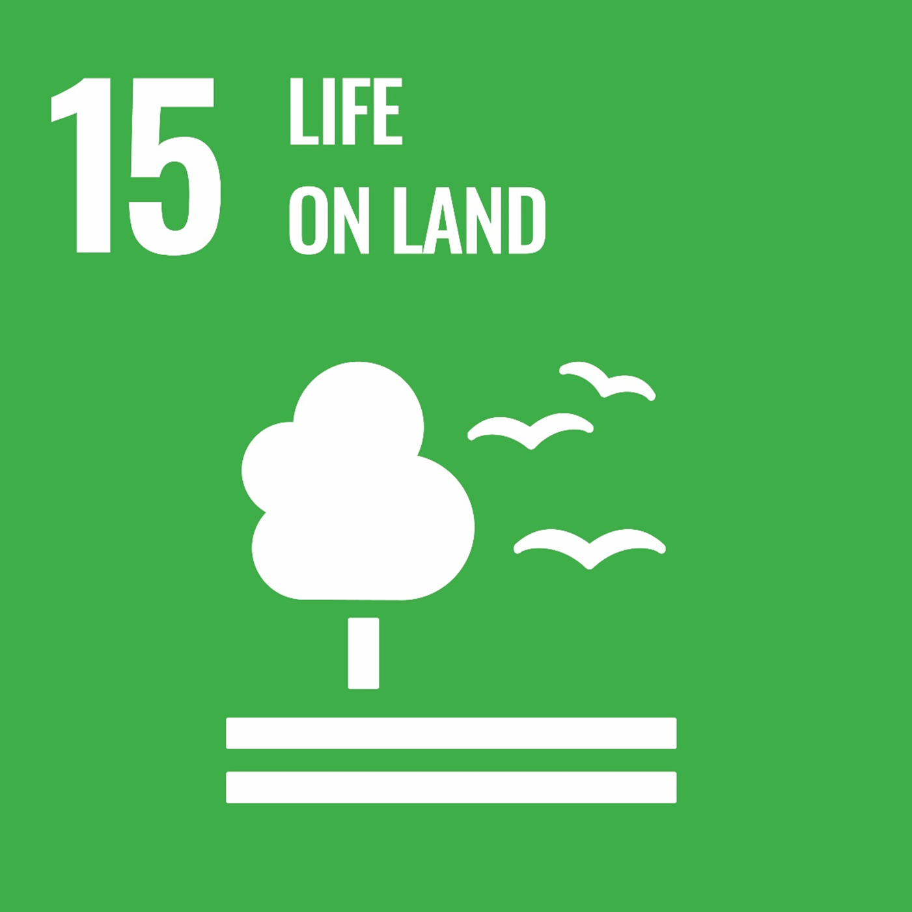

Slide 124
Forests
Forests cover 30.7% of the Earth's surface. They not only provide food security and shelter for various forms of life, but also play a key role in combating climate change, protecting biodiversity, as well as being a place of residence for indigenous peoples.
Protecting forests will improve natural resource management processes and increase land productivity.
We lose 13 million hectares of forest every year, and the ongoing degradation of drylands has led to the desertification of 3.6 billion hectares. Even though almost 15% of the area is currently protected, biodiversity is still under threat.

Slide 125
Forests are the main source of livelihood for about 1.6 billion people, including about 70 million indigenous peoples.
Forests are inhabited by over 80% of all species of animals, plants and insects that live on land.
Between 2010 and 2015, the world's forest area decreased by 3.3 million hectares. This has a special impact on the lives of poor people living in the countryside, who make their living mainly from forest raw materials, flora and fauna.

Slide 126
Desertification
2.6 billion people live directly from agriculture, with 52% of farmland affected to a greater or lesser extent by soil degradation.
It is estimated that the level of arable land loss is 30-35 times greater than at any time in history.
As a result of drought and desertification, we lose 12 million hectares (23 hectares per minute) every year, on which 20 million tons of grain could be grown.
74% of the world's poor are directly affected by land degradation.

Slide 127
Biodiversity
Of the approximately 8,300 known species of animals, 8% are already extinct, while 22% are threatened with extinction.
Of the more than 80,000 tree species, only less than 1% have been studied for their potential utility.
Fish provides 20% of animal protein to 3 billion people. Only ten species of fish account for 30% of marine catches and only ten species of fish account for 50% of aquaculture production.
More than 80% of the human diet is based on plants. Only three main types of cereals - rice, corn and wheat - meet 60% of energy needs.

Slide 128
At least 80% of people living in rural areas in developing countries rely on traditional herbal medicine as their primary form of health care.
Microorganisms and invertebrates are crucial to ecosystems, but we still do not fully understand their role in the functioning of ecosystems and still underestimate them.
Illegal poaching and wildlife trade are activities that are at odds with protecting the environment. Almost 7,000 species of animals and plants in 120 countries are illegally sold.
https://www.un.org.pl/cel15

Slide 129
SMOG

Slide 130
Smog
[eng. 'smoke', 'fog'],
fog containing atmospheric air pollution;
smog is created by primary pollutants (dusts, gases and vapors emitted by industrial plants, power plants, internal combustion engines of motor vehicles, etc.) and products of their photochemical and chemical transformations occurring in conditions of temperature inversion during windless weather; the formation of smog is favored by the location of areas at risk of smog in depressions.

Slide 131
Photochemical smog, also known as oxidative smog, is formed during strong sunlight as a result of photochemical transformations occurring in high concentrations of nitrogen oxides, hydrocarbons, especially unsaturated ones (alkenes) and other exhaust gas components (mainly automotive); these compounds create very reactive radicals, which in turn undergo chemical changes to form toxic substances, mainly peroxides, e.g. peroxyacetyl nitrate (PAN); The components of this type of smog are also: ozone, carbon monoxide, nitrogen oxides, aldehydes, aromatic hydrocarbons.

Slide 132
Acid smog, also called industrial fog, is formed in humid air heavily polluted with so-called acid gases, mainly sulphur dioxide (SO2) and carbon dioxide (CO2), and coal dust; it occurs mainly in regions where houses are heated by burning coal and other solid fuels.
https://encyklopedia.pwn.pl/haslo/smog;3976775.html

Slide 133
In the general statistics of the European Union, Bulgaria wins by exceeding the air pollution standards set for 2020 in 83% of cities.
Poland is in the second place with a score of 72%.
https ://www.focus.pl/artykul/ranking-smog-on-50-most-polluted-cities-eu-az-36-is-in-polsce-180509043616

Slide 134
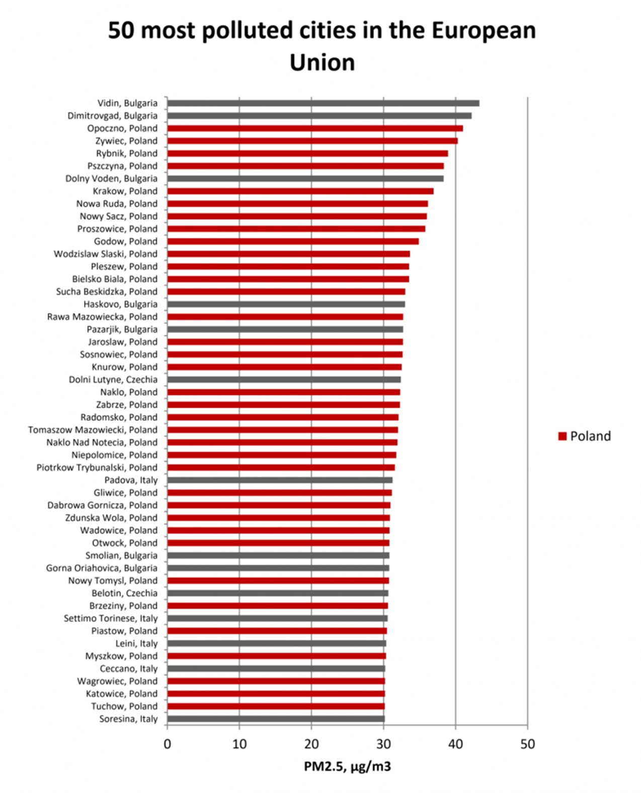

Slide 135
Smog - effects on people
https://smog.edu.pl/skutki-inf

Slide 136
Short-term effects, which are temporary, include illnesses such as pneumonia or bronchitis. They also include discomfort such as irritation to the nose, throat, eyes, or skin. Air pollution can also cause headaches, dizziness, and nausea. Bad smells made by factories, garbage, or sewer systems are considered air pollution, too. These odors are less serious but still unpleasant.
https://education.nationalgeographic.org/resource/air-pollution

Slide 137
Long-term effects of air pollution can last for years or for an entire lifetime. They can even lead to a person's death. Long-term health effects from air pollution include heart disease, lung cancer, and respiratory diseases such as emphysema. Air pollution can also cause long-term damage to people's nerves, brain, kidneys, liver, and other organs. Some scientists suspect air pollutants cause birth defects. Nearly 2.5 million people die worldwide each year from the effects of outdoor or indoor air pollution.
https://education.nationalgeographic.org/resource/air-pollution

Slide 138
People react differently to different types of air pollution. Young children and older adults, whose immune systems tend to be weaker, are often more sensitive to pollution. Conditions such as asthma, heart disease, and lung disease can be made worse by exposure to air pollution. The length of exposure and amount and type of pollutants are also factors.
https://education.nationalgeographic.org/resource/air-pollution

Slide 139
The World Health Organization (WHO) provides evidence of links between exposure to air pollution and type 2 diabetes, obesity, systemic inflammation, Alzheimer’s disease and dementia. The International Agency for Research on Cancer has classified air pollution, in particular PM_{2.5}, as a leading cause of cancer. A recent global review found that chronic exposure can affect every organ in the body, complicating and exacerbating existing health conditions.
https://www.eea.europa.eu/themes/air/health-impacts-of-air-pollution

Slide 140
The EEA estimates that, in 2019, approximately 307,000 premature deaths were attributable to PM_{2.5} in the 27 EU Member States. Nitrogen dioxide (NO₂) was linked to 40,400 premature deaths, and ground-level ozone was linked to 16,800 premature deaths.
View the map https://eea.maps.arcgis.com/apps/InteractiveLegend/index.html?appid=f008e0dc0ce24edfae5463748de10f27

Slide 141
Effects On The Environment:
Like people, animals, and plants, entire ecosystems can suffer effects from air pollution. Haze, like smog, is a visible type of air pollution that obscures shapes and colors. Hazy air pollution can even muffle sounds.
Air pollution particles eventually fall back to Earth. Air pollution can directly contaminate the surface of bodies of water and soil. This can kill crops or reduce their yield. It can kill young trees and other plants.
https://education.nationalgeographic.org/resource/air-pollution

Slide 142
Sulfur dioxide and nitrogen oxide particles in the air, can create acid rain when they mix with water and oxygen in the atmosphere. These air pollutants come mostly from coal-fired power plants and motor vehicles. When acid rain falls to Earth, it damages plants by changing soil composition; degrades water quality in rivers, lakes and streams; damages crops; and can cause buildings and monuments to decay.
Like humans, animals can suffer health effects from exposure to air pollution. Birth defects, diseases, and lower reproductive rates have all been attributed to air pollution.
https://education.nationalgeographic.org/resource/air-pollution

Slide 143
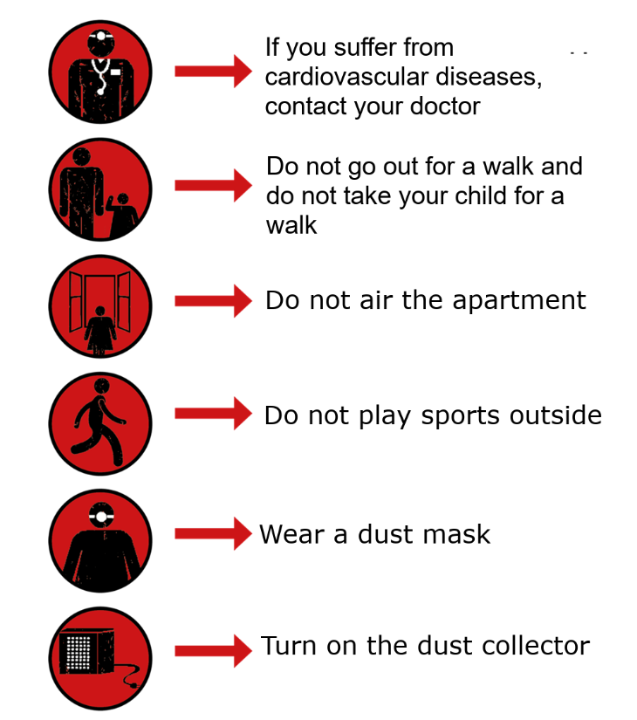
https://smog.edu.pl/skutki-inf

Slide 144
Water resources
The Earth, observed from space, has a blue color, because as much as 71% of its surface is covered with water, which reflects the blue part of the sunlight spectrum.
The vast amount of water on Earth is salty and therefore undrinkable. The average salinity of sea water depends on the type of reservoir: the open waters of the ocean contain about 33 g of salt per liter, the waters of the Mediterranean Sea - about 40 g/l, and the waters of the Persian Gulf as much as 48 g/l.
Less than 3% of the world's water is drinkable, of which 2.5% is frozen water in the Antarctic, Arctic and glaciers.

Slide 145
Only 0.5% of drinking water is used for human and ecosystem needs.
Most of the fresh water, about 70%, is stored in glaciers and snow mainly in Antarctica.
https://zpe.gov.pl/a/wody-i-ich-ochrona/D7npMF5Lo

Slide 146
Water
Water gets contaminated and is self-cleansing
Man pollutes water faster than nature can clean it by recycling, in rivers and lakes.
Over 1 billion people in the world still do not have access to drinking water.
Excessive use of water contributes to global water stress.
Natural water is free, but the infrastructure needed to deliver it is expensive.
https://www.un.org.pl/cel12

Slide 147
Water
Water is a precious resource: Less than 3% of the world’s water is fresh (drinkable), of which 2.5% is frozen in the Antarctica, Arctic and glaciers. And humans are misusing and polluting water faster than nature can recycle and purify water in rivers and lakes.
Using water smartly can help us ensure a steady flow of clean, safe water.
You can save water by taking shorter showers, turning off the tap when brushing your teeth, installing a low-flow toilet, and many other ways.
With one shower of about 10 minutes a day, an average person consumes the equivalent of over 100,000 glasses of drinking water every year.
Severe water scarcity affects about 4 billion people, or nearly two thirds of the world population, at least one month each year.
Agriculture is by far the largest water consumer, accounting for 72% of annual water withdrawals globally. Shifting towards a plant-based diet is one of the most impactful actions one can take to save water.
https://www.un.org/en/actnow/facts-and-figures
https://www.un.org/sustainabledevelopment/climate-action-superheroes-info/

Slide 148
Water footprint, i.e. what You can do! We use huge amounts of water every day. Directly - by washing hands, cleaning, cooking or drinking - and indirectly through the purchase of various products such as food, clothes, paper, electronics or furniture.
Did you know that large amounts of water are needed to produce each of these things?

Slide 149
https://ekonsument.pl/materialy/publ_711_przede_wszystkim_woda.pdf

Slide 150
 | Average amount of water used [l]
Shower | 30 (5 minutes)
Bathing in a bathtub | 60
Machine wash | 95
Brushing teeth with the faucet open | 6
Brushing teeth with the faucet closed | 1
Brushing your teeth with a cup of water | 0.2
Leaking tap (1 drop/s) | 12 thousand annually
Home water consumption

Slide 151
Bathroom:
1. While waiting for the shower water to heat up, you can place a bucket or bowl under it to collect cold water that would otherwise flow down the drain. Later, you can use it, for example, for watering plants.
2. Control your water consumption when washing your hands and teeth. You can use a cup to brush your teeth.
3. Check that all faucets are tight and that water does not escape through broken seals.
4. Invest in a gray-water toilet. This solution is becoming more and more popular on the market.
5. Install aerators in the faucets and a rain shower in the shower. It is also a good way to increase your savings.
6. Do not run the washing machine until it is full. Try to turn on the ECO mode, which has an increased soaking time, thanks to which it uses less energy.
7. Pay attention to the length of the bath - you don't need a lot of time to wash yourself.
https://ekonsument.pl/materialy/publ_711_przede_wszystkim_woda.pdf

Slide 152
Kitchen:
Don't waste food that uses a lot of water to produce.
Do not run the dishwasher until it is full. When deciding to buy a dishwasher, choose one that has a built-in water-saving system.
When boiling water in the kettle, pour in as much water as you need. If you have excess, you can pour it into a thermos that will maintain the temperature, so you won't have to heat the water again.
Use the water from washing vegetables and fruits to water the plants.
https://ekonsument.pl/materialy/publ_711_przede_wszystkim_woda.pdf

Slide 153
Balcony/garden:
Water plants in the morning or evening. As a result, less water evaporates from the plants.
From the accumulated surplus water, you can prepare a drinking bowl for pollinators, but remember that it should be safe for them. To do this, throw pebbles and/or sticks inside so that the insects can sit on something.
Install the tank under the gutter. Collecting rainwater is a great way to water plants in the city as well. It's easier than you think!
If possible, set up a rain garden (bioretention facility).

Slide 154
6R Principle

Slide 155
6R Principle
Rethink - think about whether you really need the item.
Refuse – i.e. do not buy what contributes to increasing the amount of waste in your home, e.g. vegetables or fruits packed in plastic or cheap t-shirts. In this way, as consumers, we give a signal to producers what we really care about.
Reduce - limit the amount of things you use, think about whether you really need each of them. Try to introduce the spirit of minimalism and buy only what you really need.

Slide 156
Reuse - exchange and donate unnecessary things to someone who may need them, consider whether they can not have a different function. When looking for something new, consider whether it is not better to opt for a second-hand item.
Repair – do not immediately throw away a slightly damaged item, perhaps it will be repaired and will serve you for years to come.
Recycle/rot - segregate waste and contribute to the processing of secondary raw materials, e.g. glass bottles/compost.
https://niechzyjeplaneta-edition2021-2022.onet.pl/odpady/segreguj-smieci/zasada-6r-pomaga-ratowac-srodowisko/1ft1py2 Article prepared by UNEP-GRID-Warszawa.

Slide 157
https://www.ekonsument.pl/a67196_zasada_6r_w_praktyki_Czy_prakyczny_poradnik_jak_konsumowac_odpowiedzialnie_.html

Slide 158
Rethink, i.e. think if you really need a given thing.
We often make purchases on impulse, without thinking about whether we really need a given thing. This principle prompts us to think critically. Have you ever wondered why household appliances break down most often when the warranty expires? Why the day after the premiere of a new smartphone, another one is already appearing? Why does the repair cost often oscillate around the purchase of new equipment? This is done through marketing, which drives the sales spiral. The UN reports that for several years the world has been producing over 20 million tons of electronic waste annually.

Slide 159
Rethink in practice:
Don't be manipulated by ads. Be a critical consumer!
Decide how, what and when you buy. Explore your real needs.
Pay attention to the details of the product, the country of origin, in short: read the labels, and if in doubt, ask the seller.
Appreciate and buy Polish products, it contributes to reducing the carbon footprint.
Buy certified products (GOTS, Fairtrade, FairWear, OEKO-TEX).

Slide 160
Refuse
Refuse and don't let yourself be led into compulsive consumption. This principle encourages minimalism and pays more attention to intangible issues such as harmony, peace, balance and nature. Refusing contributes to supporting slow movements (slow life, slow food, etc.) More and more people are starting to care about work-life balance. Recently, the attitude of deconsumption, i.e. consciously limiting one's purchases, has become popular. As it turns out, continuous economic growth is not a guarantee of happiness, more and more often it is said that happiness is caused by non-material factors, such as: communing with nature, lasting friendships, culture, strong local communities, etc.

Slide 161
Refuse in practice:
Limit going to the store, it will save you time and teach you better organization and planning.
Do not treat fashion as therapy for bad days, try to approach the purchase of clothes in moderation.
Remember, you don't always have to be online. It's good to switch off from time to time and see what you can do with your free time.
Think of what you see as a sense of happiness: Is it buying new clothes or maybe meeting friends?

Slide 162
Reduce
Reduce, buy less. Limit yourself to the absolute minimum. As you know, how much we buy affects how much of raw materials, energy and water is used. It is worth bearing in mind the condition of our planet.
Do you know what a carbon footprint is? It is the amount of all greenhouse gases (carbon dioxide, methane and several other gases) emitted due to human activities. For an average Pole, the carbon footprint is 8,000 kg of CO2. Meanwhile, the global target is only 2,000 kg of CO2 per person. There are even special websites where you can roughly calculate your carbon footprint (https://waznamisjazdrowaemisja.pl/kalkulator-sladu-weglowego). Calculate and think about what you can do to reduce it. Below are some tips.

Slide 163
Reduce in practice:
Don't throw away food. Buy only as much as you can consume.
Give up reusable, double packaging. Try to buy products with minimal packaging.
Carry your own shopping bag with you.
If you can choose a bike instead of a car or public transport, do not hesitate to do it!
Turn off devices that are not working, do not keep chargers in sockets unnecessarily, print on both sides (if necessary). These are small things, but during the day there can be quite a large list of actions that can be taken to make it function more efficiently and optimally.

Slide 164
Reuse
Use products repeatedly, in line with upcycling, i.e. a method of reusing and giving a new life to a product. Instead of throwing away, think about how you can reuse an item. Upcycling is a great exercise in creativity! An old t-shirt can be used as a kitchen cloth, an ice cream box is perfect for freezing parsley, eggshells work as fertilizer for plants, coffee grounds are an excellent scrub. These are just a few tips on how to give a second life to a product. There are certainly many more, the only thing that can be a limitation is our imagination.

Slide 165
Reuse in practice:
Paper scraps can be used for making notes, drafts.
Share clothes, books, toys that you no longer use.
Participate in cashless clothes swaps (so-called swap parties).
Use jars for homemade preserves (don't buy new ones !).
Exchange movies, books, CDs, etc. with your friends. This will avoid buying the same things by many people and will certainly contribute to tightening and strengthening the relationship.

Slide 166
Recovery
Before you decide to replace the equipment, try to repair it or hire someone who repairs equipment. Just a few decades ago, repairing home appliances, shoes or clothes was the norm. People used equipment that worked flawlessly for many years, and if it broke down, it was repaired. Today we live in times when repair is not "included". Note that manufacturers often intentionally "age" a product so that the consumer can quickly replace it with a newer model. This is often more cost-effective than repair.

Slide 167
Recovery in practice:
Get to know the local services such as a shoemaker, tailor, leather worker, bookbinder, etc.
Use electronic repair points.
Support and engage in social campaigns fighting against consumerism and unfair practices of producers. Remember - your voice and your actions matter.
If you can, use a desktop computer (it is much easier to make improvements and replace components in it than in a laptop).

Slide 168
Recycle
Recovering and reusing the waste and raw materials from which the product was made. It is important to segregate waste properly to facilitate its further recycling. Especially important for us should be containers for electro-waste, batteries and fluorescent lamps. It is important that the harmful waste they emit does not get into the groundwater and soil.

Slide 169
Recycle in practice:
Sort your waste properly.
Throw e-waste into regular bins (take them to places specially designed for this purpose).
Return expired medications to the pharmacy.
Compost your organic waste.

Slide 170
Exercise - segregating waste

Slide 171
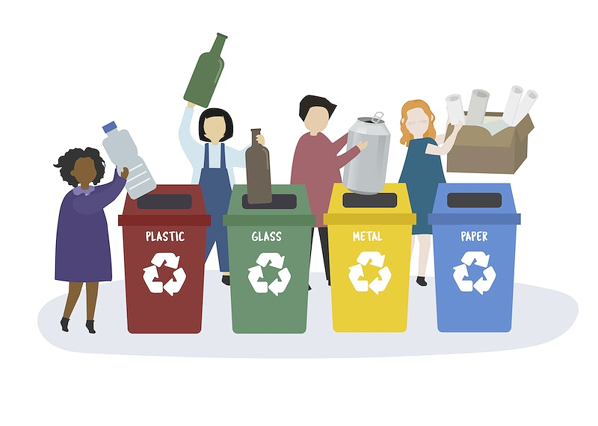

Slide 172
Where to dispose of waste after renovation?
In everyone's life, there are also non-standard or rare situations in which a particular type of waste occasionally occurs. A renovation, for example, can be such an event. There is a lot of commotion involved. Furniture is often delivered in packaging, paint containers, tape, polystyrene and many other products are left behind. What containers should I put them in? Here is a quick reference guide that everyone will find useful.
https://www.leroymerlin.pl/kuchnia/segregacja-smieci-w-pigulce-zasady-i-dobre-praktyki,e16818,l2722.html

Slide 173
packaging polystyrene | metals and plastics
adhesive tapes | mixed waste
paint containers | Point of Selective Collection of Municipal Waste
cardboard with tape | paper
brush | mixed waste
rubble | Point of Selective Collection of Municipal Waste
furniture | bulky-waste container
refrigerator | electrical and electronic equipment collection point
wallpaper | mixed waste
nitrile or rubber gloves | mixed waste
potting soil | mixed waste

Slide 174
METALS AND PLASTICS
We should dispose of:
unscrewed and crushed plastic drinks bottles
bottle tops, unless they are collected separately as part of a charity event
plastic food packaging
multi-material packaging (e.g. milk and juice cartons)
packaging for cleaning products (e.g. washing powder), cosmetics (e.g. shampoo, toothpaste), etc.
plastic bags, sacks, carrier bags, other plastic sheeting/foils
aluminium beverage and juice cans
tin cans
aluminium foil
non-ferrous metals
bottle tops, caps from jars
Do not dispose of:
bottles and containers with contents
plastic toys
Medication packaging and used medical supplies
motor oil packaging
car parts
used batteries and accumulators
cans and containers of paint and varnish
waste electronic equipment and household appliances

Slide 175
PAPER
Do not dispose of:
paper towels and used tissues
varnished and foil-covered paper
greasy or heavily soiled paper
milk and drink cartons
paper sacks of fertilizer, cement and other building materials
wallpaper
disposable nappies and other hygiene products
greasy disposable paper packaging and disposable tableware/crockery
clothing
We should dispose of:
paper packaging, cardboard (including corrugated cardboard)
catalogues, flyers, brochures
newspapers and magazines
school and office paper, printed pages
notebooks and books
wrapping paper
paper bags and sacks

Slide 176
GLASS
Do not dispose of:
ceramics, flowerpots, porcelain, faience, crystal
eyewear/spectalce glass
heat-resistant glass
grave candles with a wax content
light bulbs and fluorescent tubes
headlights
packaging for medicines, solvents, engine oils
mirrors
window panes and wired (reinforced) glass
TV monitors and lamps
thermometers and syringes
We should dispose of:
beverage and food bottles and jars (including alcohol and vegetable oil bottles)
glass packaging for cosmetics (unless it is made of several raw materials joined together permanently)

Slide 177
BIODEGRADABLE WASTE
We should dispose of:
vegetable and fruit waste (including peelings, etc.)
tree and shrub branches
grass cuttings, leaves, flowers
sawdust and tree bark
untreated wood
food leftovers
Do not dispose of:
animal bones
edible oil
animal faeces
coal ash
medicines
impregnated wood
chipboard and MDF
soil and stones
other municipal waste (including hazardous waste)

Slide 178
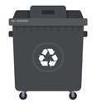
MIXED WASTE
Anything that cannot be recovered through the recycling process, excluding hazardous waste, should be put in the mixed waste container.

Slide 179
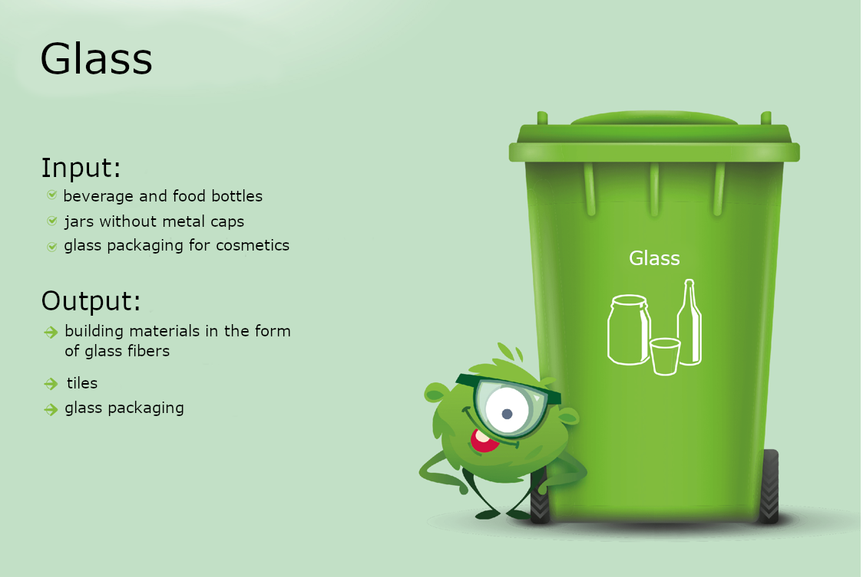

Slide 182
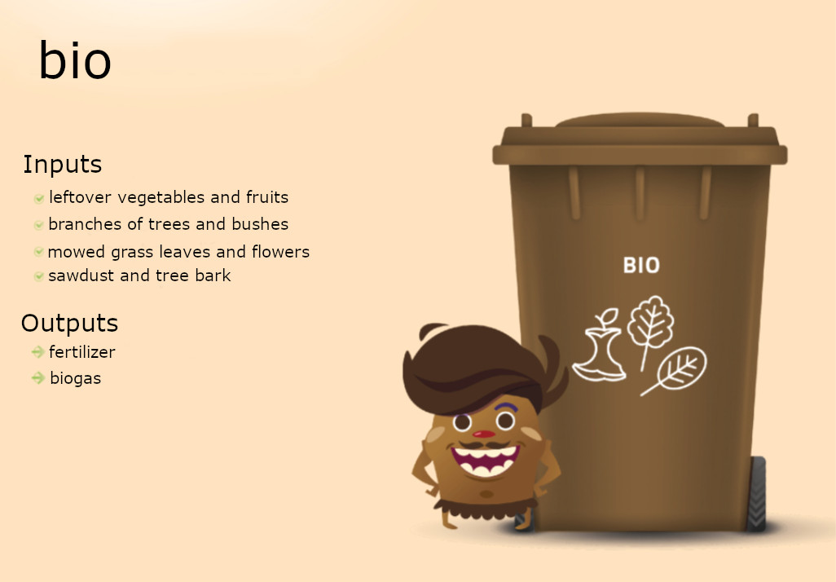

Slide 183
Greenwashing
also called "green sheen", is a form of advertising or marketing spin in which green PR and green marketing are deceptively used to persuade the public that an organization's products, aims and policies are environmentally friendly. Companies that intentionally take up greenwashing communication strategies often do so in order to distance themselves from the environmental lapses of themselves or their suppliers.
https://en.wikipedia.org/wiki/Greenwashing

Slide 184
Greenwashing is marketing communication by a company based on false or misleading claims about the environmental compliance of a product or its components.
http://sinsofgreenwashing.org

Slide 185
Examples of greenwashing:
The company uses hidden opportunity costs - misrepresents the environmental impact of a product (e.g. energy-efficient electronic devices are actually made of environmentally hazardous materials).
The company highlights as environmentally-friendly facts with no connection to reality - refers to something that is wrong (e.g. a claim in the US market that something "does not contain HCFCs" - i.e. hydrochlorofluorocarbons, the use of which was banned in the US in 2010, or emphasising that a cosmetic does not contain CFCs, when their use has been banned since the 1990s).
The company reduces its costs under the guise of environmental care (e.g. sending invoices by e-mail or asking to use towels less often).

Slide 186
We call it greenwashing when:
The company does not provide evidence - there is no information available on the environmental performance of the product nor any reliable certification.
The company is deliberately vague - the product descriptions are vague or unspecific and may be misunderstood by the consumer; an example is the term "all natural" (arsenic(III) oxide or mercury are found in nature but are highly poisonous - "natural" does not necessarily mean "green").
The company emphasizes the 'lesser evil' of using its products - for example, 'green' cigarettes or 'environmentally-friendly' pesticides.
https://pl.wikipedia.org/wiki/Greenwashing

Slide 187
We call it greenwashing when:
The company uses white lies - it illegally and unjustifiably uses eco-labels and certificates and uses overly exaggerated, suggestive images, fictitious data to prove the environmental performance of the product - in other words, the content and form of the false labelling is intended to mislead the customer.
The company distorts the real impact of the product on the environment - it highlights the ecological aspect (e.g. that the packaging is made of biodegradable material), but does not mention how large the ecological footprint of the production of the product itself or even of the packaging is.
The company omits certain information, the disclosure of which could compromise the "environmental" character of the product (e.g. a dry cleaner is called an eco-laundry).
https://pl.wikipedia.org/wiki/Greenwashing

Slide 188
https://pixabay.com/pl/photos/zmiana-klimatu-termometr-po%c5%bcar-lasu-3836835/
https://pixabay.com/pl/photos/tygrys-ogr%c3%b3d-zoologiczny-biopark-2182843/
https://pixabay.com/pl/illustrations/wzrost-rozw%c3%b3j-natura-%c5%9brodowisko-6756491/
https://pixabay.com/pl/vectors/wykrzyknik-wykrzyknika-krzyk-znak-350199/
https://www.nowy-sacz.info/50-most-polluted-cities-in-the-european-union/
https://naszesmieci.mos.gov.pl/jak-segregowac
https://agencja-informacyjna.com/greenwashing-w-przemysle-odziezowym/
https://pl.wikipedia.org/wiki/Greenwashinghttps://pl.wikipedia.org/wiki/Greenwashing

Slide 189
Disclaimer:
Funded by the European Union. Views and opinions expressed are however those of the author(s) only and do not necessarily reflect those of the European Union or the European Education and Culture Executive Agency (EACEA). Neither the European Union nor EACEA can be held responsible for them.

Slide 190
Key competences for people 50+
Course: Entrepreneurship, Module 2 "Ecology in my life"

Slide 191
European Green Deal
The main objective:
Transformation of the EU economy towards climate neutrality by 2050
Based on: https://klimada2.ios.gov.pl/europejski-zielony-lad/

Slide 192
1. Improvement of energy efficiency
could help reduce energy consumption in the EU by a half compared to 2005, it applies to the energy efficiency of both equipment and buildings. New buildings are built in accordance with the relevant standards, old buildings will be adapted thanks to EU financial assistance.

Slide 193
What can you do?
– Use devices wisely. Remember to turn them off when you're not using them. Remember that devices in standby mode and chargers left in contact also consume energy.
– Choose energy-saving household appliances and electronics. From March 2021, energy efficiency standards have changed - the most energy-efficient devices, which until now were marked as A+++, will now be marked as class C.
- Ensure that your flat/house is thermally upgraded to reduce heat loss in winter and coolness in summer - think about airtight windows, doors, roof and wall insulation.

Slide 194
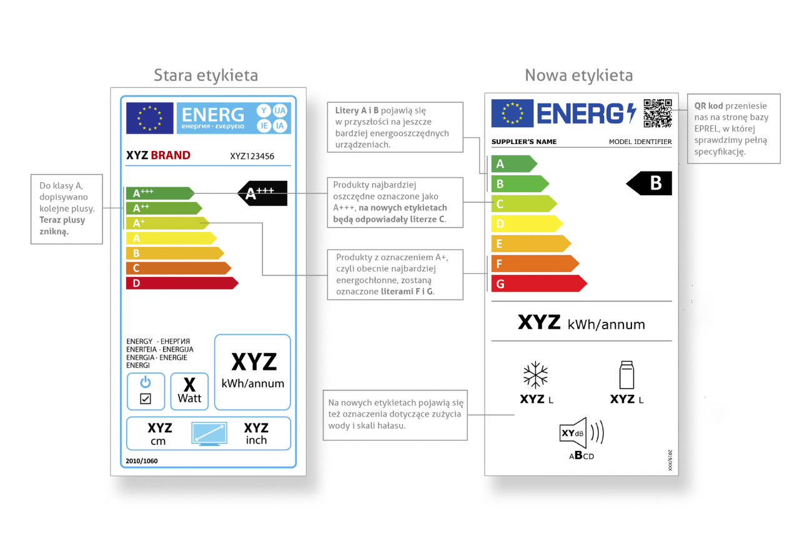
Picture describing the difference of Energy class plates on household appliances.
(more Energy class markings, water usage and noise level indicators and QR code implementation)

Slide 195
2. Implementation of renewable energy sources
which will reduce CO₂ emissions and meet the growing needs. The plan assumes that by 2050 over 80% of electricity will come from RES and will account for a half of the final energy demand in the EU. What can you do? – Change the way you heat your home – choose low- and zero-emission devices, e.g. solar panels or a heat pump. – Obtain green energy to power electrical equipment, e.g. from photovoltaic panels. – Check whether your energy supplier uses renewable energy sources (RES).

Slide 196
3. Clean, safe and connected mobility
Currently, transport is responsible for a quarter of EU greenhouse gas emissions. The modernization of all types of transport will contribute to the reduction of emissions into the atmosphere, and thus provide us with better air quality, lower noise levels and accident-free traffic. Particular emphasis will be placed on the development of safe paths for residents on bicycles and on foot. Facilitations will be related to the expansion of car and bicycle rental services. Public transport will be exclusively zero-emission. Large investments will allow the development of rail connections, so that train travel can partly replace carbon-intensive air travel.

Slide 197
What can you do?
– When buying a car, pay attention to its emissivity. – Take passengers and use eco-driving rules to reduce harmful exhaust emissions. – Plan your journey by choosing routes that will get you to your destination as soon as possible. – Limit business trips – where possible, organize online meetings. – Buy local products that have not had to be transported long distances. – Limit flights by plane – if possible, consider travelling by train.

Slide 198
4. Competitive and circular industry
Maintaining the competitiveness of the EU industry - currently one of the most efficient in the world - has been linked to the efficient use of resources and the development of a circular economy. As recycling becomes more popular, the production of many industrial goods, such as steel, glass and plastics, will become more resource-efficient and less carbon-intensive.

Slide 199
What can you do?
– Segregate your waste. Remember that garbage is a source of raw materials.
– Avoid plastic wherever possible.
– Do not buy products unnecessarily wrapped in plastic. Choose those in recyclable packaging, e.g. glass.
– Repair and pass on – instead of throwing away.

Slide 200
5. Infrastructure and connections
The completion of trans-European transport and energy networks will enable the economy to function more efficiently and exchange materials, products or information more quickly.
What can you do? – Use e-services and help develop them. – Buy local products that did not have to be transported far away – this way you will contribute to reducing your carbon footprint.

Slide 201
6. Bioeconomy and natural carbon sinks
It was assumed that a more efficient use of biomass would be needed in a zero emission economy. Its increased production must come from sustainable sources to ensure that forests and other ecosystems that absorb emissions in the EU are not degraded. The processes of revitalization of degraded forest areas and the protection of wetlands and peat bogs will contribute to improving the efficiency of CO2 absorption from the atmosphere and help to achieve negative emissions.

Slide 202
What can you do?
– Plant trees – they are the best CO2 sinks.
– Check if wood and paper products are certified as being sourced from sustainably managed forests (e.g. FSC).
– Save paper and remember to put used paper in segregated waste.
– If you are a farmer, limit the use of artificial fertilizers that deplete the soil.
– Choose organic products.
– Think about changes in your diet. Limit your meat consumption – meat production has a high carbon footprint and high methane emissions.
– Do not destroy forests and wetlands.

Slide 203
Interesting facts
https://www.un.org/en/actnow/facts-and-figures

Slide 204
Food
Three billion people cannot afford a healthy diet. Two billion are overweight or obese. Food systems generate one-third of all greenhouse gas emissions and are responsible for up to 80% of biodiversity loss.
17% of all food available at consumer levels is wasted. This amounts to a big waste of resources used in production, such as land, water, energy and other inputs, and unnecessary greenhouse gas emissions. By reducing food waste, you can save money, reduce emissions, and help preserve resources for future generations.
Meat and dairy provide just 18% of calories consumed, but use 83% of global farmland and are responsible for 60% of agriculture’s greenhouse gas emissions.
Shifting to healthy diets that include sustainability considerations can contribute to reductions in environmental impacts on land, energy and water use.
A diet that is higher in plant-based foods, such as vegetables, fruits, whole grains, legumes, nuts, and seeds, and lower in animal-based foods, has a lower environmental impact (greenhouse gas emissions and energy, land, and water use).

Slide 205
Home energy
Electricity drives our lifestyles. Although some 750 million people in the world still lack access to electricity, for the rest, everything from a computer to a television to a refrigerator needs energy.
The energy supply sector (electricity, heat, and other energy) is the largest contributor to global greenhouse gas emissions, responsible for approx. 35% of total emissions.
Globally, residential and commercial buildings, consume over half of all electricity.
Phasing out fossil fuels for home heating is crucial, for instance by banning on new gas-fired boilers and introducing electric heat pumps.

Slide 206
Increasing the thermostat setting from 24°C to 28°C during the cooling season can reduce annual cooling energy use by more than a factor of three for a typical office building in Zurich, Switzerland.
Energy demand for cooling is the fastest growing end-use in buildings, with ten air conditioners expected to be sold every second over the next 30 years.
Emissions from air conditioning and refrigeration are expected to rise 90% from 2017 levels by 2050.
Being mindful of the living space you need is important, too. In developed countries, the average living space per person has dramatically increased over the past decades.
Switching to renewable energy sources, such as solar, wind or hydroelectric power, also means less pollution and new and better jobs. Currently, around 80% of global energy and 66% of electrical generation are supplied from fossil fuels.

Slide 207
Transport
In most high-income countries, personal transport is the lifestyle domain with the largest contribution to the overall lifestyle footprint.
The world’s roadways are clogged with vehicles, most of them burning fossil fuels. Fossil fuels power the ships that carry trade and the airplanes that allow us to travel.
Greenhouse gas emissions from the transport sector have more than doubled since 1970, with around 80% of this increase coming from road vehicles.
Around 10% of the global population account for 80% of total motorized passenger-kilometres, with much of the world’s population hardly travelling at all.

Slide 208
But we do have alternatives to driving that can make a difference. Walking, biking, urban public transit and trains help reduce air pollution and greenhouse gas emissions.
Switching to an electric car can help reduce emissions, improve air quality and boost green jobs — if the electricity is not powered by fossil fuels. By achieving a 60% share of battery-electric and plug-in hybrid vehicles on the road, more than 60 billion tons of CO2 could be saved between now and 2050.
Domestic and International aviation is responsible for about 10% of global emissions in the transport sector, and an estimated 1% of the world population is responsible for more than half of these emissions.

Slide 209
Fashion
Being stylish does not mean being wasteful. Buying fewer clothes, shopping second-hand, or upcycling, i.e. creating new clothes out of old ones, helps save water and reduce waste.
In the last 15 years, clothing production has doubled while the number of times a garment is worn before being discarded has decreased by 36%.
The fashion industry (clothing and footwear) produces more than 8% of the greenhouse gases and 20% of global wastewater annually.
It takes about 7,500 litres of water to make a single pair of jeans -- from the production of the cotton to the delivery of the final product to the store.
85% of textiles end up in landfills or are incinerated although most of these materials could be reused. Every second, the equivalent of one garbage truck full of textiles is landfilled or burned.
Some 93 billion cubic meters of water -- enough to meet the consumption needs of five million people -- is used by the fashion industry annually.

Slide 210
Waste
Every year, an estimated 11.2 billion tonnes of solid waste is collected worldwide, and decay of the organic proportion of solid waste is contributing about 5% of global greenhouse gas emissions.
Where waste cannot be avoided, recycling leads to substantial resource savings. For every tonne of paper recycled, 17 trees and 50% of water can be saved.
Recycling also creates jobs: the recycling sector employs 12 million people in Brazil, China and United States alone.
Only 9% of all plastic waste ever produced has been recycled. About 12% has been incinerated, while the rest — 79% — has accumulated in landfills, dumps or the natural environment.

Slide 211
Water
Water is a precious resource: Less than 3% of the world’s water is fresh (drinkable), of which 2.5% is frozen in the Antarctica, Arctic and glaciers. And humans are misusing and polluting water faster than nature can recycle and purify water in rivers and lakes.
Using water smartly can help us ensure a steady flow of clean, safe water.
You can save water by taking shorter showers, turning off the tap when brushing your teeth, installing a low-flow toilet, and many other ways.

Slide 212
Using a refillable bottle, bringing your own reusable bag, and asking the restaurants you frequent to stop using plastic straws helps reduce plastic waste.
Around the world, one million plastic drinking bottles are purchased every minute, while up to 5 trillion single-use plastic bags are used worldwide every year. In total, half of all plastic produced is designed to be used only once — and then thrown away.
From 2010 to 2019, e-waste generated globally grew from 5.3 to 7.3 kilograms per capita annually. Meanwhile, the environmentally sound recycling of e-waste increased at a much slower pace – from 0.8 to 1.3 kilograms per capita annually.

Slide 213
With one shower of about 10 minutes a day, an average person consumes the equivalent of over 100,000 glasses of drinking water every year.
Severe water scarcity affects about 4 billion people, or nearly two thirds of the world population, at least one month each year.
Agriculture is by far the largest water consumer, accounting for 72% of annual water withdrawals globally. Shifting towards a plant-based diet is one of the most impactful actions one can take to save water.

Slide 214
Disclaimer:
Funded by the European Union. Views and opinions expressed are however those of the author(s) only and do not necessarily reflect those of the European Union or the European Education and Culture Executive Agency (EACEA). Neither the European Union nor EACEA can be held responsible for them.

Slide 215
Key competences for people 50+
Course: Entrepreneurship, Module 2 "Ecology in my life"

Slide 216
Household budget - ecological perspective

Slide 217
Plant-based diet
Research from the University of Oxford in 2021 showed that in Europe, Australia and the USA, switching to a plant-based diet results in savings of 25-29 per cent.

Slide 218
A bicycle instead of a car
Giving up or limiting the use of the car results in savings of several hundred zlotys per month.
It also reduces air pollution – passenger cars in Europe generate more than 60% of all CO2 emissions from road transport.
Regular cycling affects good physical shape, stimulates and improves the work of the heart, lungs and circulatory system, reduces the risk of cardiovascular diseases.

Slide 219
Collecting rainwater
Rainwater is not suitable for drinking, but it can be used for watering the lawn, garden, washing and cleaning.
By collecting rainwater, you can save up to 50% of drinking water.
During a 10-minute rain, approx. 180 liters of water can be collected from a 120 m2-roof. That's what it takes to take 5 showers, do 6 washing or flushing the toilet 30 times.

Slide 220
Make full use of the food you buy
About 1/3 of food worldwide is wasted. This is a huge burden on wallets and on the climate.
Food production requires large amounts of water, land and energy.
Before shopping, it is important to consider how much food you actually need, and only stock up on products with a sufficiently long shelf life.
Applications, e.g. Too Good To Go, thanks to which you can buy surplus food from various stores and restaurants at attractive prices.

Slide 221
Limiting clothing purchases
The 2015 documentary The True Cost revealed that humanity consumes around 80 billion new clothes a year, 400 per cent more than 20 years ago.
One of the reasons for this is the chain stores - so-called fast fashion, i.e. cheap clothing produced for little money that takes into account current trends, is quickly marketed and the unsold surplus ends up in landfills.
Some chain stores introduce as many as 50 collections a year.

Slide 222
Low production costs are associated with practices that degrade the environment and employing workers in poor conditions, threatening their health and life.
Washing clothes that are mostly plastic increases the amount of microplastics in the oceans and seas.
According to data from 2017, up to 35% of microplastics comes from washing synthetic fabrics (International Union for Conservation of Nature).

Slide 223
Quit smoking
Cigarettes have a negative impact not only on health and finances, but also on the environment.
One of the most common forms of man-made pollution is littering the environment with cigarette residue.
As much as 65% of all cigarette butts are thrown into the environment.
Cigarette butts often end up in the sewage system and from there go into rivers and oceans.

Slide 224
Due to the content of harmful organic compounds: nicotine, derivatives of pesticides or metals, cigarette butts pose a threat to marine ecosystems.
Filters used in cigarettes are mostly composed of cellulose acetate fibres, a type of bioplastic that can take several decades to decompose.
E-cigarettes are also harmful - batteries contain dangerous substances such as mercury and lead.

Slide 225
Drinking tap water
Around 1.2 million plastic bottles are used every minute on Earth.
Approximately 91% of plastic is not recycled.
The composition of tap water is no different from that in bottles, and is sometimes more favourable in terms of mineral concentration. These include the calcium, magnesium, phosphorus, sodium, sulphur, copper and potassium that humans need. The presence of calcium magnesium is indicated by limescale deposited in the kettle, which is often mistakenly regarded as a sign of poor water quality.
It is possible to buy a reusable bottle, such as a glass one, to fill with tap water.
Such water is cheaper (up to 600 times cheaper).

Slide 226
Disconnecting unused devices from the power supply
Phantom charging is responsible for wasting 30% of household energy.
Phantom charging is a phenomenon in which appliances consume electricity even when switched off.

Slide 227
Conscious shopping
In Poland, two-thirds (almost 70%) of missed purchases are grocery purchases.
The second most common is stimulants (31%).
28% of Poles admit to buying unnecessary clothes.
Restaurants (22%) and hobbies (19%) are the next expenses Poles describe as ill-considered/hasty.

Slide 228
Disclaimer:
Funded by the European Union. Views and opinions expressed are however those of the author(s) only and do not necessarily reflect those of the European Union or the European Education and Culture Executive Agency (EACEA). Neither the European Union nor EACEA can be held responsible for them.

Slide 229
Key competences for people aged 50+
Course: Entrepreneurship
Module 3: Projects in My Life

Slide 230
What is a project?
A temporary, gradually refined undertaking aimed at achieving a unique result or solving a specific problem.
From: M. Kapusta, Zarządzanie projektami krok po kroku. Warszawa: Edgard, 2013, ed. I, p. 8.
Key features:
Focus on achieving a unique and specific goal
Limitation of time - with a clearly defined start and end (schedule)
Coordinated, joint and interrelated activities carried out in a team
Specified budget and resources (e.g. human, equipment, financial resources, know-how, etc.)
R. Luecke, N. Oparska (trans.), Zarządzanie projektami małymi i dużymi: podstawowe umiejętności pracy zgodnej z budżetem i terminarzem. Warszawa: Wydawnictwo MT Biznes, 2006, p. 9.

Slide 231
What elements does the project consist of?
The need to implement the project
Project recipients
Main goal
Actions (and specific objectives)
Risk of failure to achieve project assumptions
Schedule
Project effects
Project management
Staff (including volunteers)
Cost estimate (budget) of the project

Slide 232
Stages of project management:
Initiating,
Planning,
Executing,
Controlling and monitoring,
Closing.

Slide 233
Problem analysis
The analysis of problems allows for an in-depth understanding of them, and thus - finding the most effective solution.
Tools:
→ problem tree – a pictorial way of presenting the logic of a given situation
The problem tree allows you to analyze and visualize the links between the main problem, its consequences and root causes; shows cause and effect-relationships.
→ tree of objectives – a visual way of presenting the intervention logic

Slide 234
Goal analysis
Setting goals using the SMART method helps to define goals correctly, which increases the chances of achieving them. The name is an acronym consisting of the English words:
Specific
Measurable
Achievable
Relevant
Time-bound

Slide 235
Specific
The goal must be clearly and specifically defined
We precisely describe the goal, not the way to achieve it
Understandability of the message

Slide 236
Measurable
Indicators
Quantifiers

Slide 237
Achievable
Is the given goal achievable, e.g. within the set time?
Determining the necessary resources
The goal should also be attractive and ambitious

Slide 238
Relevant
An important goal is the basis for a sense of meaning and motivation to work
Each team member should feel that they play an important role in achieving the goal
A goal has value for those who pursue it

Slide 239
Time-bound
Setting a deadline for the set goal
Setting a deadline for its achievement
Determination of specific start, end and milestone dates
Adoption of realistic assumptions: the time to achieve the goal can be neither too short (pressure, threat that the goal will not be achieved), nor too long (decrease in motivation)

Slide 240
Project Schedule
Gantt chart - the most common tool for presenting the time dependencies of the project. Visualizes the project schedule and related tasks/events in the project lifecycle using a bar chart.
The bars of the graph represent tasks, and their length reflects the amount of time needed to complete these tasks.
The Gantt chart may consist of the following elements:
The date and duration of each task
Tasks
Task owner
Milestones

Slide 241
Creating the Gantt chart
Specify the time period - set the start and end date of the project.
Add tasks to the chart - for each task, it is also good to set its start and end date, duration.
Determine the dependencies between individual tasks in the project.
Set milestones - "checkpoints", specific points in time that represent the completion of larger groups of tasks and serve to prioritize them. These can be: team meetings, project approvals, task start, endpoint of a project stage, etc.
Source : https://asana.com/pl/resources/gantt-chart-basics _

Slide 242
Project budget - definition
Project budget – „is a financial plan for the implementation of the project or a numerical expression of the plan of activities in the project, enabling the measurement of project performance in financial terms. It is also referred to as the breakdown of costs, presented in tables, for the use of activities carried out in the project.”
Source : https://mfiles.pl/pl/index.php/Bud%C5%BCet_projektu _

Slide 243
Step by step: project budget
1. Once the goals of the project are set, the scope of work needed to achieve them should be defined. The scope of the project describes what final products we want to achieve and when. We need to consider factors such as available resources, time constraints, and what we don't want to achieve (if something is outside the scope of the project, it can also potentially be over budget).
2. Create a list of the final products of the project and break them down into smaller elements, e.g. if the project product is publishing an article on a blog, it can be divided into components, e.g. drafting, proofreading the article, designing images/graphics, sharing on social media, etc.
3. Make a list of the resources needed to deliver the final products, e.g. team members (maybe some work needs to be outsourced?), training, equipment, work space, data collection, professional services, travel costs, etc.

Slide 244
Step by step: project budget
4. Estimate the cost:
Estimating from scratch - estimate the cost of each element separately and add them together
Backward estimation from a certain amount – it consists in selecting the amount and spreading it over the final products and milestones of the project. It will work in a situation where we want to check what we can achieve within a certain budget
Estimating by comparing budgets of similar projects, by analogies
Estimate by considering different scenarios - the average cost of different scenarios can then be taken as the budget

Slide 245
A budget document should include several key elements:
A list of the elements that make up each end product of the project and the required resources along with the cost of each.
A timeline indicating when you will need each resource and when you will spend the funds.
A person responsible for each element of the budget. For example, you can write that the assistant editor is responsible for monitoring the hours worked by freelancers and the invoices received from them.
Clear documentation of what part of the company's budget will be paid for which item. For example, your marketing budget might pay for video ads, and your IT budget might pay for a software update.
The total cost of the project. If necessary, you can include the individual amount of budget available in each department.
A place where once the project starts, you can monitor the actual cost against the planned cost on an ongoing basis.
Source : https://asana.com/pl/resources/project-budget _

Slide 246
Risk management
Project risk management is a series of activities aimed at identifying and reducing or eliminating threats that could affect the successful implementation of the project.
Project risk is typically:
operations that will not be successful and may lead to losses or hinder the achievement of the goal,
operations whose result is not known - it can be better or worse, but - unlike the previous risk - here we can see not only a threat, but also an opportunity.
It is necessary to recognize all threats and focus on identifying factors that may threaten the smoothness of project implementation, achievement of goals, but also those that represent an opportunity. Risk can be identified based on various methods, e.g. by brainstorming or using the Delphi method (seeking advice from experts).

Slide 247
After identifying the risks, you can create the so-called register of threats, i.e. a list of threats that may occur in the project. Sample questions that will help you create such a record:
What are the chances of this risk occurring?
What is the probability of this risk occurring?
What will be the impact and severity of this risk?
What is our response plan for this risk?
Given the likelihood and impact, what is the priority of this risk?
Who is responsible for this risk?
Don't worry if we can't answer all your questions right away. Some answers will emerge during the next steps.
Source : https://asana.com/pl/resources/project-risk-management-process

Slide 248
Project results
The effects of the project can be divided into three categories that result from each other:
products
results
impact
Products are all countable goods and services that will be created as part of our project. Number of printed training materials or books, number of trainings, number of consultations, number of internships, number of beneficiaries of training, internship, conference, workshop, etc.
Results are all the immediate and direct benefits that the beneficiaries have derived from participating in the project, and more specifically in a given product. The result may be, for example, raising the level of knowledge or acquiring new skills or changing attitudes.
Source: https://aktywny.blog/2015/06/03/produkt-rezultat-efekt-oddzialywanie-czym-to-jesc/

Slide 249
We divide the
Hard results - easy to measure: increase in knowledge and skills among beneficiaries, measured e.g. through tests, certification, subjective feelings of participants;
Soft results - difficult to measure: change of attitudes, breaking barriers, increasing motivation, increasing interest in a certain topic.
Quantitative and qualitative results – this division applies to indicators, but it can also be applied to project outputs, e.g. cultural projects. For example, the product "theatrical performances" can be converted into a "high-quality theatrical performance", and the quality will be confirmed by the number of positive reviews or the number of famous artists involved in the production.
The impact is the long-term effect of the fact that the beneficiaries of our project will find themselves back in their communities. The impact is defined in the long term and usually extends significantly beyond the end date of the project. We usually refer to it as an estimation because there are no mechanisms to measure it. We can only observe it. The logic of the entire project and the selection of appropriate activities tell us what the impact will be.
Through products we achieve results that have a certain impact.
Source: http://wid.edu.pl/2018/03/wskazniki-produktu-rezultatu-projektach-ue/

Slide 250
Sources
M. Kapusta, Zarządzanie projektami krok po kroku. Warszawa: Edgard, 2013, wyd. I.
R. Luecke, N. Oparska (tł.), Zarządzanie projektami małymi i dużymi: podstawowe umiejętności pracy zgodnej z budżetem i terminarzem. Warszawa: Wydawnictwo MT Biznes, 2006.
J. Martins, Czym jest zarządzanie ryzykiem w projekcie? 6 kroków do zwiększenia szans powodzenia projektu, https://asana.com/pl/resources/project-risk-management-process
https://www.google.com/url?sa=t&rct=j&q=&esrc=s&source=web&cd=&ved=2ahUKEwiXgZS8gJ__AhWSjYsKHU8WDWwQFnoECAkQAQ&url=https%3A%2F%2Fngo.krakow.pl%2Fpliki%2F5016&usg=AOvVaw31sLjapCYYTnrlk2emFvtS
https://www.datocms-assets.com/36998/1608568194-zarzadzanieprojektemsempre.pdf
https://efektpmo.pl/jak-definiowac-cele-w-projektach/
https://mfiles.pl/pl/index.php/Zasada_SMART
https://mtc.pl/cele-smart/
https://www.powiat-slupca.pl/wp-content/uploads/2021/07/Podrecznik-nt-tworzenia-projektow.pdf
http://zarzadzanieprojektami.it/21.html
https://en.duf.dk/fileadmin/user_upload/Editor/5_The_problem_tree_and_development_of_solutions.pdf
https://asana.com/pl/resources/gantt-chart-basics
https://mfiles.pl/pl/index.php/Bud%C5%BCet_projektu
https://asana.com/pl/resources/project-budget
https://publicystyka.ngo.pl/czym-jest-rezultat-w-projekcie
https://aktywny.blog/2015/06/03/produkt-rezultat-efekt-oddzialywanie-czym-to-jesc/
https://mtc.pl/zarzadzanie-ryzykiem-w-projekcie/
https://asana.com/pl/resources/project-risk-management-process

Slide 251
Disclaimer:
Funded by the European Union. Views and opinions expressed are however those of the author(s) only and do not necessarily reflect those of the European Union or the European Education and Culture Executive Agency (EACEA). Neither the European Union nor EACEA can be held responsible for them.

Slide 252
Key competences for people aged 50+
Course: Entrepreneurship
Module 3.2: Personal Projects

Slide 253
Personal projects
Definition:
"any kind of activity that requires planning, formulating goals, organizing activities".
Sikora, K. (2005). Zmiana osobowości w ujęciu psychologii projektów osobistych. In: A. Niedźwieńska (red.), Zmiana osobowości. Wybrane zagadnienia. Kraków: Wydawnictwo Uniwersytetu Jagiellońskiego, p. 77.
Typology:
Inter- / intrapersonal
Short- / long-term
General / more specific
Feasible/impossible
The projects most often concern education, professional work, children/family, household, leisure time, social life, health, and other activities of everyday life.

Slide 254
Personal projects are not just what people plan, it's something more concrete - what people work on. Projects can range from afternoon plans to lifetime plans, from simple tasks such as taking out the garbage to very complex tasks such as maintaining a relationship in crisis.
The project, although it can be described in a simple sentence ("I want to...", "I plan...", "I intend to..."), is in fact a process in which the phase of project formulation, planning, implementation, evaluation of the operation effects and possible modification can be distinguished.
The project is assessed by the person who implements it - it can be perceived as easy/difficult, important/unimportant, giving/unsatisfying, etc. At every moment of their life, a person is involved in many projects of varying complexity, advancement, time range and different - subjectively perceived - importance.
Sikora K. (2008). Projekty osobiste - samoregulacja ukierunkowana na rozwój. In: Niedźwieńska. (red.) Samoregulacja w poznaniu i działaniu, UJ, Kraków, pp. 104-105.
https://core.ac.uk/download/pdf/250299874.pdf (accessed November 18, 2022)

Slide 255
Self-motivation
"Motivation refers to the mental sphere of a person, it is internal, attribute-based, it is a process of regulation that controls activities so that they lead to the achievement of a specific result, goal."
Jasiński Z. (2006), Podstawy zarządzania operacyjnego, Oficyna ekonomiczna, Kraków, p. 249.
Self-motivation is motivating and stimulating oneself to act.

Slide 256
To increase your level of motivation, you can:
Change the perception of a given task,
Change the conditions, e.g. environment,
Change your approach to the task,
Change your usual way of dealing with a given task, try a different approach,
Make changes in yourself,
Change the reward (or designate one),
Changing the “stick” – e.g. telling someone what you are going to do and what your goal is – will make it harder to fail in a task that someone else knows about.

Slide 257
Sources:
Sikora K. (2008). Personal projects - self-regulation focused on development. In: Niedźwieńska A. (ed.) Self-regulation in cognition and action, ed. Jagiellonian University, Krakow. https://core.ac.uk/download/pdf/250299874.pdf _ _
Sikora, K. (2005). Personality change in terms of the psychology of personal projects. In: A. Niedźwieńska (ed.), Change of personality. Selected Issues. ed. Jagiellonian University, Krakow. https://ruj.uj.edu.pl/xmlui/bitstream/handle/item/81479/sikora_zmiana_osobowosci_w_ujeciu_psychologii_projektow_osobistych_2005.pdf?sequence=1&isAllowed=y _ _
Jasiński Z. (2006), Fundamentals of operational management , Oficyna Ekonomiczna, Krakow.
https://mfiles.pl/pl/index.php/Automotive _
Ingham C. (2000), Self- motivation in 101 ways , IFC Press.
Sikora K. (2008). Projekty osobiste - samoregulacja ukierunkowana na rozwój. W: Niedźwieńska A. (red.) Samoregulacja w poznaniu i działaniu, wyd. UJ, Kraków. https://core.ac.uk/download/pdf/250299874.pdf
Sikora, K. (2005). Zmiana osobowości w ujęciu psychologii projektów osobistych. W: A. Niedźwieńska (red.), Zmiana osobowości. Wybrane zagadnienia. wyd. UJ, Kraków. https://ruj.uj.edu.pl/xmlui/bitstream/handle/item/81479/sikora_zmiana_osobowosci_w_ujeciu_psychologii_projektow_osobistych_2005.pdf?sequence=1&isAllowed=y
Jasiński Z. (2006), Podstawy zarządzania operacyjnego, Oficyna ekonomiczna, Kraków.
https://mfiles.pl/pl/index.php/Automotywacja
Ingham C. (2000), Automotywacja na 101 sposobów, IFC Press.

Slide 258
Disclaimer:
Funded by the European Union. Views and opinions expressed are however those of the author(s) only and do not necessarily reflect those of the European Union or the European Education and Culture Executive Agency (EACEA). Neither the European Union nor EACEA can be held responsible for them.

