Slide 1
Key competences for people 50+
Course: Literacy
Material for learners

Slide 2
MODULE 1 – LANGUAGE IN DIFFERENT CONTEXTS
Material:
Levels of language – introduction and example texts
Short form –introduction and example texts for an invite and a meeting summary

Slide 3
Levels of language – social media
The social media opinion and commentary field refers to the comments and opinions posted by individuals on social media platforms, such as Twitter, Facebook, or Instagram.
These comments are often unfiltered and can be emotionally charged. They may contain inaccuracies or misrepresentations of facts and are not typically subjected to rigorous fact-checking.
What expectations would you have for language used in social media? Consider the following:
Formal/informal
Correct spelling and grammar
Vocabulary

Slide 4
Social Media Opinion:
"Bicycles on pedestrian lanes in Oslo are a total nightmare! Get off and walk your bike or stay in the cycling lane, idiots! #pedestriansfirst"
Comment 1: "I totally agree!!!! It's so dangerous and annoying to have bikes weaving in and out of pedestrians on the sidewalk."
Comment 2: "I disagree, it's not always possible to cycle on the road, and there are so many pedestrians in the cycling lanes. Let's share the sidewalk!"

Slide 5
Levels of language - news articles
A newspaper article is a piece of writing published in a newspaper or an online publication that provides readers with news, opinions, and analysis of current events.
Newspaper articles are typically written by professional journalists who are trained to report accurately and objectively. They often follow strict guidelines and standards of journalistic ethics and are subject to editorial review and fact-checking
What kind of expectations would you have for the language used in news article? Consider the following:
Formal/informal
Correct spelling and grammar
Vocabulary

Slide 6
Oslo KK50+ News, 31.5.2025:
Oslo's pedestrian lanes have become a contentious issue in recent years, with cyclists increasingly using them as shortcuts. On Monday afternoon in front of the Oslo City Hall, cyclist Simon Hansen and pedestrian Amina Smith shared their thoughts on the matter.
When asked about the problem, Simon stated that while he understood the frustration of pedestrians, he felt that using the pedestrian lane was sometimes necessary to avoid heavy traffic. Maria, on the other hand, felt that cyclists should not be using the pedestrian lane at all, as it posed a danger to pedestrians. Both agreed that the issue required a solution that would satisfy everyone.
"We need to find a way to share the lanes and respect each other's space," said Simon. Maria added that "enforcement of existing laws and regulations" was also important to ensure safety for everyone.
Reporter: Alexander Ramos

Slide 7
Levels of language – official texts
An official text from authorities refers to documents or statements released by government agencies, institutions, or other authoritative bodies.
These texts are typically written in formal language and are designed to provide accurate and reliable information to the public. They are often subject to legal scrutiny and may contain technical jargon or specialized terminology
What kind of expectations would you have for language in this kind of texts? Consider the following:
Formal/informal
Correct spelling and grammar
Vocabulary

Slide 8
"According to the Oslo City Code of Conduct, bicycles are not allowed on pedestrian lanes. Cyclists must use designated cycling lanes or ride on the road. Failure to comply may result in a fine."

Slide 9
How to get started - short form Invitation
When you write an invitation, think about the following questions:
- What is the activity?
- Who is the invitation for, who is the reader?
- When and where does the activity take place?
- How do you want the invitees to contact you?
- Is the invitation personal (e-mail attachment, text message, letter) or public (Facebook event, information board at the coffee room)?
- Do you expect an answer from the invitees?
See examples of short invitations on the next page

Slide 10
Invitation to a public event
You're invited to the International Food Festival organized by the women's group Dialogue! Join us on Saturday 20th of May, from 12.00 to 15.00, at the beautiful Victory Park in the city center. There will also be music and entertainment to enhance your experience. So come and join us for an afternoon of fun, food, and friendship! Don't miss this chance to taste the world, right here in our city.
Entrance is free, and all are welcome. We hope to see you there!
For more information, contact: XXX

Slide 11
Invitation to a private event
Dear Ingrid and Mariusz
It's been five years since we took that amazing trip to Greece, and we've been thinking about it a lot lately. We thought it would be great to get together with our group of friends to reminisce and catch up.
So, we are organizing a small dinner soiree on November 25th at our place in Huelva Street 18, and we would love for you to join us. We'll be cooking some delicious Greek food, and we'll be listening to Greek music to set the mood. It's going to be a night full of laughter, good food, and fond memories.
Please let us know by November 20th if you can make it, so we can plan accordingly. We can't wait to see you two and spend an evening together.
Best regards,
Amina and Anne
(phone number for contact)

Slide 12
How to get started – short form A meeting summary
Writing a meeting summary is a useful skill both at work and in any collective activity where planning takes place. The summary makes it easier to follow the decisions and work processes neede for the common goal.
Official meetings have an agenda – a list of issues that will be discussed in the meeting. Usually, the points in the agenda are used as the main points in the summary, too.
Sometimes the agenda does not exist, and the person writing the summary (often called the secretary of the meeting) will have to evaluate what is important to include in the summary. If you are unsure, you can ask the attendees if the subject should be included in the summary. You can also read the main points of your summary to everyone in the end of the meeting.
Send a copy of the meeting summary both to everyone who attended the meeting and those who were invited, but were not present.

Slide 13
What should be included in a summary?
Date, time and location of the meeting
List of attendees and their roles or positions
Brief overview of the agenda and topics discussed
Summary of the main points or decisions made during the meeting
Action items or next steps identified during the meeting, including who is responsible for each item and the deadline for completion
Any important announcements or updates shared during the meeting
Date and time of the next meeting, if applicable.
Keep the summary concise and to the point, focusing on the most important information shared during the meeting. It should provide a clear picture of what was discussed, what was decided, and what needs to happen next.

Slide 14
Project Fleamarket, Meeting summary May 15th 2023
Attendees: Anna, Amina, Mariusz
Summary:
During the meeting, we discussed the details of the flea market, which will take place on the backyard of Mariusz house on the last Saturday in June. We decided that each of us will bring their items to sell, such as clothes, books, and household items, and can ask two friends to do the same.
Areas of responsibility: Anna will take care of setting up tables and chairs, Amina will handle pricing and selling, while Mariusz will be in charge of handling the money and keeping track of the sales.
Finally, we brainstormed some ideas for a marketing strategy. We decided to create flyers and distribute them in the neighborhood, as well as post about the event on local community groups on social media. We will decide who does what in the next meeting.
Next Meeting: Our next meeting will be on June 10th, 2022, at Anna's apartment to finalize the details of the flea market.

Slide 15
Other short form texts
Here are some other texts you might want to practise writing:
Short messages to your employer, landlord, teacher, janitor
Complaints: noisy neighbours, wifi not working, parking tickets etc
Short applications: asking free from work/school, applying for economical support or funding for a specific project etc
Thank you –notes for presents, kind words etc
Always start with questions to yourself: what, where, why, to whom and how
Remember the tone, informal/formal, friendly/firm
Ask the trainer for more ideas!

Slide 16
MODULE 2 – CONTRACTS, GUIDELINES AND INSTRUCTIONS
Material:
Wordbank – how to get started
Composing an e-mail

Slide 17
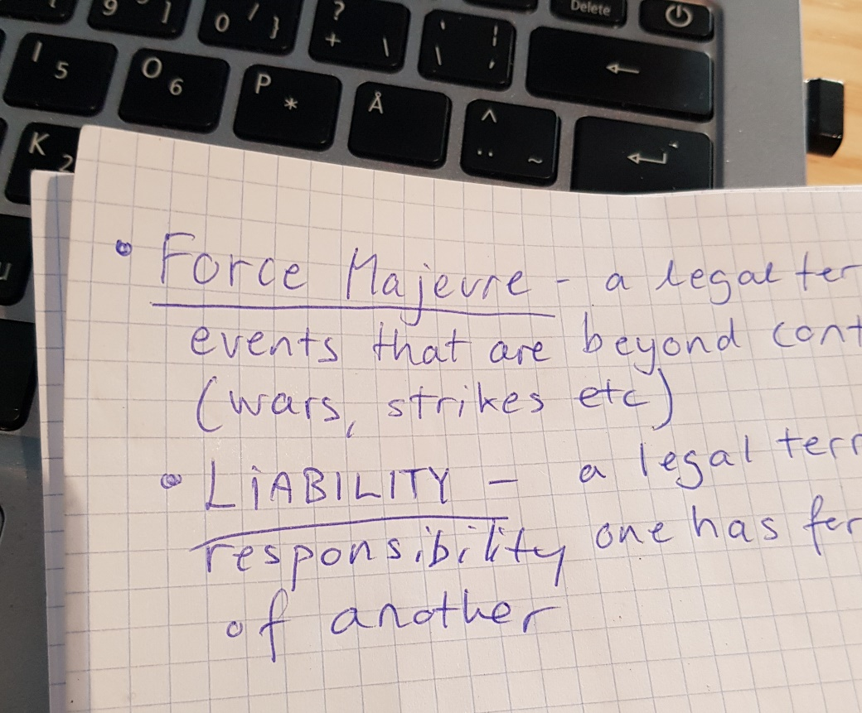
Word bank – a method for learning challenging vocabulary

Slide 18
Word bank – how to get started:
A word bank is a method for learning difficult words that involves creating a list of challenging vocabulary words and their definitions, and then studying and practicing them regularly.
Identify difficult words: Start by reading the text you find difficult to understand. Look for words that you find particularly challenging.
Create a list: Write down each difficult word and its definition. You can use a designated writing block or a digital tool, such as a spreadsheet or flashcard app.
Practice and review: Study your word bank regularly by reviewing the definitions and using the words in sentences. You can also practice by writing short paragraphs or stories that use the words in context.
Expand your word bank: As you become more comfortable with the words on your list, add new challenging words to your bank to continue expanding your vocabulary.
Using a word bank can help you improve your vocabulary and feel more confident when reading and writing contracts and other texts with difficult words!

Slide 19
Writing an e-mail – good practises
Use a clear and concise subject line.
Address the recipient appropriately: Use the appropriate salutation, such as "Dear“ followed by the person's name, and make sure to spell their name correctly.
Keep the email brief and to the point: Avoid writing long paragraphs and unnecessary details. Stick to the main point of your email and keep it concise.
Use proper grammar and spelling: Take the time to proofread your email for any spelling or grammar errors.
Use a respectful and professional tone, even if you are emailing a friend or colleague. Avoid using slang or informal language.
Include a clear call to action: If you are asking the recipient to do something, make sure to clearly state what you are asking for and any deadlines.
Remember to sign off the e-mail with a phrase like “Best regards”, “Best” or other.
Include your name and contact information in your email signature.

Slide 20
Phrases you can use at the beginning and end of an email:
1. Beginning: "Dear [Name], "Hello [Name], "Good morning/afternoon [Name],"
2. The first sentence: "I hope this email finds you well,“, "Thank you for your prompt response to my previous email," (if you are following up on a previous email)
3. The last sentence: "Looking forward to hearing from you,“, "Let me know if you have any questions,“,"Have a great day,"
4. End: "Best regards,“, "Sincerely,“, "Thank you,“, "Thanks in advance," (if you are requesting something)
Using appropriate phrases at the beginning and end of your email can help establish a professional tone and leave a positive impression on the recipient.
Read the following examples and examine how they differ from each other…

Slide 21
Amina is having a difficult life situation and has to inform her employer that she can’t make it to an important meeting at work. What kind of impression of her do these two e-mails leave?
Subject: This and that
Hey Boss,
What's up? Just wanted to let you know that I'm gonna be late for work and can’t come to the meeting tomorrow morning. I'm super swamped with other stuff right now and I'm having some trouble getting it sorted out
Anyway, just wanted to give you a heads up. Catch you later XXX
Hugs, Amina

Slide 22
Subject: Running Late for Meeting
Dear [Boss’s Name],
I hope this email finds you well. I wanted to inform you that I will be running late for the meeting tomorrow morning and unfortunately won’t be able to attend. I apologize for any inconvenience this may cause.
Currently, I am handling a few urgent things that require my immediate attention. I am doing my best to resolve these issues as soon as possible so that I can get back to my regular schedule.
Thank you for your understanding, and please let me know if there is anything I can do to help make up for this missed meeting.
Best regards,
Amina Smith

Slide 23
MODULE 3 – ACTIVE CITIZENSHIP
Definitions of the public, private and third sector
Phrases and words for communication with public entities

Slide 24
Public sector
Public sector refers to the part of the economy that is controlled and managed by the government, including government agencies and institutions, such as schools, hospitals, police departments, and public utilities.
The main aim of the public sector is to provide essential services to the citizens of a country, funded by tax revenue.

Slide 25
Discuss:
How is the public sector organized where you live?
Which services are provided by the local, regional and national government, agencies and institutions?
Do you know how to contact them?

Slide 26
Private sector
Private sector refers to the part of the economy that is owned and managed by private individuals or companies, including businesses such as retail stores, manufacturing companies, and financial institutions.
The main aim of the private sector is to generate profit for the owners or shareholders

Slide 27
Discuss:
Can you give examples of entities that belong into the private sector where you live?
When and why would you contact them, and do you know how to do it?

Slide 28
The third sector
The third sector, also known as the non-profit or voluntary sector, refers to organizations that are neither part of the public nor private sector, such as charities, social enterprises, and community groups.
The main aim of the third sector is to promote social or environmental objectives, rather than generating profit or providing services directly to the government or citizens.
The third sector relies on donations, grants, and other forms of support to fund their activities.

Slide 29
Discuss:
Why do we have the third sector?
Can you name entities that belong in the third sector where you live?
Do you know how to contact them?
Choose one such entity and find out together how they get their funding.

Slide 30
Some useful phrases for formal written communication
INTRODUCTION
I am writing to express my concern about...
I would like to bring to your attention the issue of...
I am writing to express my dissatisfaction with...
SPECIFICS
I would like to draw your attention to [give specific details of the problem]...
It appears that [state the cause of the problem or issue]...

Slide 31
REQUEST FOR ACTION
I would appreciate it if you could [state the action you want to be taken]...
I request that the matter be investigated and appropriate action taken...
I urge you to take immediate steps to rectify the situation...
CLOSING
I look forward to hearing from you soon...
Thank you for your attention to this matter...
I trust that you will take this matter seriously and resolve it as soon as possible...

Slide 32
MODULE 4 – INFORMATION
MATERIAL:
How to agree to disagree, respectfully
Where to start when you want to verify a piece of news

Slide 33
Expressing disagreement
Expressing disagreement in a respectful tone is important in maintaining a positive and productive group dynamic.
By following the tips on the next slide, a group of students or workers can express disagreement in a way that promotes open communication and positive group dynamics.
Do you know other ways you can ensure a respectful tone in conversation?

Slide 34
Listen carefully to the speaker and try to understand their perspective. This shows respect and helps to ensure that your response is well-informed.
Use "I" statements: Rather than attacking the speaker or their ideas, focus on your own perspective and how you feel about the topic. For example, "I see things differently" or "I'm not sure I agree with that."
Avoid personal attacks: Stick to discussing the ideas and issues at hand, rather than attacking the speaker personally. This helps to keep the conversation focused and respectful.
Even if you disagree, try to find something you can agree on or acknowledge the other person's perspective. This shows that you are open to hearing different viewpoints.
Avoid using aggressive or confrontational language. Instead, use language that is respectful and non-judgmental.
Find common ground: Look for areas where you can find agreement or compromise. This helps to build a sense of teamwork and can lead to more productive discussions in the future.

Slide 35
Verifying information
“It's important to be able to distinguish between reliable and fake news, especially in today's world where misinformation and disinformation can spread rapidly through social media and other online platforms.” But what does all this mean?
Fake news: False information presented as if it were real news, typically created to mislead people or influence their opinions.
Misinformation: False or inaccurate information that is spread unintentionally or without malice.
Disinformation: False information that is deliberately created and spread to deceive or manipulate people
Have you noticed any of this in your social media feed?
Today, we are going to look at the news and good practices in verifying their content.

Slide 36
Six useful verification tips
Check the source: Make sure the news source is reputable and trustworthy. Do a quick search to see if the source has a history of publishing reliable news. Do they follow journalistic guidelines of a national or an international association?
Look for evidence: Check whether the news article provides evidence to support its claims. Have they included links to their sources, quotes from experts, and statistics to back up their claims. Do the journalist and interviewees have names? Does the news article give clear information as to where and when the events took place?
Check for bias: Every news outlet has a bias, but some are more objective than others. Look for sources that strive to present a balanced view of the issue, rather than pushing a particular agenda that is aggressively for or against the issue.

Slide 37
4. Verify the information: Check if the information has been reported by other reputable news sources. If you can't find any other sources reporting the same information, it may be fake news.
5. Be wary of clickbait headlines, read before you share or react: Don't rely on the headline alone, read the full article to get the complete picture.
6. Use fact-checking websites: There are several fact-checking websites that can help you verify the accuracy of news stories, like FactCheck.org, PolitiFact, and Snopes.
Now you are ready for the assignment the trainer has for you!

Slide 38
MODULE 5 – PUBLIC SPEAKING AND WRITING
MATERIAL
Why and how to use speech cards (note cards)
Tips and guidelines for using body language
How to write an opinion text

Slide 39
Speech cards (note cards)
Speech cards, also known as note cards and cue cards, are a tool many experienced public speakers use to keep their presentations well structured.
Cards help you to lift your eyes up from the material and be present for your audience. They also help to keep your hands in check when you are nervous.
Instead of reading your speech from a piece of paper, you divide it in shorter parts, and write keywords and –sentences for each part on a piece of cardboard or thick paper. Some people like to use colour and drawings on their cards.
Set the cards cronologically in right order, and practice giving your speech card-by-card.
When presenting, keep your eyes on the audience, take a glance at the card on the top, talk about the theme and set the card aside when you are done with it.
There are many useful instructional videos on Youtube. You may find some in your native language. Here is a good explanation on how to use such cards in English: https://youtu.be/sCGBgx8o0Lo

Slide 40
Help, my cards are in wrong order!
The history behind our product
Thank you for your attention!
Introduce the next speaker
Me and my company
Why our product is great - examples
Wish everyone welcome to the event

Slide 41
Speeches, presentations and body language
A speaker that looks relaxed and confident may be in reality be very nervous, but they have learned to master their body language when presenting.
Body language refers to the non-verbal cues that we use to communicate our thoughts, feelings, and intentions. These cues can include gestures, facial expressions, posture, eye contact, and even the tone of voice.
A good use of body language when presenting is like any skill, if you practice it, you will get good at it.
The following two slides give examples of good and bad body languages. Test them out! Try giving a small speech both ways.

Slide 42
Good use of body language:
1. Maintaining good eye contact with the audience.
2. Using facial expressions to convey emotions and engage the audience.
3. Using hand gestures to emphasize key points and make the speech more dynamic.
4. Using appropriate posture and body language to project confidence and authority.
5. Moving around the stage or lectern to create visual interest and engage different parts of the audience.

Slide 43
Bad use of body language:
1. Avoiding eye contact with the audience, which can make you appear unconfident or disinterested.
2. Using inappropriate facial expressions, such as looking angry or bored, which can alienate the audience.
3. Overusing or misusing hand gestures, which can be distracting or confusing for the audience.
4. Slouching or leaning on the lectern, which can make you appear unconfident or unprofessional.
5. Moving around the stage excessively or pacing nervously, which can be distracting for the audience and detract from your message.

Slide 44
Before we start working on our final presentations, let’s discuss…
Body language is not universal. Gestures, posture and eye contact can be interpreted differently in different cultures. Do you have experience with, or examples of this?
Have you noticed if you do something distracting (like play with your jewellery or scratch your neck a lot..) when you are nervous? Are there ways how stress behaviour can be avoided when you are speaking in public?

Slide 45
How to get started – long form Opinion text
An opinion text is a type of written composition in which the author expresses their personal opinion or viewpoint on a particular topic or issue.
The purpose of an opinion text is to persuade the reader to agree with the author's point of view, using well-reasoned arguments and supporting evidence.
Opinion texts can take many forms, including editorials, essays, reviews, and commentary pieces.
They can be published in a variety of media, including newspapers, magazines, blogs, and social media platforms

Slide 46
How to construct an opinion text
The title should be both informative and engaging. Many writers like to state their opinion already in the title, or they ask a direct question from the reader.
In introduction you present your main argument. If your text is a reaction to an earlier text you have read, it should be referred to here.
Use the main bulk of the text for evidence and supporting arguments and data that back up the main argument. Make your points in an organized, clear and persuasive manner.
Close the opinion text either by calling for action, re-stating your main argument, asking a question, or answering the question from your own title.

Slide 47
Two points of consideration:
This form of writing allows for exaggeration and sharp tone as style choices, but do avoid being disrespectful. Opinion pieces are usually published under the author’s own name. It is one thing to be known for your strong, but well argued opinions, and another to be known for being a generally difficult and rude debater.
You have learned the principles of process writing in this class. Finding a writing partner, or someone who can read, suggest changes, and re-read your texts will ensure that what you write and publish will have the impact it is supposed to have.
Good luck with your opinion pieces!

Slide 48
Opinion piece - Are people 50+ a burden on society?
As our population ages, there is a tendency to view us over 50 as a burden on society. We turn invisible in the media, and are deemed as has-beens in the labour market. This perspective is not only misguided but also dangerous. People over 50 are a vital resource to society and should be celebrated as such.
Firstly, we have a wealth of knowledge and experience. We have lived through historical events, economic cycles, and societal changes. This knowledge and experience is something that should be valued and respected.
Secondly, people over 50 often have a strong work ethic and are committed to their communities. We are more likely to volunteer, donate to charity, and mentor younger generations.

Slide 49
Thirdly, people over 50 are not a homogeneous group. We come from diverse backgrounds, have different interests, skills and roles, and should not be reduced to a single stereotype. We are doctors, teachers, artists, entrepreneurs, grandparents, neighbours, volunteers and so much more.
In conclusion, people over 50 are a huge resource to society, not a burden or a group that should be marginalized and forgotten. It is time for the society recognize and make our contributions visible, rather than stigmatize and belittle them. It is time to shift the narrative and embrace the value and diversity of our aging population.
Amina Smith
Retiree and community organizer

Slide 50
Disclaimer:
Funded by the European Union. Views and opinions expressed are however those of the author(s) only and do not necessarily reflect those of the European Union or the European Education and Culture Executive Agency (EACEA). Neither the European Union nor EACEA can be held responsible for them.

